Slide 1
Analysis of Sport and Recreation
on the Tidal Thames
Prepared for Port of London Authority
London Sport Insight Team
Tristan.Farron-Mahon@LondonSport.org

Slide 2
Contents
The Brief
Project Scope
Organisation Delivery
12 Month Participation Trend
Organised Participation and Capacity Utilisation
Disability Access
East London Opportunity Zone Factsheet
Sport Factsheets

Slide 3
The Brief
………To provide an analysis of current participation and potential opportunities for sport and recreation on the River Thames in and around London, of which the findings will be used to support the Thames Vision goal of greater participation in sport and recreation on and alongside the Tidal Thames.
Research Method:
Stakeholder survey
National Governing Body participation and events data

Slide 4
The Project Scope
Response rate:
73 out of 145 identified organisations operating on the Tidal Thames
20 in the East London opportunity growth zone
45 in South-west and West London
8 in Central London

Slide 5
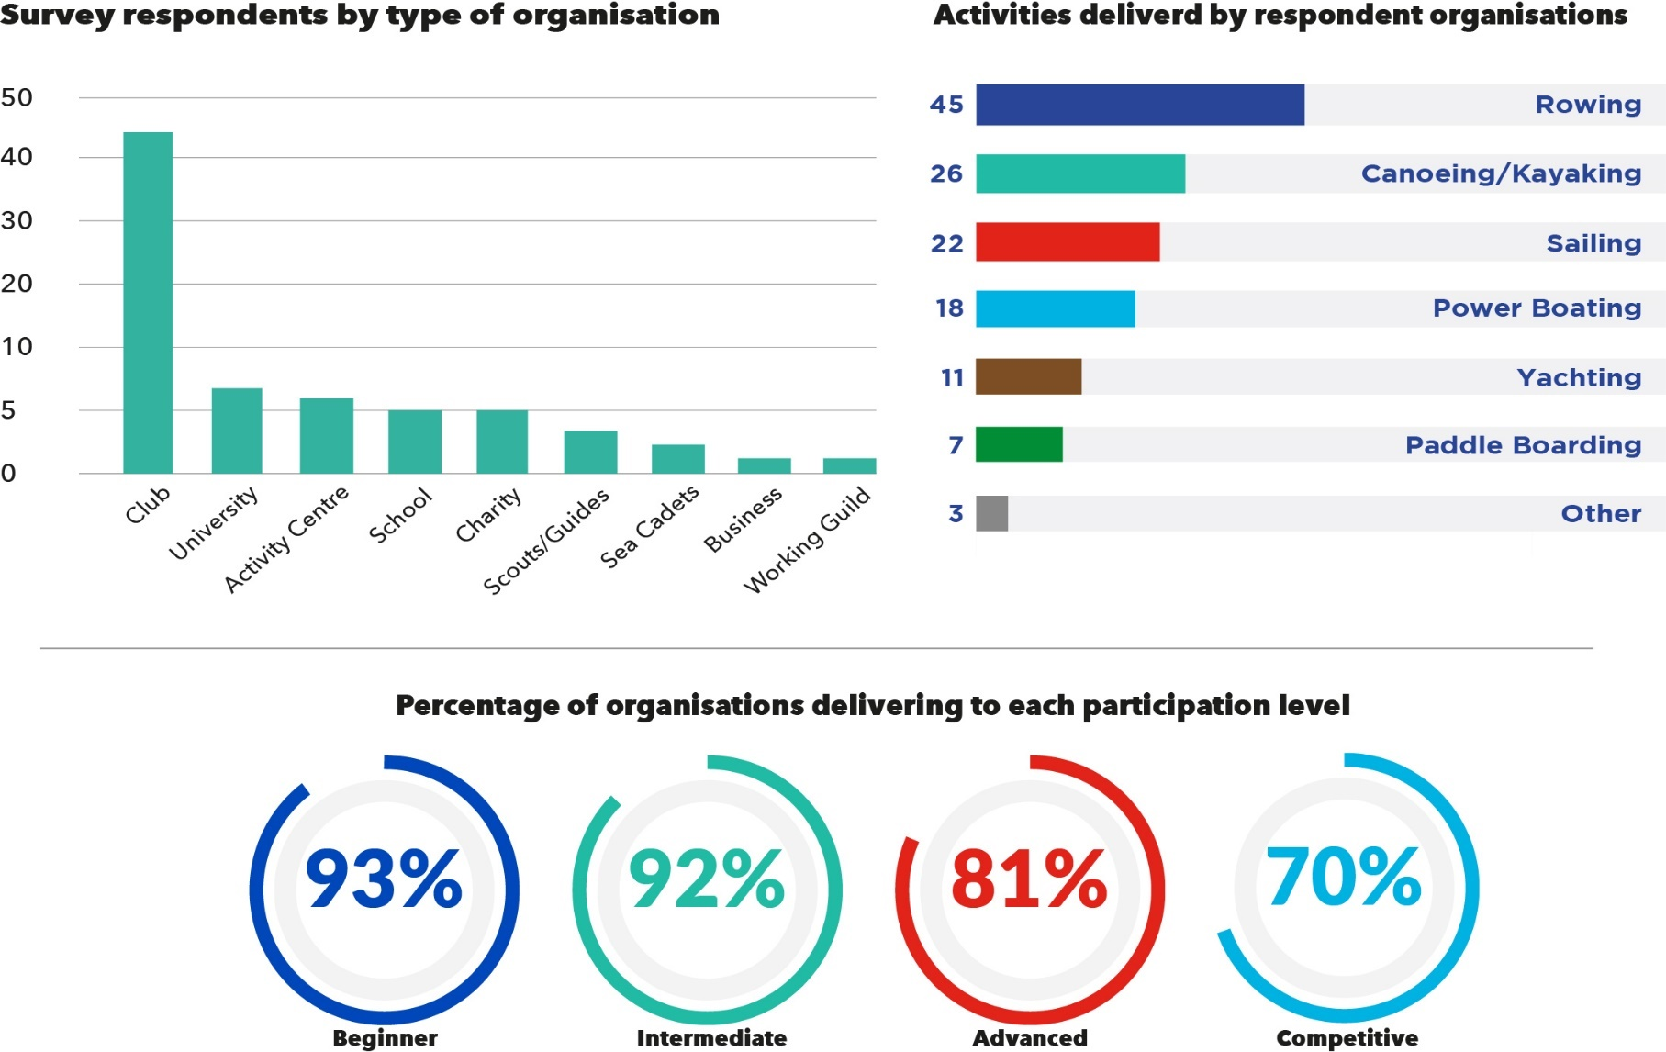
Organisation Delivery
Notes:
58.9 % of respondents classified as ‘clubs’ – broadly reflective of the current overall delivery model for sport and recreation across England.
Rowing delivered by over 60% of the responding organisations
- Canoeing/Kayaking (36%), sailing (30%) and power boating (25%) also widely delivered
Beginners/Intermediates are the main focus of delivery; but advanced and competitive members also well catered for

Slide 6
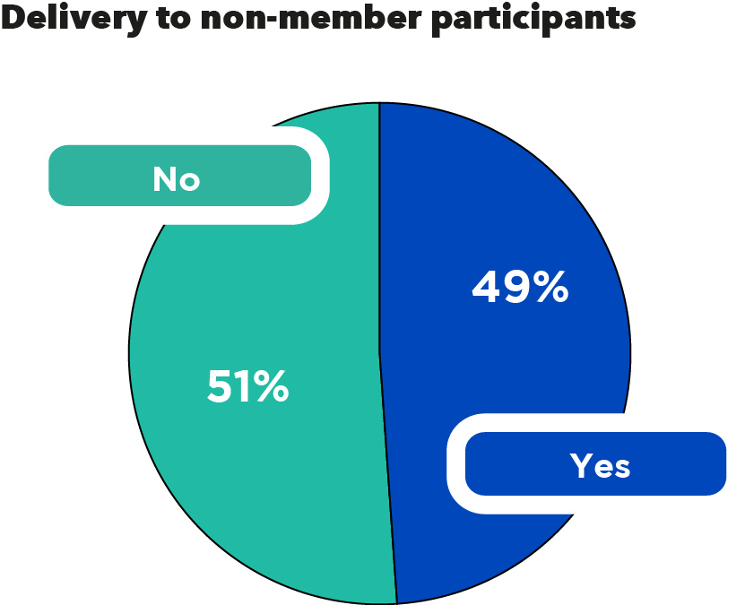
Delivery to Non-Members
Delivery to non-members opens up potential for:
Increased revenue
Potential to transfer non-member participants to membership once they are ‘hooked’
Utilisation of off-peak times to develop sport for the identified low participation target groups (e.g. women and girls, youth aged 11-24, BAME groups etc.)

Slide 7
12 Month Participation Trend
The majority (58%) of clubs/organisations delivering activity on the Tidal Thames reported a growth in participation over the last 12 months.

Slide 8
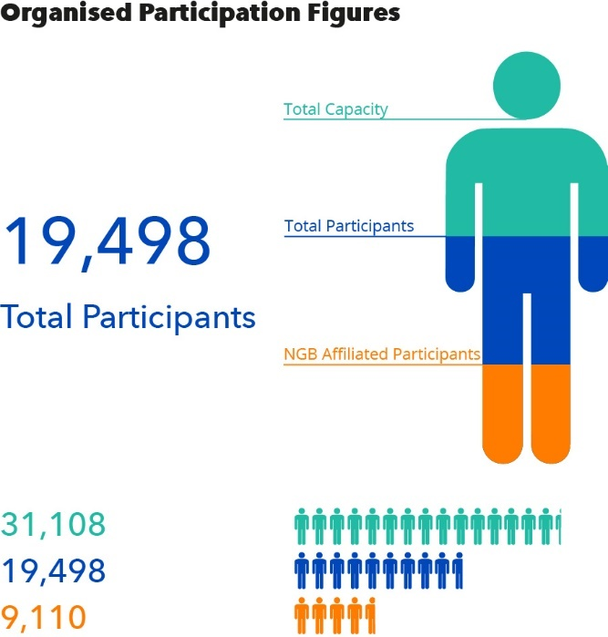
Organised Participation
Majority of participants male (61%).
Participation rates decrease with age:
51% aged under 25
19% are aged 50+
NGB affiliated members account for approximately 47% of organised participation
Notes:
Organised participation: participation through a formal structure (e.g. clubs, school, activity centres)
Does not account for participation in non-responding organisations or un-monitored participation (e.g. individuals etc.).
Based on combination of self-declared membership and participation in organized delivery (2 organisations, 3500 participants)
BAME/Disability participation: Response rate too low to validate results

Slide 9
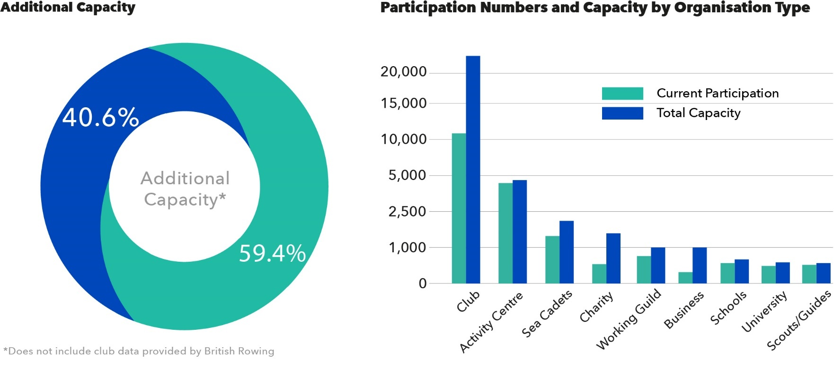
Capacity Utilisation
Unused capacity across the 73 respondent organisations estimated at 40.6% (13,000)
‘Clubs’ represent 65% of all participation capacity along the Tidal Thames
Average operational capacity at ‘clubs’ is currently only 51%
Potential to almost double current club participation (10,500)
Notes:
Unused capacity: The difference between current participation/membership and the maximum capacity for participation stated by the responding organisation

Slide 10
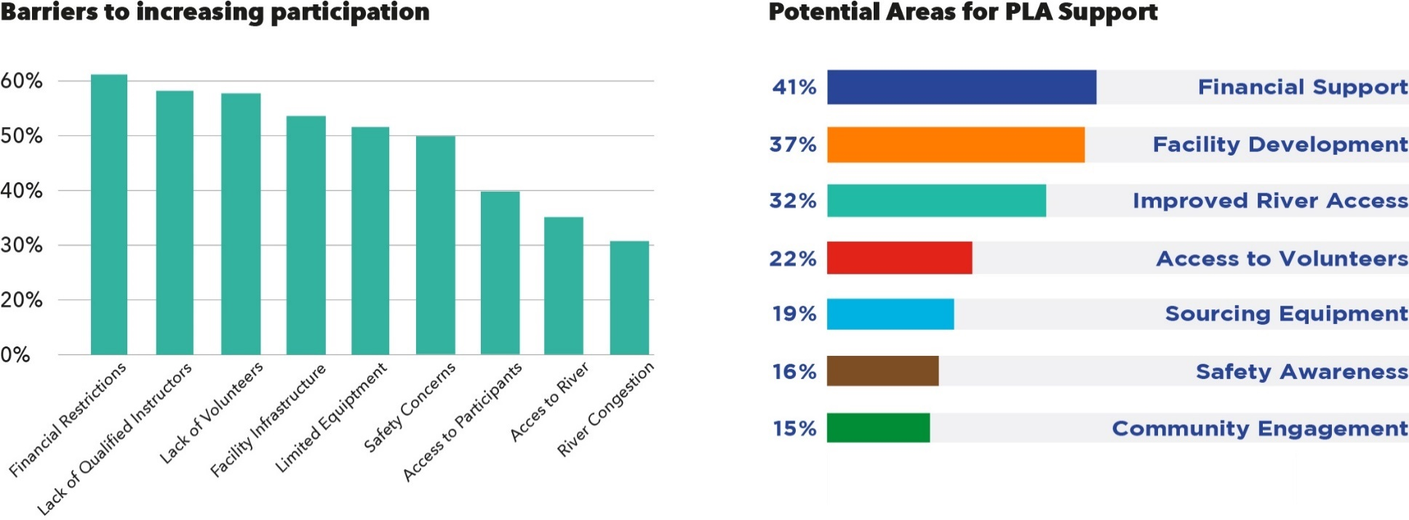
Growing Participation (1)
Financial restrictions (62%), lack of qualified instructors (58%) and lack of volunteers (58%) reported as most restrictive barriers to increasing participation by highest proportion of organisations
Financial support (41%), facility development (37%) and improved river access (32%) reported as areas organisations would most like support from the PLA

Slide 11
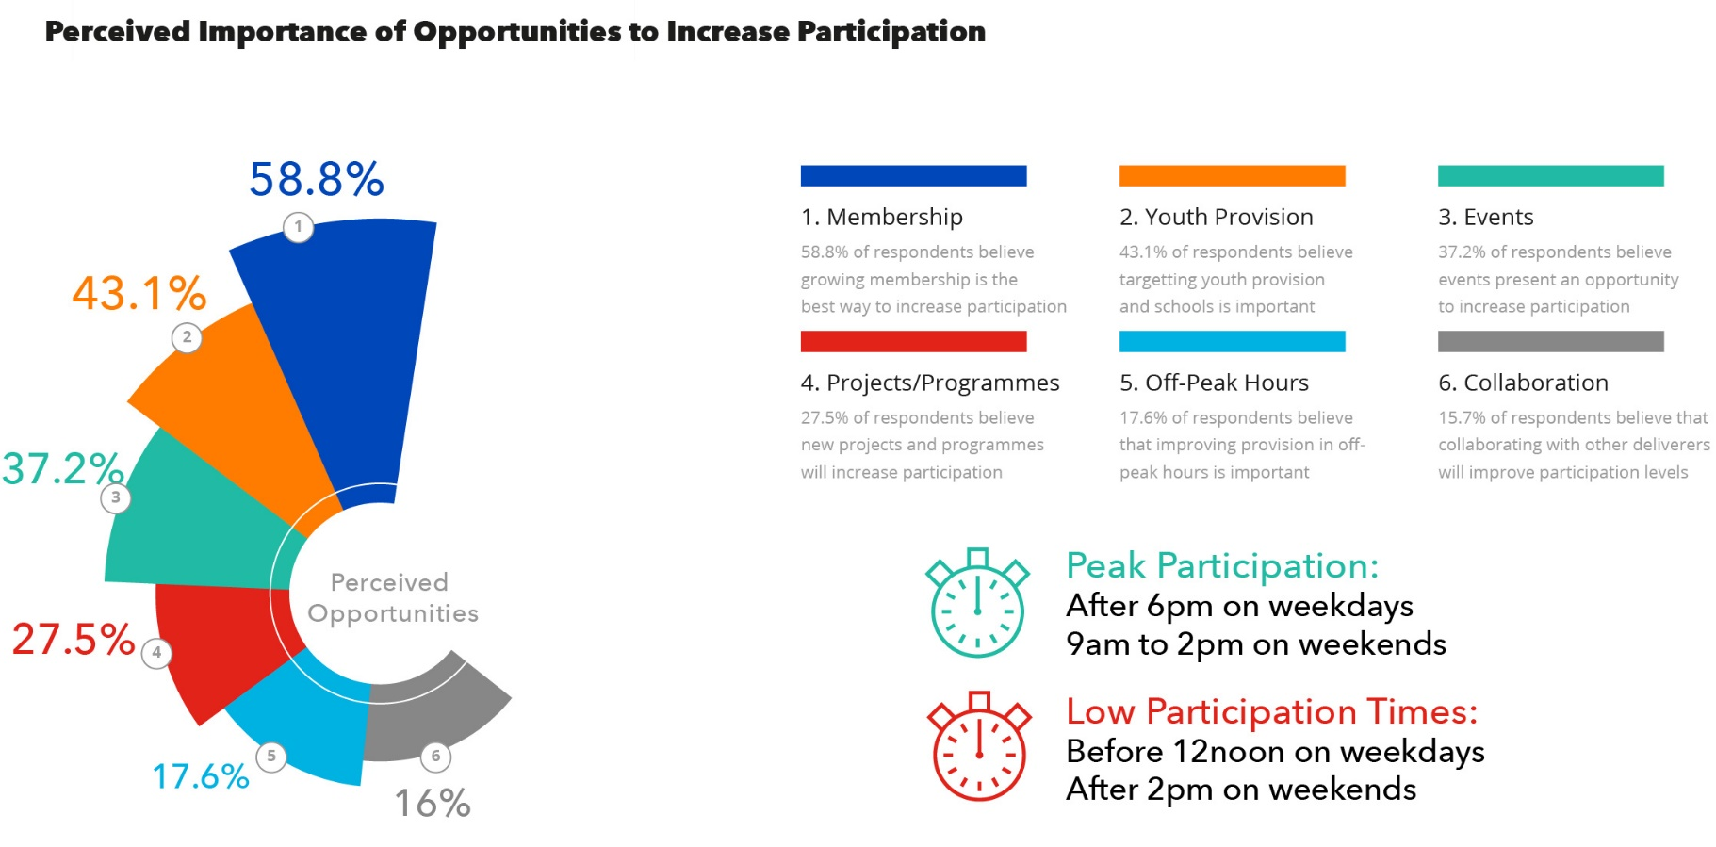
Growing Participation (2)
Increasing membership viewed as an effective way to grow participation by 58.8% of respondent organisations
Youth provision (43.1%) and events (37.2%) also seen as effective ways to grow participation
Peak participation after 6pm on weekdays and before 2pm on weekends

Slide 12
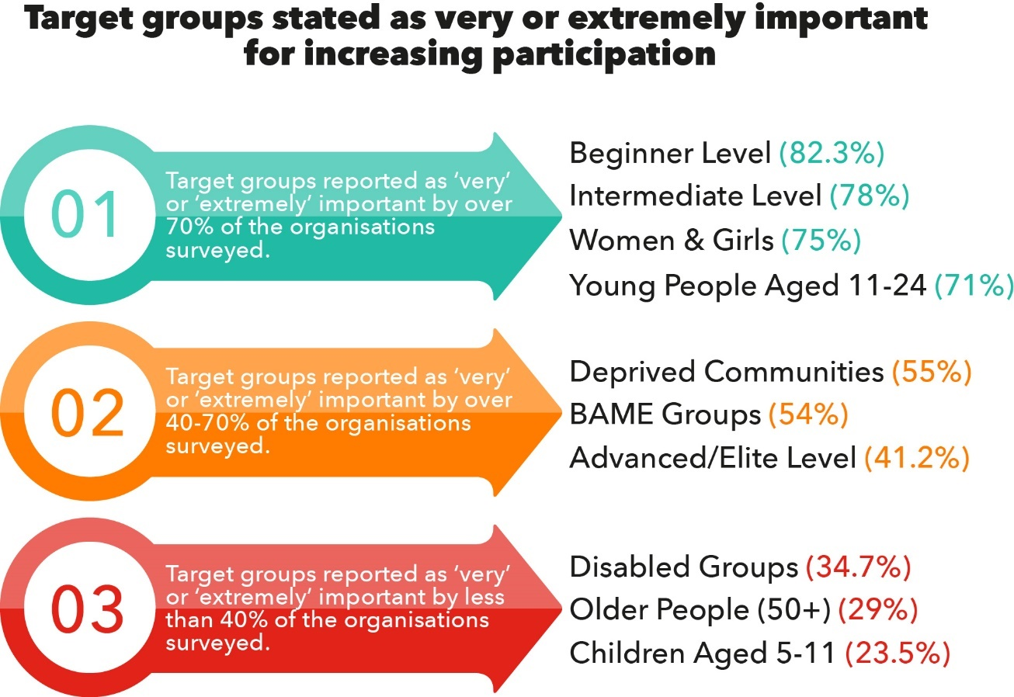
Target Groups
Targeting beginners (82.3%) and intermediate participants (78%) viewed by a higher proportion of organisations as more important than advanced/elite participants (41.2%)
Women & girls (75%) and young people aged 11-24 (71%) considered target groups with most potential to expand participation

Slide 13
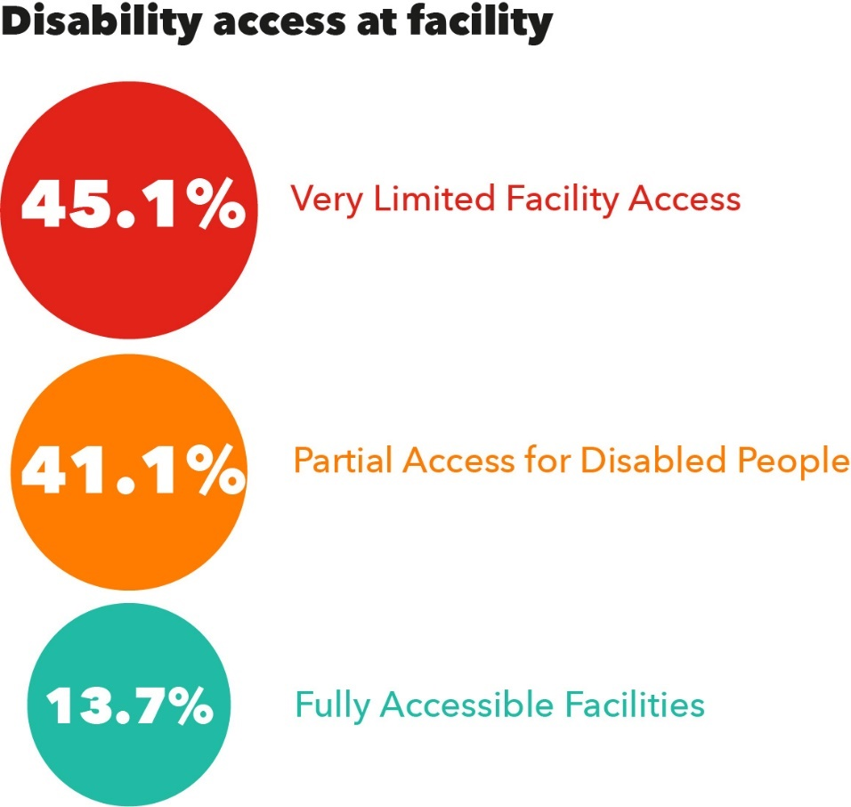
Disability Access
A limited number of facilities (13.7%) declared that they are fully accessible to participants with disabilities.
47% of respondent organisations stated they would welcome support to improve disability access

Slide 14
Interest in Working with PLA
Notes:
- 29% did not respond
- 9% stated they were not interested

Slide 15
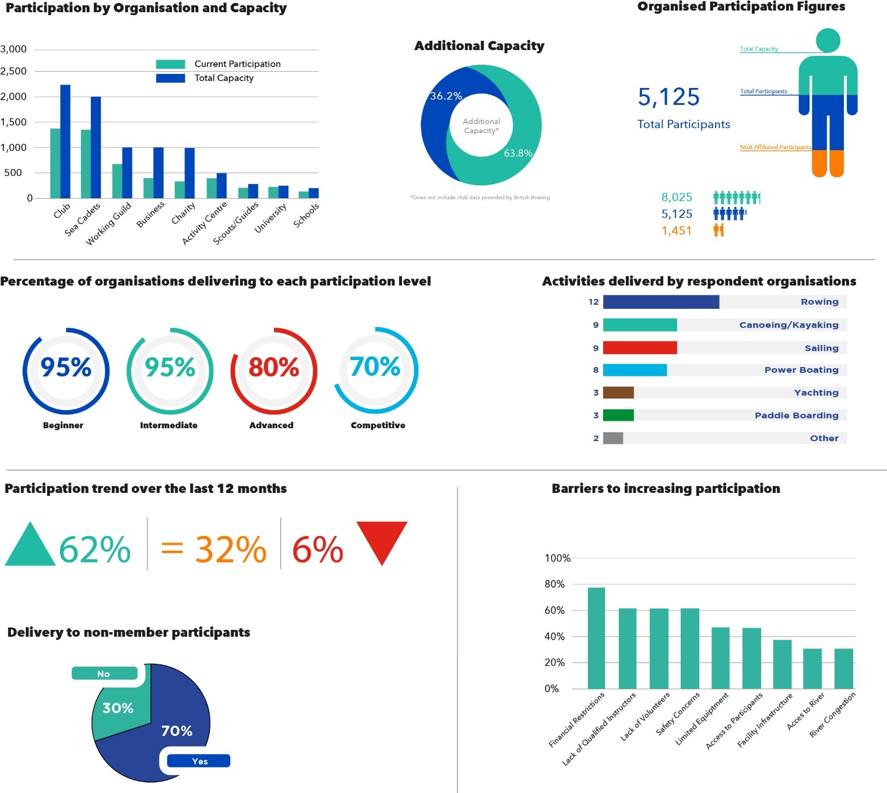
East London Opportunity Growth Zone
Notes:
Higher proportion of activity centres and charities (low response rate from activity centres)
• Higher rate of delivery to non-member participants

Slide 16
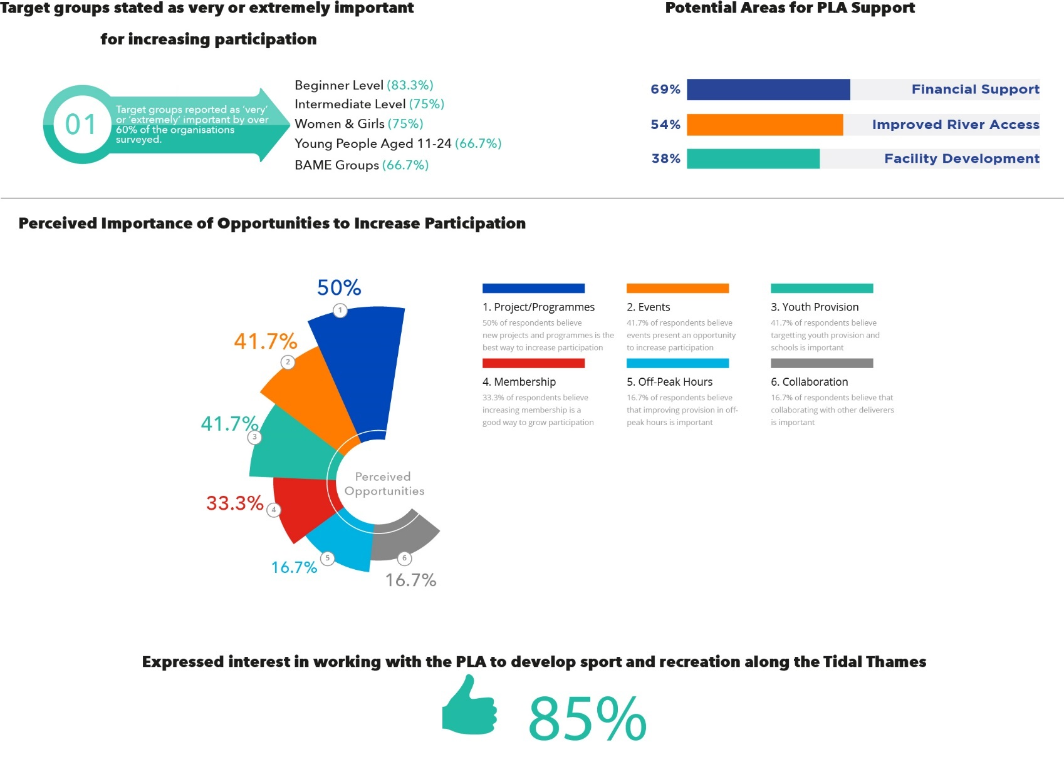
East London Opportunity Growth Zone (2)
Notes:
BAME groups found to be of increased importance as a target group
‘Improved river access’ features highly as an area for support
‘Projects/programmes’ considered the best way to increase participation in the area
Traditional membership not considered a key method for increasing participation
Higher proportion of respondents expressed interest in working with PLA to develop sport and PA

Slide 17
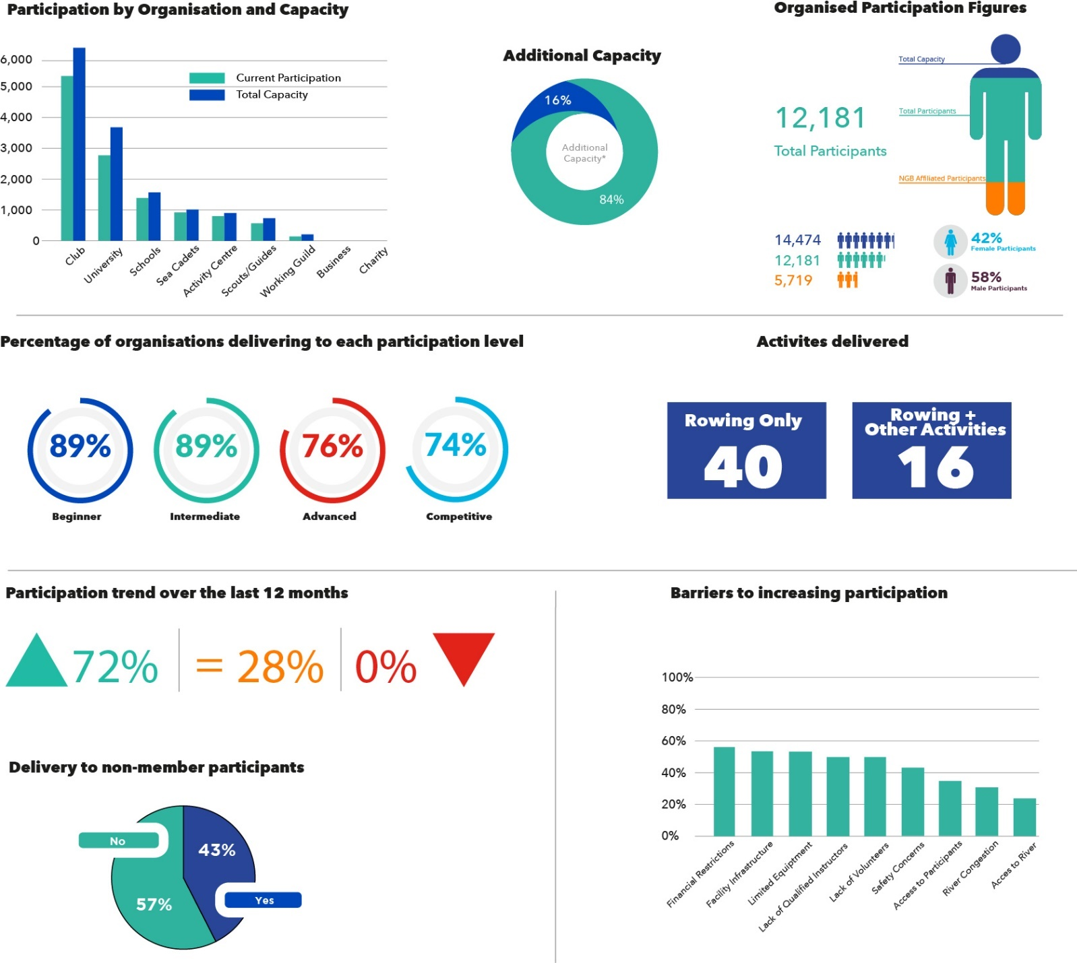
Rowing Factsheet
Notes:
After clubs, universities and schools make up the majority of delivery bodies
Rowing has highest participation numbers but lower capacity to increase participation than other sports (16%)
Participation increasing at a higher rate than other sports
Low rate of delivery to non-member participants

Slide 18
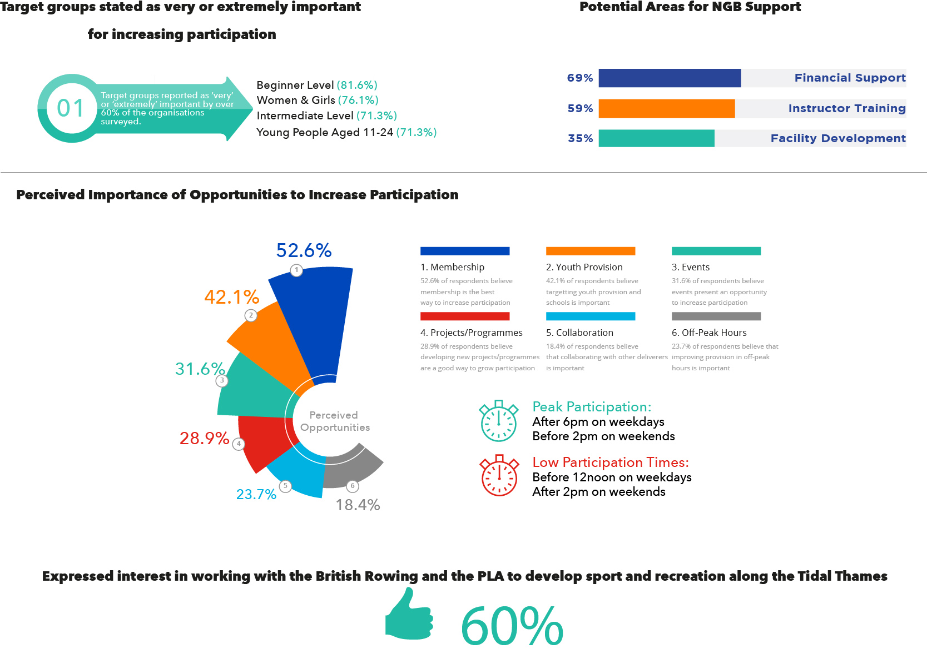
Rowing Factsheet (2)
Notes:
Target group - Women and girls found to be of increased importance as a target group
NGB support - ‘Facility infrastructure’ and ‘instructor training’ feature highly as areas for support
Opportunity - ‘Traditional membership’ considered the best way to increase participation
peak participation

Slide 19
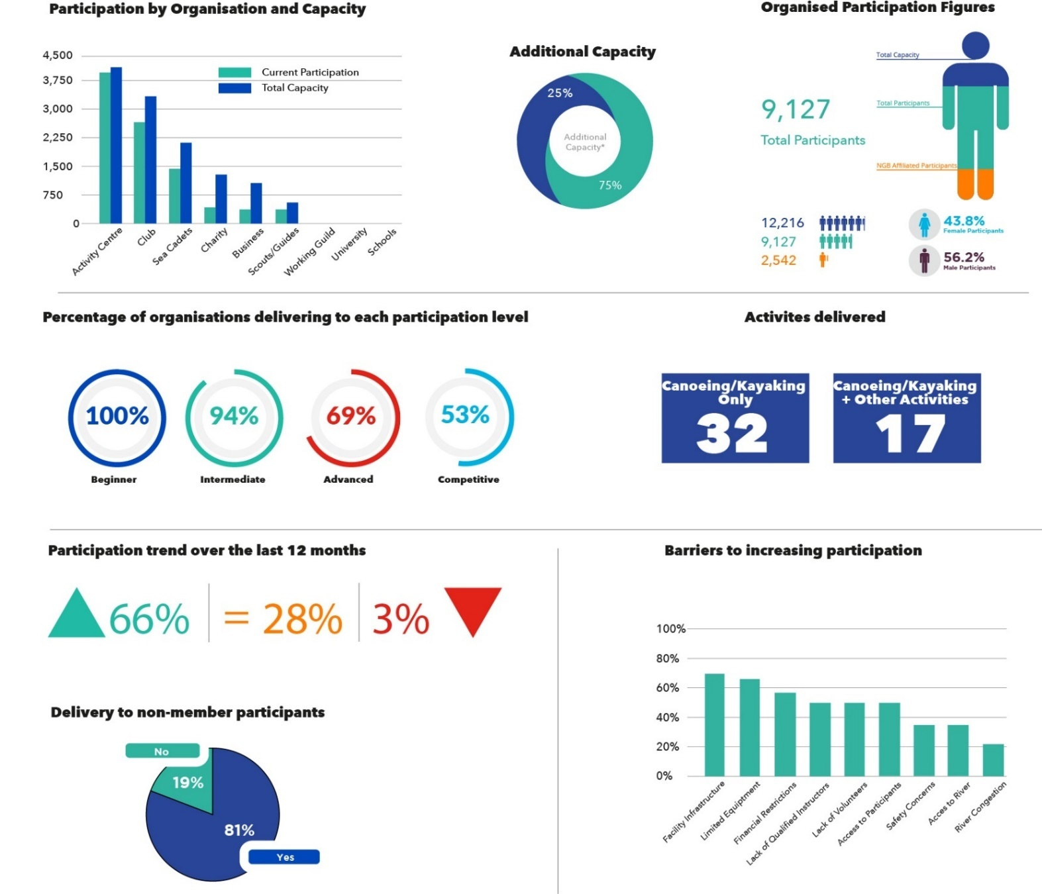
Canoeing/Kayaking Factsheet
Notes:
Activity centres most likely to type of organisation to deliver canoeing/kayaking
Over half of the delivery organisations deliver multi-sport activities
High rate of delivery to non-member participants (81%)
Facility infrastructure and limited equipment seen as key barriers

Slide 20
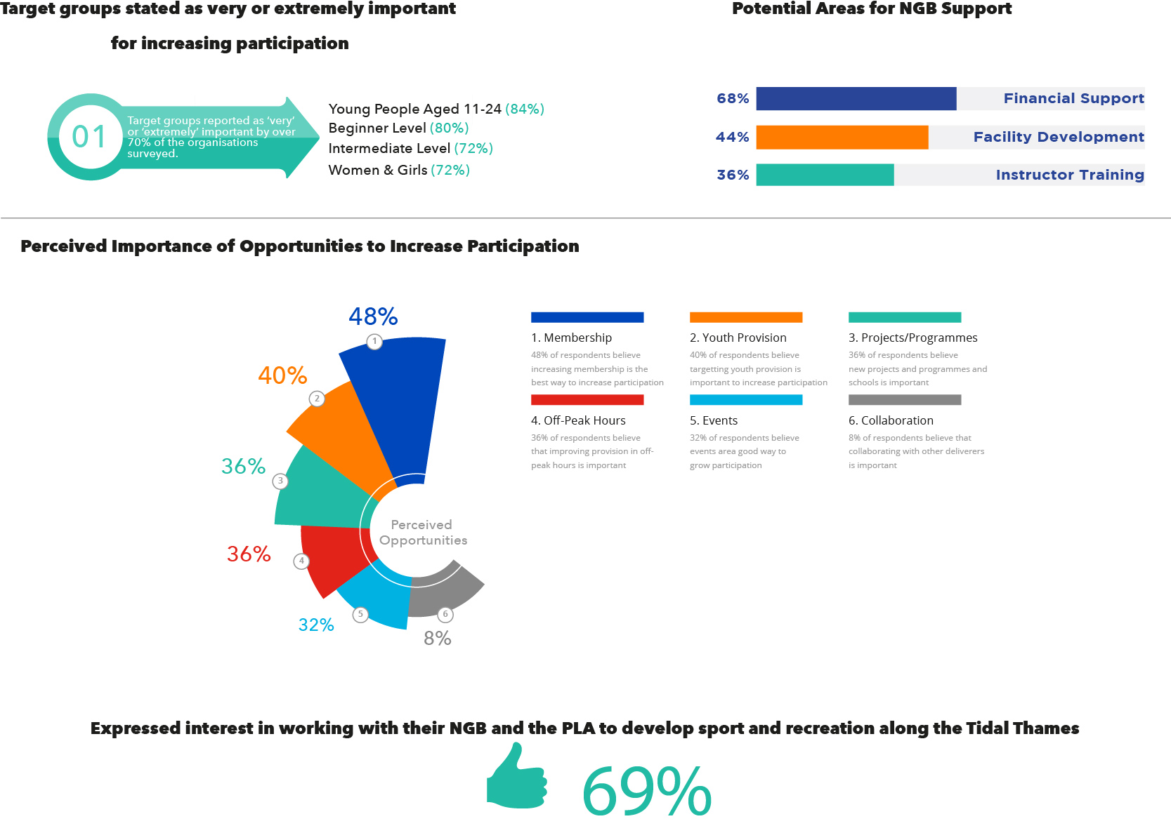
Canoeing/Kayaking Factsheet (2)
Notes:
Young people aged 11-24 found to be highest importance as a target group
‘Traditional membership’ considered the best way to increase participation (48%)
Closely followed by youth provision (40%)

Slide 21
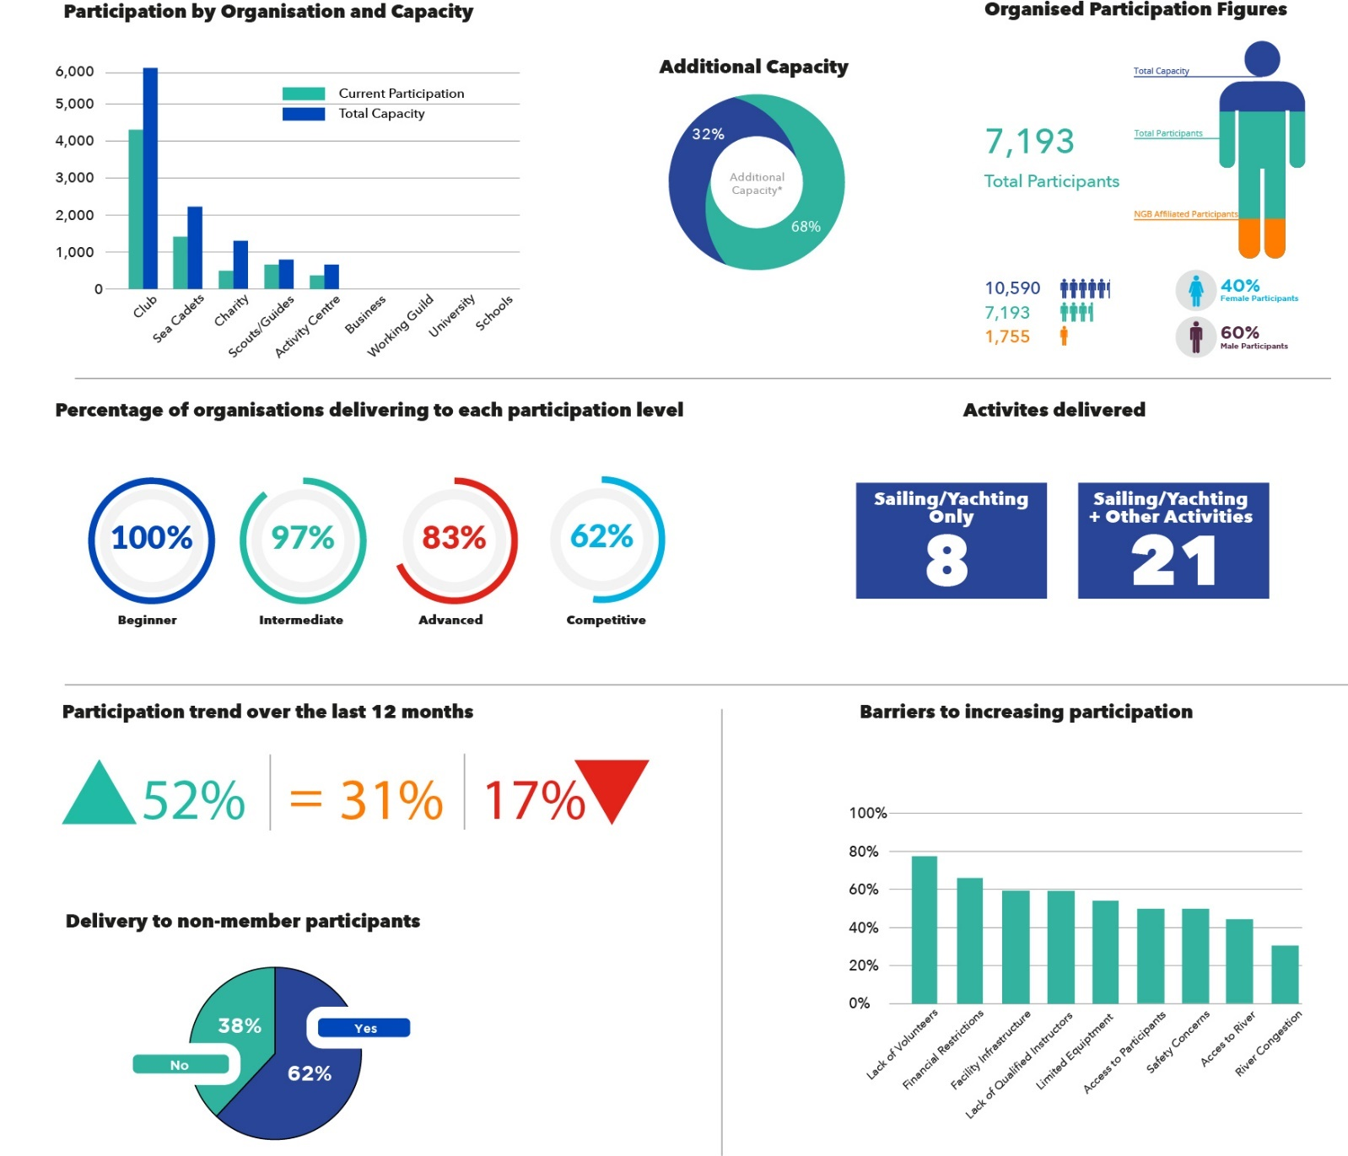
Sailing/Yachting Factsheet
Notes:
Dominated by traditional club delivery
Limited number of sailing/yachting only clubs, majority of delivery is alongside other sports and activities
Highest rate of organisations reporting a participation decrease (17%)
Lack of volunteers seen as a key barrier by 77% of organisations

Slide 22
Sailing/Yachting Facsheet (2)
Notes:
Young people aged 11-24 found to be highest importance as a target group (96%)
‘Traditional membership’ considered the best way to increase participation (52%)
Closely followed by youth provision (48%)

Slide 23
For more information…
Get in touch:
tristan.farron-mahon@londonsport.org
For more information…
Get in touch:
Tristan.Farron-Mahon@londonsport.org
londonsport.org
#MostActiveCity

