Slide 1


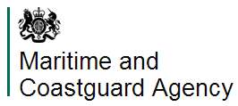



Watersports Participation Survey
Executive Summary

Slide 2
Introduction
The research has been continuously conducted by Arkenford since 2002 with BMF and RYA our original partners, MCA and RNLI joining in 2005 and BCU and MMO joining in more recent years. Over the years there have been several changes to the sample and boating and watersport activities surveyed, details of which are provided below.
The Survey
The 2013 results enable us to give an insight into trends by activity over a 12 year period for the 12 ‘Any boating activities’ and for trends for the additional 9 activities surveyed between 2004 and 2009 and again in 2011, 2012 and 2013.
The data on which the 2005 - 2013 analyses have been based/ come from a nationally representative sample of around 12,000 respondents across the United Kingdom (England, Scotland, Wales and Northern Ireland) via omnibus. The surveys prior to 2005 had a sample of 6,000 and only covered Great Britain (England, Scotland and Wales), as there was no omnibus survey facility in place covering Northern Ireland. The weighted sample provides information representative of the UK population in terms of age, gender, socio-economic grouping and origin.
In 2011, in addition to the omnibus survey a bespoke online survey was introduced to ask more detailed questions of a representative sample of watersports participants. In 2013 the sample for this survey was 2,642.
This survey is only possible with the face to face omnibus as the results of the omnibus are used to correctly weight the profile of participants in each of the individual watersport activities.

Slide 3
The Questions
Each respondent is asked if they have taken part in each of the watersport activities over the 12 months preceding September when the survey is conducted. As far as possible the descriptions of each activity are provided in layman’s terms to allow all respondents, whatever their level of expertise, to give accurate replies:
To make sure the respondents are understanding what is meant by the terms used, the following definitions are provided to them:
small sail boats are dinghies, open keelboats and multihulls (not including seaside inflatables) which tend to be brought ashore after use.
yachts are usually left in the water, have cooking facilities and a cabin for sleeping on board.
power boating is defined as fast craft that plane over water whilst motor boating / cruising is defined as river boating or coastal motor cruising
Relevant respondents are then asked more detailed questions on each sport they participate in.

Slide 4
Glossary
Any Boating Activity: covers the 12 core activities measured since 2002:
  Small sail boat racing
  Other small sail boat activities
  Yacht racing
  Yacht cruising
  Power boating
  General motor boating/cruising
  Canal boating
  Canoeing
  Rowing/Skulling
  Windsurfing
  Water skiing & wakeboarding
  Using personal watercraft
Any watersports activity: covers the 12 core activities to the left plus the additional watersport activities that have been included during various years since 2004:
  Surfboarding/ Body boarding/ Paddle boarding
  Kitesurfing
  Angling
  Cliff climbing activities
  Coastal walking activities
  Spending general leisure time at the beach
  Outdoor Swimming
  Leisure sub-aqua diving (open water - from the shore or boat)
  Coasteering

Slide 5
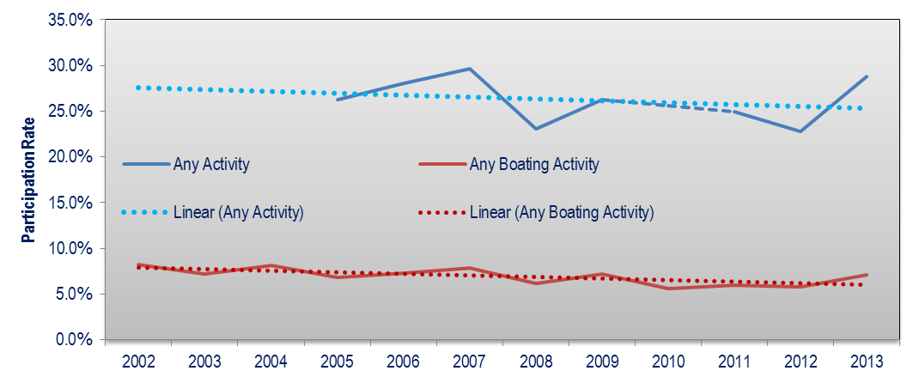
Headlines
Participation in any of the activities measured is at its highest level since 2007, after seeing a decline since 2009 from 26.3% to 22.7% in 2012, 2013 has shown a 6.1% point increase. The best estimates for participation is 14.1m adults but this could range between 13.8m and 14.4m
Participation in any of the core boating activities has also seen an increase in 2013, up 1.3% points after staying between 5.5%-6% for the previous three years. The trend has shown a relative decline over the study period but the last 3-4 years show a more constant rate indicating a levelling out. In terms of volume this puts the best estimates for participation at 3.5m adults, with a range between 3.4m and 3.7m.
 | 2002 | 2003 | 2004 | 2005 | 2006 | 2007 | 2008 | 2009 | 2010 | 2011 | 2012 | 2013
Any Activity |  |  |  | 26.3% | 28.0% | 29.6% | 23.0% | 26.3% |  | 25.0% | 22.7% | 28.8%
Volume (000s) |  |  |  | 12,580 | 13,506 | 14,400 | 11,294 | 12,893 |  | 12,589 | 11,153 | 14,124
Any Boating Activity | 8.2% | 7.2% | 8.1% | 6.8% | 7.3% | 7.8% | 6.2% | 7.2% | 5.6% | 5.9% | 5.8% | 7.1%
Volume (000s) | 3,819 | 3,222 | 3,740 | 3,276 | 3,494 | 3,811 | 3,040 | 3,534 | 2,752 | 2,996 | 2,837 | 3,491
*Blue figures indicate the maximum row value

Slide 6
The warmest summer in six years is likely to have a large impact on the increase in the participation rate across most activities
  An improving economic picture and the Olympic legacy are also likely to be contributing factors to the increase in participation
This years participation rate for ‘any boating activity’ is 7.1 % (3.5m people)
Canoeing/ kayak participation is at an all time high with a participation rate of 3%
  This influences the ‘any boating activity’ category because of sheer volume of participants (nearly 1.5 million)
Leisure time at the beach is at an all time high with a participation rate of 16.9% across the UK
  This is the main contributing factor in the large rise in the ‘any activity’ participation rate as the volume of participants has increased from 6.1 million in 2012 to 8.3 million in 2013
Although participation rates have increased, the number of boating events taking place (16.6m) has remained at a similar level to last year
There has been an increase in ‘casual’ participants in boating activities (less than 6 times) but a decrease in the more regular participants. Those participating less than 6 times now make up 82% of participants (the highest figure in the study period) – 73% of those participating in ‘any boating activity’ 2-5 times are doing the individual sport less than 2 times in the year
Female participation in ‘any boating activity’ continues a steady increase since 2010 (volume of participants are now up 40% on that year)
Participation by the older age group (55+) in ‘any boating activity’ also continues to rise and has now increased in volume by over 50% since 2002 (over the same period the total for ‘any boating participation’ has fallen 8%)
Participation rates in ‘any boating activity’ amongst the C1 demographic SEG are at there highest level since 2004 (9.4%)
Participation in Northern Ireland (70%), London (27%), South East (37%) and Wales (34%) are at an all time high for ‘any activity’. However, participation in the North East and East England have fallen
In terms of boat ownership, boats/crafts owned has decreased to 721,000 in 2013 (2.7%) (from 2.8% in 2012) .
  The biggest fall has been seen in those larger boating vessels with increases in canoes, windsurfers and inflatables or sportsboats
The participation in ‘any activity’ continues to move inland with 35% now taking place away from the coast. For ‘any boating activity’, 49% of the activity happens at the coast

Slide 7
Participation 2013
The participation rate in 2013 for ‘any boating activity’ is 7.1% (3.5m people)
Canoeing/kayaking has the largest participation (3%; 1.5m people) among the activities that constitute ‘any boating activity’
28.8% of people took part in at least one of the full list of 21 activities
  This figure is largely driven by those spending leisure time at the beach

Slide 8
Participation 2012 vs 2013
The table shows the summary of participation rates for each activity, comparing 2012 and 2013
The majority of activities have increased participation rates on 2012, others have only changed very slightly
The biggest increase has come from Leisure time at the beach, which has increased 4.53% points to roughly 8.3m participants
The only fall has been in yacht racing, decreasing by 0.04% points to around 88,000 participants

Slide 9
Participation by gender
As in 2012, males are more active than females in almost every activity
  Coastal walking and leisure time at the beach are the only exceptions
However, in terms of volume, females have a greater amount taking part in ‘any activity’
*Blue figures indicate the maximum row value

Slide 10
Participation by age group
Participation in most activities declines with age, those under 34 participate the most in boating activities. However, there are a few exceptions:
Yacht cruising and Canal boating are participated in most by those over 55
There are 6 activities where 35-54 year olds participate the most
The following page shows each activity by the volume in each age group
*Blue figures indicate the maximum row value

Slide 11
Participation by SEG
The participation rate amongst each SEG continues to be greatest for those in the AB class.
There are 4 activities which are greatest for the C1 SEG
However, as the UK population is not evenly distributed, in terms of volume, participation is much more spread across the SEGs
  C2DE has the greatest number of participants in ‘any activity’ but C1 has the greatest number in ‘any boating activity’
Angling, using personal watercraft and beach time have the highest volume in the C2DE SEG
*Blue figures indicate the maximum row value

Slide 12
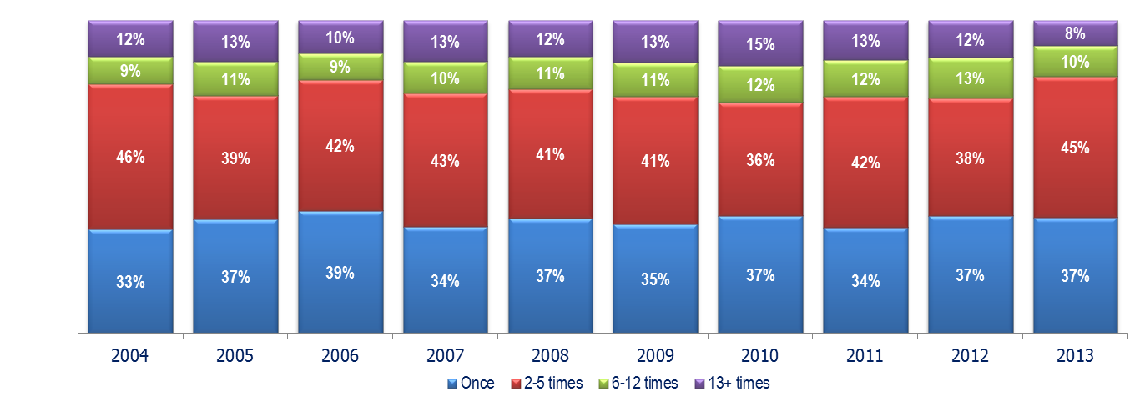
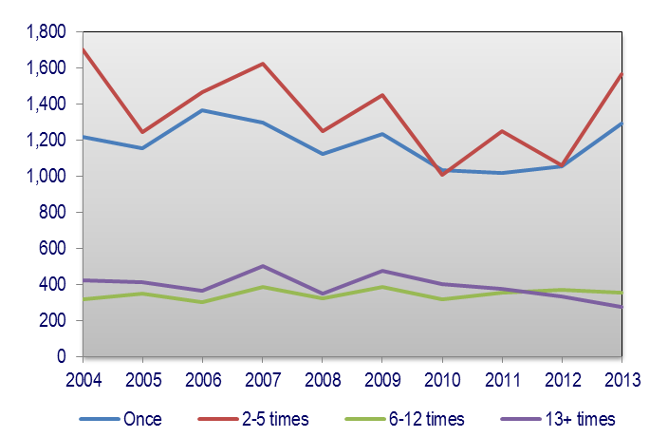
Proportion of boating participants by frequency
The proportion of people participating in ‘any boating activity’ more than 6 times has fallen, however, the proportion of people who have participated in ‘any boating activity’ less frequently has increased
  Increase of 7% points in those participating 2-5 times
  Proportion has stayed constant for participants taking part once, although volume has increased greatly on 2012 figures

Slide 13
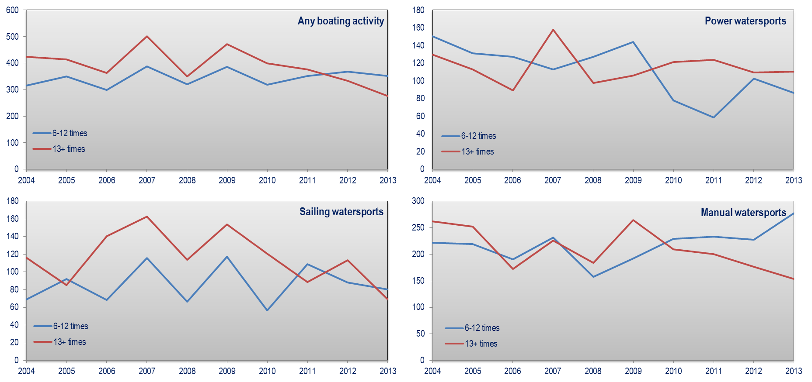
Trends in frequent boating participation
The graphs show the volume trends of those people who participate between 6-12 times per year (‘occasionals’) and those who participate over 13 times (‘enthusiasts’)
The majority have fallen or stayed at a similar level from 2012 figures. The exception is in manual watersports where the number of those participating 6-12 times has increased
Enthusiasts in ‘any boating activity’ are at their lowest level in the study period, this could be due to the increased number of trialists and casual boating participants this year

Slide 14
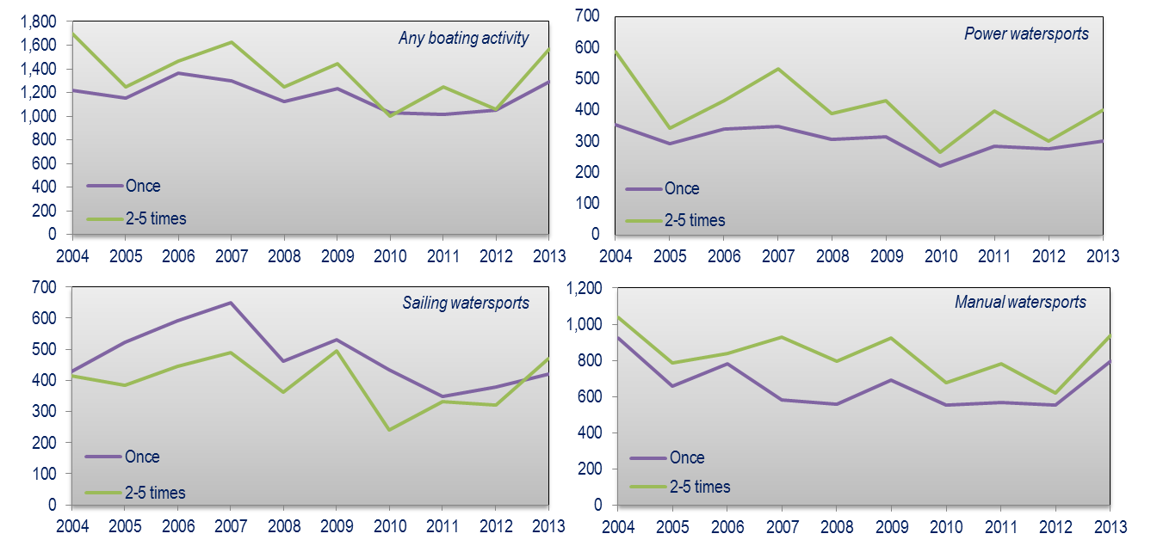
Trends in casual boating participation
The graphs show the volume trends of those people who participate between 2-5 times per year and those who participate once
These ‘casual’ participants have increased across all the boating activities from 2012
73% of those in the ‘2-5 times’ category for ‘any boating activity’ have participated in any individual boating activity 2 times or less

Slide 15
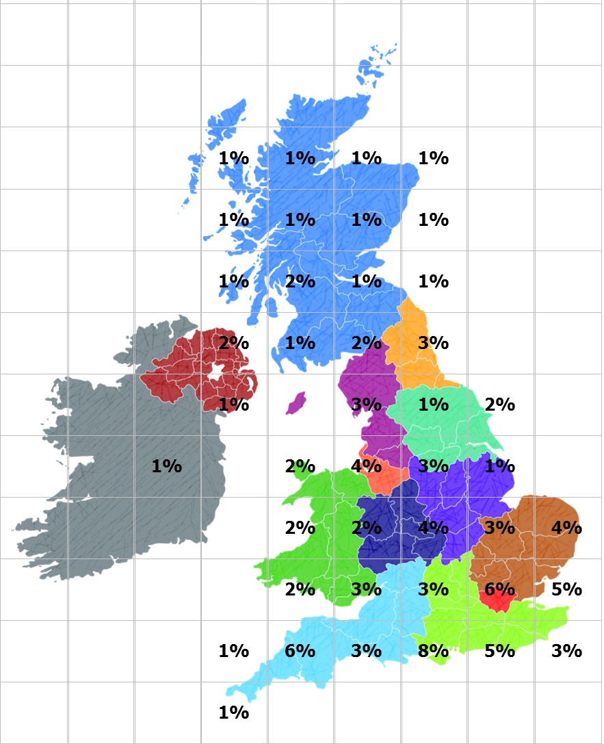
Distribution of any boating activity
There have been roughly 16.6 million boating events taking place in the UK in 2013, the map shows their distribution
The spread of activities is distributed throughout the UK
The majority of activities take place in the south of England, especially along the coast
  This is especially true for sailing sports around the Solent area
Other areas where participation is most frequent are East, the North West as well as areas around Wales
When viewed by an individual activity the participation areas tend to be a lot more grouped into an area of the country (e.g. 86% of stand up surfing events take place in the South West)
Map showing % participation of any boating activity in the UK

Slide 16
Participation by region of residence
Participation rates remain high for residents of Northern Ireland and residents of the South of England
Residents in Scotland have the lowest participation rate in ‘any activity’ but this has risen from 2012
The biggest change has been among residents in the London/South East region where participation in ‘any activity’ is up 11.4% points on 2012 numbers
*Blue figures indicate the maximum row value

Slide 17
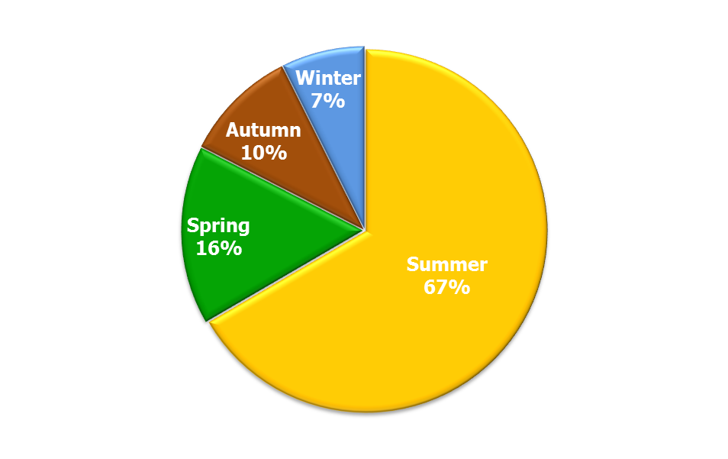
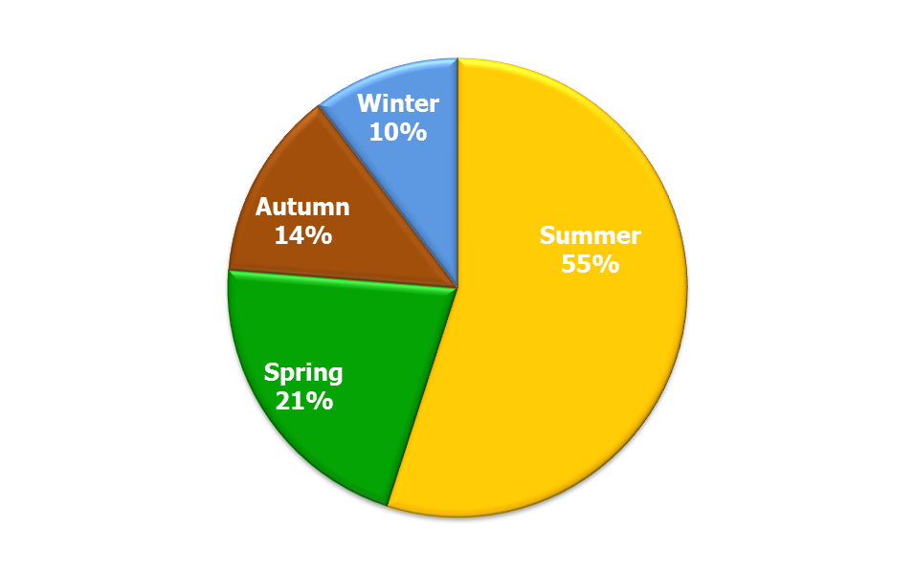
Seasonal participation - overview
The majority of participation in ‘any activity’ takes place in the summer months (66.6%) – 57.3% in 2012
As previously shown, 2013 had a significantly better summer than average and with 67% of events taking place in this season it likely caused an increase in the participation rate
Boating activities are more spread out but the majority (55%) still take place in the summer
There are a few exceptions to this:
  Rowing/Skulling has a higher proportion in spring than summer
  Power boating has a more even distribution with 22% taking place in winter
The following table shows how activities are distributed by participation each season
All activities
Boating activities
Spring | March – May
Summer | June – August
Autumn | September – October
Winter | December - February

Slide 18
Seasonal participation - detailed

Slide 19
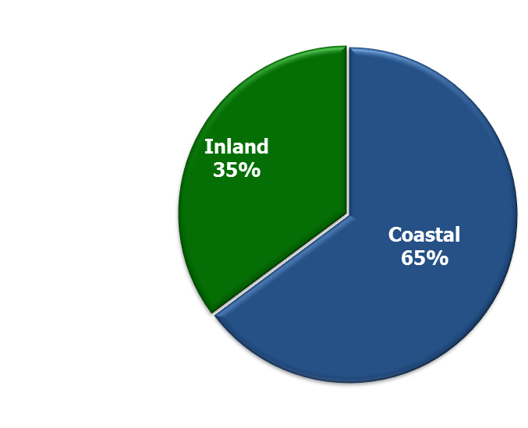
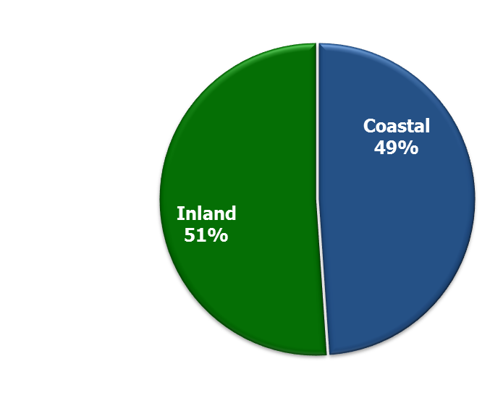
Participation distribution - overview
2012
For ‘any activity’ the proportion of events taken part in at the coast was 65%, down 2% points on 2012
For ‘any boating activity’ the slight majority are taking place inland but this distribution has evened out compared to 2012 where the split was 62% inland and 38% coastal (2012 was the first year the proportions were so different)
The highest proportion of coastal activities (greater than 85%:15% split) are cliff climbing, leisure sub aqua diving from a boat, windsurfing and yacht racing
Those activities done mainly inland (greater than 65%:35%: split) are angling from the shore, diving from the shore, rowing and canoeing
The biggest change at the coast from 2012 was by small sail boat racing whose proportion increased 27% points.
All activities
2012
Boating activities

Slide 20
Participation distribution - detailed
* Except coasteering, coastal walking, surfing, general time at the beach and canal boating
** Except canal boating
n.b. 2012 used grouped activity so the average of the relevant activities in 2013 have been used to compare the change where appropriate

Slide 21
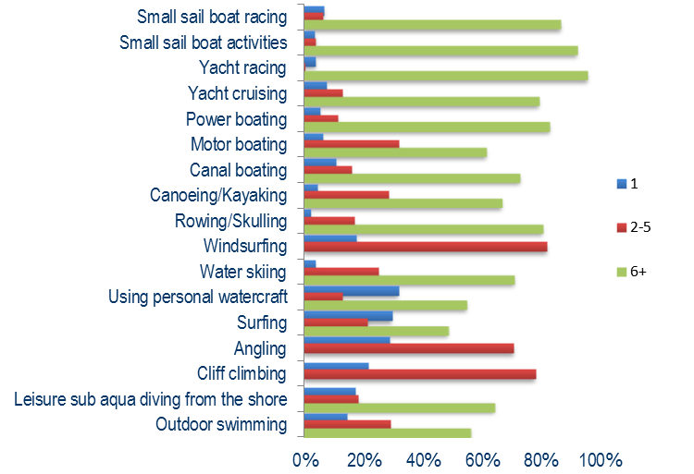
Club or association membership
Rowing/Skulling has the highest membership with 37% of participants being a member of a club
Apart from coasteering, the lowest proportions are from cliff climbing (1.2%) and using personal watercraft (1.3%)
The less accessible activities tend to have the higher proportions of membership
Those that are members of a club are much more likely to participate in an activity more than 6 times

Slide 22
Boat ownership by activity
For most of the boating activities, it is usually the respondent or friends or family of the respondent who own the boat/craft. This is likely to influence their views on alcohol consumption before or during the activity

Slide 23
UK vs. abroad ownership
For each boat owning household the average amount owned is 1.35. Of these boats/crafts, 1.25 are kept in the UK
  Represents 92%
The highest proportion of boats kept overseas are power boats (23%) but in terms of volume, canoes and kayaks account for nearly 30,000
It should be noted that the sample sizes are quite small for some boating activities which could explain some variations in the data from year to year
For robustness, the results presented here use 3-year rolling average data from 2011-2013

Slide 24
  This is the executive summary report for the Watersports Participation Survey 2013.
  The full survey covers a wide range of subjects including:
  Participation in the UK and abroad
  Frequency of participation
  Geographic region of participation
  Participation by demographic breakdowns
  Boat ownership
  Seasonal participation
  Inland and coastal participation
  Average duration of participation
  Club membership
  Formal training on activity
  Safety (Drinking alcohol, wearing a lifejacket/buoyancy aid, awareness of symptoms associated with Cold Water Shock, equipment used and considerations before boating)
  Reaction to incidents whilst boating and who they required assistance from
  Sea temperature
  Factors which would increase the participation in any boating activity
  Full activity profiles are provided to consortium members in a separate excel document.
  The full report is available on request for affiliates of the consortium of organisations who commission the research.

Slide 25
Participation estimates
A range of participation estimates are provided around our reported figures based on the 90% and 95% confidence limits to the data

Slide 26
Participation by postcode area (3 year average)

Slide 27


This years report has been funded by:
British Marine Federation
Royal Yachting Association
Maritime and Coastguard Agency
Royal National Lifeboat Institution
British Canoe Union
Marine Management Organisation

