Slide 1
Eureka! 2015
On overview

Slide 2
Why we are all here

Slide 3
EUREKA! 2015
ACHIEVING MORE CRICKET
PLAYED IN TEAMS IN 2016
NATIONAL PICTURE
Notes:
Our third year of joining you at this session
Lots of change and water under bridges…
New people in the room
For us a benefit of this session being in London as opposed to Manc or L’boro means us to introduce you to one of the guys doing the hard yards who normally we can’t get out of the office (cue few words from VDP)’
Ask Matt and Luke to intro
And we’ve changed – I’ll let Gareth say a few words about that’ (you summarise the position and explain how it makes us stronger and fitter)
And every year we get closer to the truths about recreational cricket…’ cue analogy about peeing back the layers of the onion… deeper rigour than ever before e.g. Forensic analysis of effect of weather we’ll share with you today’
Un changed is we intend to present ourselves clearly and comprehensibly so as ever, our titles give you the topic of the slide, our straps tell you what it’s saying…. Ask questions, it’s our job to make ourselves understood not yours to struggles to understand us…..keep discussion at top level so we do it justice…

Slide 4
Core
Played at least 12 weeks out of the last 26 week season in teams (Summer or Winter)
Team players 14-65yrs
‘The Cricket Market’
Occasional
Played 3 to 11 weeks out of the last 26 week season in teams (Summer or Winter)
Cameo
Played 1 or 2 weeks of the last 26 week season in teams (Summer or Winter)

Slide 5
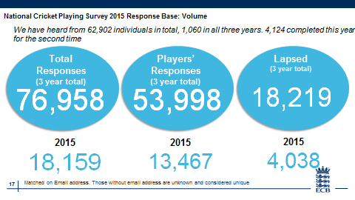
The cricket market is,
at best,
static

Slide 6
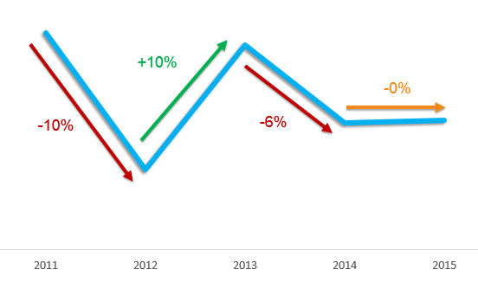
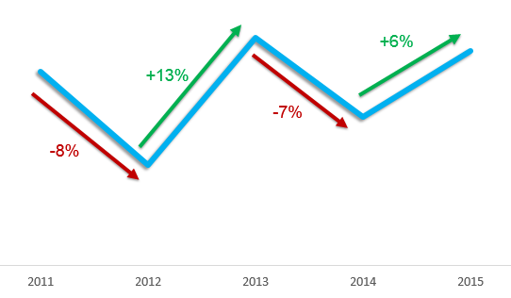
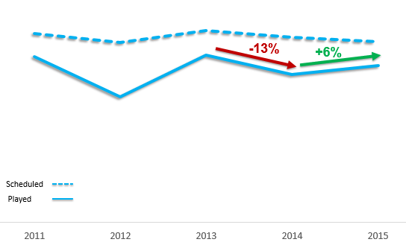
Calculating change in the Market
#
f
=

X
NUMBER OF PLAYERS
FREQUENCY
CRICKET PLAYED
+0%
+6%
+6%
2015 Vs 2014
2015 Vs 2014
2015 Vs 2014
Source: Play-Cricket 2011-2015. Up to end of week 17 of season. Over 14s only. County Control Group

Slide 7
Fixture analysis from Play-Cricket 2011 to 2015 – Cricket Market
Play metrics have all improved in 2015…
Played fixtures have increased by 6% from 2014 to 2015
Conceded fixtures have plateaued
-13%
+6%
Scheduled
Played fixtures
Increased
Played
Conceded fixtures
Stabilised
3.5% of fixtures have been Abandoned in comparison with 7.2% in 2014
5% of all scheduled fixtures this year have been Cancelled
Abandoned fixtures
Decreased
Cancelled fixtures
Decreased
Source: Play-Cricket 2011-2015 14+ Only. Up to end of week 17 of season. Control Group and National Data

Slide 8
Player flow 2014-2015 seasons
Around a quarter of last year’s players have not returned to play this year
NEW
21%
844K
Players
2014 season
844K
Players
2015 season
RETAIN
73%
27%
LAPSE
6%
RETURN
Source: Play-Cricket index groups. Corroborated by Hits Cricket club-level analysis

Slide 9
The cricket market is, at best, static
Overs
Played
Start
Times
End
Times
SATISFACTION
Satisfaction is declining quicker than cricket is responding

Slide 10
Are players being heard?
And most of them don’t believe that they are being heard by the people who run cricket
48%
of players
think cricket isn’t listening
Source: NCPS 2015 Data
Question: Do you feel that your views are heard and acted upon by the people who run cricket in your area? n=13,069
Notes:
The people who run cricket are Baby Boomers, maybe Generation X

Slide 11
Overall satisfaction of the cricket playing market
Despite the effect of Get the Game On and other reforms, satisfaction is down on last year
Highest
Satisfaction
Lowest
Satisfaction
14 to 18s | 8.1
Women | 8.0
Core | 7.8
26-34 | 6.1
Occasional | 7.2
Cameo | 7.2
Source: NCPS 2015 Data
Question: How satisfied or dissatisfied are you overall with your cricket experience? (n=13,370)

Slide 12
Dissatisfaction with the start time of matches
More than a quarter of players are dissatisfied with start times in 2015
28%
22%
Vs
24%
= 2013
of players are now
dissatisfied
with start times
of players
dissatisfied with start times in 2014
2015
2014
2013
Source: NCPS 2015 Data
Question: How happy or unhappy are you with the finish time of matches: (n=12,301) Happy = Happy or Very Happy
Notes:
Highest dissatisfaction from Saturday players, 26-34s, Occasionals and Cores: all way up on last year

Slide 13
Dissatisfaction with the start time of matches
The overall change is reflected in responses from Saturday players, 26-34s and Occasionals
Sat = c. 70% of cricket
26-34 = Biggest drop-off age group
Market 2015
unhappy
Market 2014
Occasionals = c. 48% of the market
Core = c. 29% of the market
Occasionals 2015
Occasionals 2014
Cores 2015
Cores 2014
Source: NCPS 2015 Data
Question: How happy or unhappy are you with the finish time of matches: (n=12,301) Happy = Happy or Very Happy

Slide 14
Dissatisfaction with the end time of matches
One in three players are dissatisfied with end times in 2015
34%
27%
Vs
28%
= 2013
of players
dissatisfied
with end times in 2014
of players are now
dissatisfied
with end times
2015
2014
2013
Source: NCPS 2015 Data
Question: How happy or unhappy are you with the finish time of matches: (n=12,276) Happy = Happy or Very Happy
Notes:
Again highest dissatisfaction from Saturday players, 26-34s, Occasionals and Cores: 43% of 26-34 year olds are dissatisfied

Slide 15
Dissatisfaction with the end time of matches
Again, Saturday players, and 26-34s, the most dissatisfied
Sat = c. 70% of cricket
26-34 = Biggest drop-off age group
Market 2015
unhappy
Market 2014
Occasionals = c. 48% of the market
Core = c. 29% of the market
Occasionals 2015
Occasionals 2014
Cores 2015
Cores 2014
Source: NCPS 2015 Data
Question: How happy or unhappy are you with the finish time of matches: (n=12,276) Happy = Happy or Very Happy

Slide 16
Dissatisfaction with the number of overs per innings
Dissatisfaction with overs is up by 30% on 2014….
22%
17%
Vs
18%
= 2013
of players are now
dissatisfied
with overs
of players
dissatisfied with
overs in 2014
2015
2014
2013
Source: NCPS 2015 Data
Question: How happy or unhappy are you with the number of overs you play: (n=12,301) Happy = Happy or Very Happy
Notes:
1 in 4 Occasionals is dissatisfied

Slide 17
Dissatisfaction with the number of overs per innings
Dissatisfaction is high – and accelerating quickly – among Occasionals
Sat = c. 54% of cricket
26-34 = Biggest drop-off age group
Market 2015
unhappy
Market 2014
Occasionals = c. 48% of the market
Core = c. 29% of the market
Occasionals 2015
Occasionals 2014
Cores 2015
Cores 2014
Source: NCPS 2015 Data
Question: How happy or unhappy are you with the number of overs you play: (n=12,301) Happy = Happy or Very Happy

Slide 18
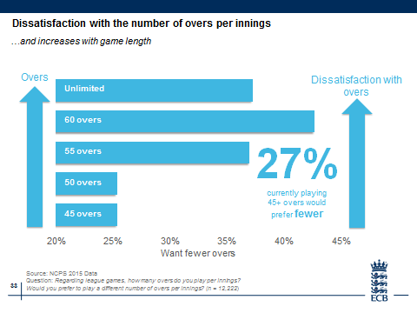
Dissatisfaction with the number of overs per innings
…and increases with game length
Overs
Unlimited
60 overs
55 overs
50 overs
45 overs
Dissatisfaction with overs
Unlimited
60 overs
55 overs
50 overs
45 overs
27%
currently playing
45+ overs would
prefer fewer
Source: NCPS 2015 Data
Question: Regarding league games, how many overs do you play per innings?
Would you prefer to play a different number of overs per innings? (n = 12,222)
Notes:
Highest for55+, women, Core. Lowest for 19-25, Occasional and Cameo. 19-25 down 18% on last year

Slide 19
Balancing cricket with other commitments
Over half of players now say they struggle to include cricket in their busy lives..
52%
find it difficult to
balance cricket
with other commitments
49%
= 2014
Over half of today’s cricket market are
MILLENNIALS (20 - 34), who:
- Want instant gratification (= short matches)
- Are time-poor (= short matches)
- Need constant recognition and reward (= win/lose)
- Will vote with their feet… (= lapse)
Source: NCPS 2015 Data
Question: To what extent do you agree or disagree with the following statements about your cricket experience? |
I find it difficult to balance my playing commitments with my other commitments outside cricket
Source on Millennials http://hmapr.com/10-traits-of-millennials/

Slide 20
The cricket market is, at best, static
Advocacy, your #1
recruitment mechanic,
is declining steadily
Satisfaction is declining quicker than cricket is responding
#1
65%
of recruitment driven by friends/family

Slide 21
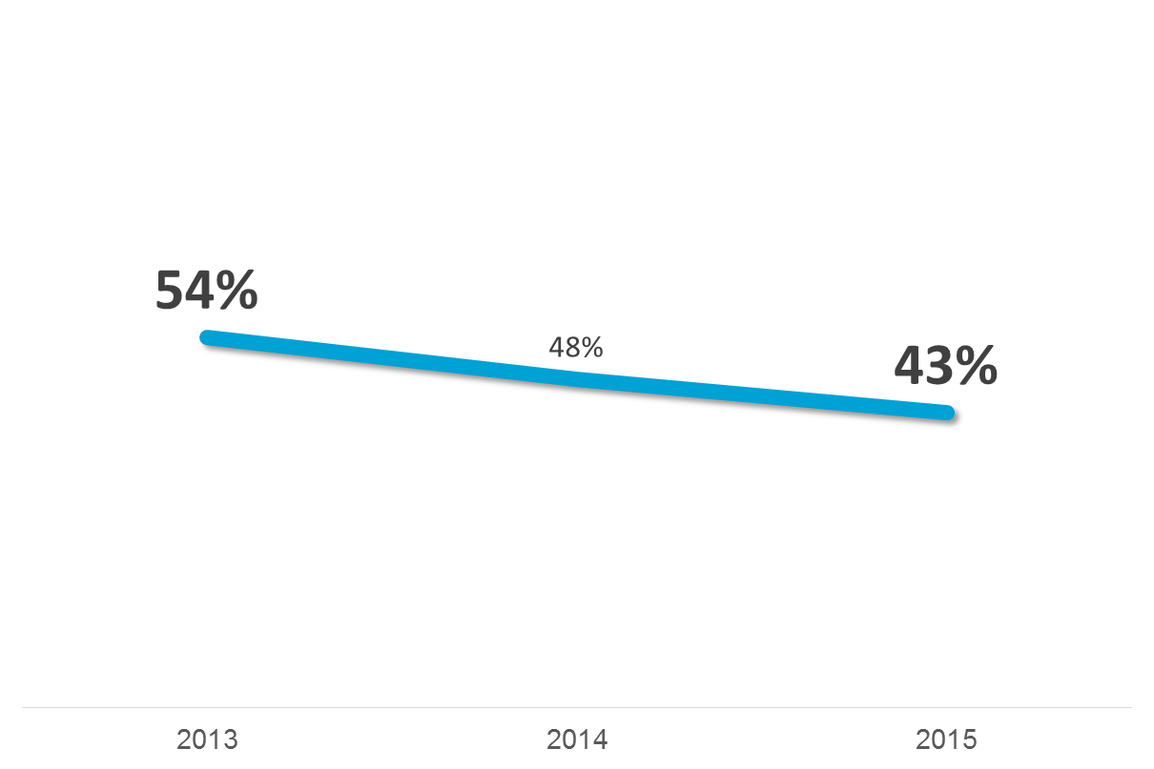
% Net Promoter Score
Cricket’s Net Promoter Score, ultimate predictor of advocacy, is down again
Source: NCPS 2015 Data
Question: How likely are you to recommend cricket to your friends and family? (n = 13,123)

Slide 22
The cricket market is, at best, static
Match day make up
Satisfaction is declining quicker than cricket is responding

Slide 23
Start time tolerances: Saturday league players
Saturday league players prefer to start at 1pm or earlier
55%
Only
42%
would start at midday
happy with 2pm
Saturday league players
77%
Occasionals and Cameos
At 1pm
Source: NCPS 2015 Data
Question: Please tell us the earliest and latest time you would be happy to start at… Saturday league n=10,330; Occasionals and cameos league n=1,886

Slide 24
Saturday start times: satisfaction
1pm starts could make an extra player per team happy
30%
of Saturday players
are currently
dissatisfied
with start times
77%
Would be happy with 1pm
Source: NCPS 2015 Data
Question: How happy or unhappy are you with the start time of matches: (n=12,301) Happy = Happy or Very Happy
Please tell us the earliest and latest time you would be willing to start at? (n=10, 330)
Notes:
Highest dissatisfaction from Saturday players, 26-34s, Occasionals and Cores: all way up on last year

Slide 25
End time tolerances
There is a clear preference for 7pm as a cut-off on Saturdays
79%
65%
happy with 7pm
would end at 6pm
Saturday league players
50%
Occasionals and cameos
prepared to play to 7.30pm
Source: NCPS 2015 Data
Question: Please tell us the earliest and latest time you would be happy to start at… Saturday league n=10,330; Occasionals and cameos league n=1,886

Slide 26
Overs per side: tolerances
Innings of 40 and 45 overs are most popular. Occasionals and Cameos prefer 40
75%
happy with 40 overs
Saturday league players
Occasionals and Cameos
57%
would play 45 overs
Overs per innings
Source: NCPS 2015 Data
Question: Please tell us the fewest and most overs per innings you would be happy with:… Saturday league n=10,330; Occasionals and cameos league n=1,886

Slide 27
Overs preferences: ideal length of innings
The preference for 40 overs is even clearer for players asked for their ideal number
Overs per innings
Source: NCPS 2015 Data
Question: If we were to consider reducing overs, what would be your ideal number of overs? (n=1508)

Slide 28
Travel time: preferences
Away matches more than 45 minutes away are a turn-off for all groups
67%
happy with
30-minute journeys
59%
33%
fine with 45 mins.
22%
10%
will travel an hour
4%
Away travel (minutes)
Source: NCPS 2015 Data
Question: Please tell us the maximum average travel distance you would be happy with:… Saturday league n=10,330; Occasionals and cameos league n=1,886

Slide 29
The cricket market is, at best, static
Lapsers:
Catch them while you can
Satisfaction is declining quicker than cricket is responding
Advocacy, your number one recruitment mechanic, is declining steadily
Reform is working: go harder, go deeper,
go louder
Matchday blueprint: 140WL30

Slide 30
Lapsed players: propensity to return by year of lapsing
Lapsed players are much more likely to return in the first two years after lapsing…
Source: NCPS 2015 Data.
Question: Would you consider returning to cricket? (n=2193)

Slide 31
The cricket market is, at best, static
Recreational Cricket in 2015
Satisfaction is declining quicker than cricket is responding
Advocacy, your number one recruitment mechanic, is declining steadily
Reform is working: go harder, go deeper,
go louder
Matchday blueprint: 140WL30
Lapsers: Catch them while you can

Slide 32
Current Picture of Cricket
Concessions and abandoned games - national trends

Slide 33
Fixture analysis from Play-Cricket 2011 to 2015 – Cricket Market
Play metrics have all improved in 2015…
Played fixtures have increased by 6% from 2014 to 2015
Conceded fixtures have plateaued
-13%
+6%
Scheduled
Played fixtures
Increased
Played
Conceded fixtures
Stabilised
3.5% of fixtures have been Abandoned in comparison with 7.2% in 2014
5% of all scheduled fixtures this year have been Cancelled
Abandoned fixtures
Decreased
Cancelled fixtures
Decreased
Source: Play-Cricket 2011-2015 14+ Only. Up to end of week 17 of season. Control Group and National Data

Slide 34
Nationally

Slide 35
Caveat Play Cricket Driven

Slide 36
Current Picture of Cricket – Reformed leagues

Slide 37
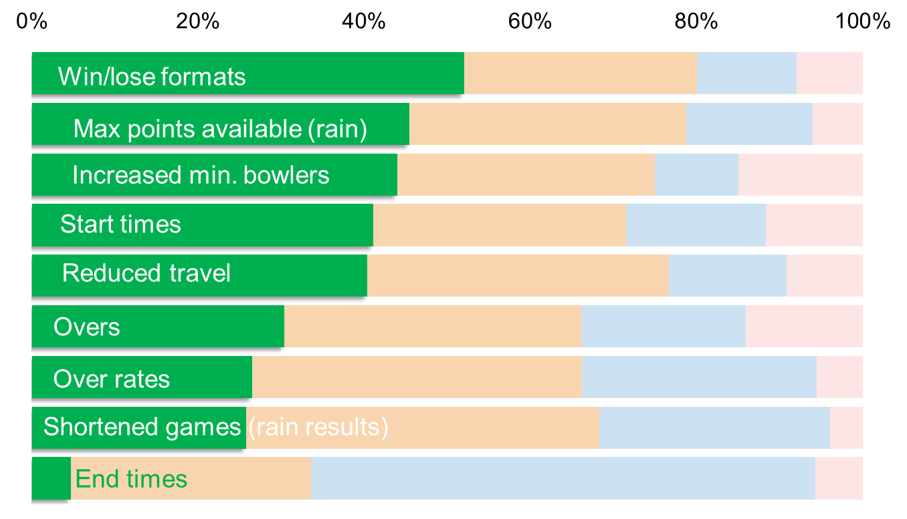
Best received reforms
Many players who have experienced reform in game day factors are saying they’re better
Better
No impact
Unaware
Worse
Source: NCPS 2015 Data
Question: Various league-level questions.

Slide 38
Incidentally, If did a league

Slide 39
Are players being heard?
And most of them don’t believe that they are being heard by the people who run cricket
48%
of players
think cricket isn’t listening
Are we?
Source: NCPS 2015 Data
Question: Do you feel that your views are heard and acted upon by the people who run cricket in your area? n=13,069
Notes:
The people who run cricket are Baby Boomers, maybe Generation X

Slide 40
Reflections?

