Slide 1
TRANSFORMING LOCAL SPORTS DELIVERY FOR WOMEN AND GIRLS

Slide 2
CSP WORKSHOP TOOLKIT
This toolkit has been created by Women in Sport and Sport England to help you get the most out of conversations with potential or existing partners. You will be able to share insights and advise partners on how get more women and girls active.
Please use the information provided in a variety of ways including in 1 to 1 meetings, or in presentations. Feel free to use all sections together or select certain elements.
There are four sections that summarise key guidance on women and girls sport that will help your partners:
Understanding your audience
Marketing and communications
Running your sessions
Keeping them coming back

Slide 3
KEY RESOURCES
Women in Sport:
CSP Resource hub
Understanding Women’s Lives
Resource Library
Sport England:
Go Where Women Are
Helping Women and Girls to Get Active: A Practical Guide
This Girl Can
Local Insights: [Add local insights/data]
Notes:
Guidance notes:
The content of this workshop has been developed by Women in Sport and Sport England and is informed by some key insights (hyperlinks to full reports provided).
Add local insights to make more relevant for partners.

Slide 4
TASK
Before we start…
Group discussion: women & girls’ sport
What are you trying to achieve as an organisation?
What do you find challenging?
10 minutes
Notes:
Guidance notes:
Open discussion to understand partners aims and challenges relating to women and girls sport. Insights gathered here will ne useful for discussions throughout the presentation.
TIME: 10 minutes discussion/feedback.

Slide 5
Before planning delivery…
Make sure you are familiar with the key principles to engaging better with women and girls

Slide 6
KEY INSIGHT PRINCIPLES
Change the offer to suit the women you are targeting – don’t expect women to change to fit sport and exercise
Don’t just talk about ‘sport’ – for many women, sport has baggage
Differentiate sport and exercise from other interests by promoting (not preaching) the additional benefits – sell what your audience is asking for
Seeing is believing. Making sport the ‘norm’ for women relies on local women of all ages, sizes and faiths not only becoming active but celebrating it and encouraging others to join in
Use positivity and encouragement to drive action – stimulating action through fear of consequences will have little traction
Make it easy for women to act: right time, right place, right welcome, right company, right gear
People make or break the experience – ensure your audience are appropriately supported
Source: Go Where Women Are, Sport England, 2015
Notes:
Guidance notes:
These key insight principles which you will find described in more detail in ‘Go where women are’ should be the starting point. Getting just some of these right will be great progress and underpin all of our practical guidance.
Change the offer to suit the women you are targeting - don’t expect women to change to fit sport and exercise
The current offer doesn’t appeal or appear to be relevant for many women who would like to be active. Listen to what your audience care about and tailor the activity, marketing and customer experience to deliver what they want.
2. Don’t just talk about ‘sport’ – for many women, sport has baggage
The word ‘sport’ and its traditional image can trigger negative associations for many women. Address this by considering how you present the experience women will have.
3. Differentiate sport and exercise from other interests by promoting (not preaching) the additional benefits – sell what your audience is asking for
In addition to health benefits, which many women do already recognise, sport and exercise can provide the opportunity to socialise, develop skills and spend time with the family. Makes sure your activity promotes these benefits that many women prioritise other activities for.
Seeing is believing. Making sport the ‘norm’ for women relies on local women of all ages, sizes and faiths not only becoming active but celebrating it and encouraging others to join in
Relatable women and girls visibly enjoying being active, at their own pace and somewhere local feels more attainable. Take activity into the community and attract new people by becoming part of their everyday sphere rather than waiting for them to join yours.
Use positivity and encouragement to drive action – stimulating action through fear of consequences will have little traction
Reassure the women and girls you are targeting that they are in safe and understanding hands. Don’t let women beat themselves up about what they do or don’t have.
Make it easy for women to act: right time, right place, right welcome, right company, right gear
Address both practical and emotional barriers together to ensure that neither outweigh the motivation to be active. A more convenient crèche facility may only attract those who feel confident with the activity or in a sporting environment already.
People make or break the experience – ensure your audience are appropriately supported along the way
Invest in the people that shape the experience of sport and exercise the women you are targeting have. Ensure your audience are welcomed, feel cared for and are regularly communicated with - whether they are familiar faces, new or have recently stopped attending.

Slide 7
1. UNDERSTANDING YOUR AUDIENCE
Notes:
Guidance notes:
Understanding your audience (the potential or current participants coming to your programmes/sessions) is so important and sits behind all of the key principles
By having a greater understanding of their motivations, values and barriers you will be better placed to attract and deliver to women and girls (whether they are new to sport or not)

Slide 8
One size does not fit all
Notes:
Guidance notes:
We all know this intuitively… but it is normal and tempting to develop an approach and stick with it…
How many deliverers are armed with the skills and tools to be responsive to different people with different sets of needs?

Slide 9
“I think about exercise everyday”. “I feel guilty about exercise everyday” Women shoulder a lot of guilt which causes exercise to carry with it negative overtones
I should be healthier
I’d like to lose weight
I shouldn’t be so lazy
All my friends are exercising
I think I would feel better
I used to like it
Source: This Girl Can Evaluation (Futurethinking)
Notes:
Guidance notes:
We also know that women and girls think about being active all the time - whether it's about being healthier or losing weight!
However, there is a lot of guilt out there. Just realising what you’re not doing or should be doing almost immediately make sport and exercise a negative thing.

Slide 10
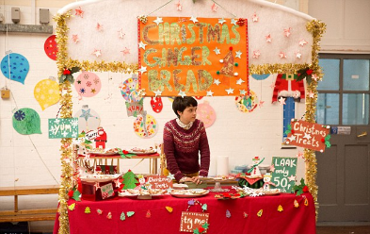
We are mainly driven by emotion…
Notes:
Guidance notes:
Emotions trigger attention and action…
Emotion wins out over reason and logic almost every time…
We respond best to stories / faces / people… not number, symbols or statistics…
As much as people need the right basic information about what is available and when… what really creates a connection and memorable experience is emotion. The annual Christmas advert battle is a great example of this. The ‘winner’ is the brand that makes the most people cry… and the emotional connection established with customers is what drives sales.
And people tend to find that the most emotional were the most memorable… can you name the brand behind these adverts? [John Lewis (2014), John Lewis (2013), Waitrose (2014), and Sainsbury's (2014)]
And this is especially interesting, because we all theoretically understand this… we know it to be true and we see it in our own lives… and every one of our partners that I speak to about this wholeheartedly agree… everyone from development directors to fitness instructors…
… and the coaching world is very comfortable with the idea of sport psychology in elite sport – and emotional barriers to high performance…
BUT – how often do you see this applied, in the sport sector, in practice? How many coaches think about how to create an emotionally engaging session for people, as much as they think about the technical aspect?
Adverts Top Row L-R…. John Lewis (2014), John Lewis (2013)
Adverts Bottom Row L-R…Waitrose (2014), and Sainsbury's (2014)…

Slide 11
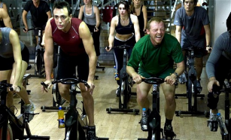
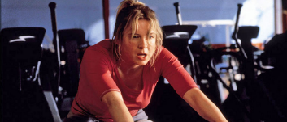
Emotional barriers are just as important as practical barriers
FEAR OF JUDGEMENT
Notes:
Guidance notes:
And our emotional barriers are often our primary barriers (before practical barriers are even considered).
Our pattern of thought, when it comes to considering something new, is never ‘what is the very best way that I could do this? what are my options?’ but rather ‘what is the very worst thing that could happen if I do this? And how can I be sure that won’t happen?’
This relates to Sport England’s insight into barriers to exercise for women – please read ‘Go Where Women Are’ on the Sport England website for full details
Fear of being judged is for many an important all-encompassing concern, which then surfaces re-articulated in the form of another more ‘acceptable’ barrier. For example, whilst a woman may cite lack of time as the reason she doesn’t manage to do any exercise, her concern could actually be that (in the case of mums in particular) spending time on exercise will be perceived as self-indulgent and implies she is neglecting other priorities such as spending time with her family.
Fear of being judged also includes:
A fear of being in unfamiliar territory, not knowing how to use any of the equipment and looking out of place.
A fear of being exposed for lacking ability, being the odd one out when the rest of the class are all really fit.
A fear of looking sweaty or un-attractive in an open or busy environment
A fear of looking like the odd one out by wearing the wrong thing or not having the right gear.

Slide 12
Understanding Women’s Lives (2013)
Notes:
Guidance notes:
Read full report before presenting this section.
This insight provides a great platform to understand your female audience
Ground breaking study: field research was conducted in 2013 and Women in Sport have been working since them to apply the key findings and test with partners
The research involved women 16+ from a variety of locations across England and with very different lifestyles. (The research has been tested with girls under 16, but no specific research published just yet).
Aim to unlock new research into:
Women’s lives in modern Britain and what’s important to them;
Women’s perceptions of sport versus fitness and how we need to reposition sport to appeal to women; and
How we can tap into women’s values in order to activate behaviour change towards increased levels of physical activity.

Slide 13
‘Values…principles or standards of behaviour; ones judgement of what is important in life’
Notes:
Guidance notes:
When Women in Sport started the research they thought it would be a ‘segmentation’ – where they would find different types of women
But…the research went beyond this and identified that women have a number of key values
Introduce definition of a ‘value’ – in essence its ‘why we do what we do’

Slide 14
A COMPLEX
VALUE SYSTEM
LOOKING GOOD
FEELING GOOD
HAPPINESS
CONTENTMENT
SELF WORTH
NURTURING
MY FRIENDS
& FAMILY
ACHIEVING
MY GOALS
DEVELOPING
MY SKILLS
HAVING FUN
Notes:
Guidance notes:
Women hold six core values which inform their behaviour and decision making
The six core values that the research has identified as being those women prioritise in life are:
• looking good
• feeling good
• achieving goals
• developing skills
• nurturing friends and family
• having fun
They represent what is important to women in modern life and how they want to spend their time and energy. These values will be dialled up and down for different women and at different stages in their lives.
Feeling good is a growing priority for women. Women see the importance of looking after holistic mind, body and soul, as contributing to longer term health. They are increasingly investing in their emotional and spiritual wellbeing as well as physical. Wholesome experiences and ‘me-time’ are increasingly being prioritised as women seek to avoid letting stressful lives get the better of them.
“I feel fitter and stronger and happier and more comfortable in my body than ever, none of that is related to my dress size or goal weight but instead the strength I am building in my muscles.” (Linda)
Looking good is a value that resonates with many women, and increases in importance at different times in their lives. This can include being slim, toned, having muscle definition or taking care of hair and nails. The importance of this value is likely to increase when women are approaching ‘on show’ events like weddings, holidays and parties.
“All I’m thinking about is my body in a bikini on the beach.” (Poppy)
Nurturing friends and family: Women value spending time with family, friends, children and partners, often instinctively prioritising others’ needs over their own. Wives and mothers invest their time in their family’s development - particularly in the case of their own children. Women often adopt the role as family linchpin.
“My commitment is at home and my family are almost my team, I need to be there for them.” (Sam)
Achieving goals: Women like to feel as if they are progressing in life. They set themselves goals of what they’d like to achieve in life, not just professionally but also personally, and feel a great sense of satisfaction when they are able to tick these off. Women can be very determined in seeking to achieve these goals, especially when proving others wrong in terms of what they are capable of.
“It’s important for me to be ambitious and achieve things in life – I like to make sure I am getting the most out of life and making sure I tick all those things off my bucket list while I can!” (Anne)
Developing new skills to enhance personal development is an important element of life. Women want to feel as if they are learning new things, developing as a person and broadening their horizons. They can gain satisfaction from mastering something new, increasing their knowledge or producing something. There is also interest in developing soft skills such as leadership, interpersonal skills and coaching.
“I use the internet to research how to do things – it’s amazing what you can find online – there are really good tutorials that take you though it step by step.” (Maureen)
Having fun is a fundamentally important part of women’s lives. It provides an essential release from the day to day grind that women can often feel. Having fun is about doing things they choose to do rather than feel obligated to do. Socialising, interacting and laughing with friends is an essential part of life. However spending time alone can also fulfil this value.
“I don’t know what I’d do without my friends to have a laugh with at the end of a hard day!”

Slide 15
“Cycling is something I can enjoy with the kids so I love it – it’s a wholesome family activity”
LOOKING GOOD
FEELING GOOD
NURTURING
MY FRIENDS
& FAMILY
HAPPINESS
CONTENTMENT
SELF WORTH
ACHIEVING
MY GOALS
DEVELOPING
MY SKILLS
HAVING FUN
“Of course going out with my friends and having fun is really important – it can’t all be about work!”
Notes:
Guidance notes:
All 6 values are in play at one time, but some may be more dominant than others.
Dominant values will change over time from day to day, season to season, year to year.
They will also change in conjunction with large life stage changes – such as getting married, moving house, having children, getting a new job
This diagram represents one of the women from the research (27 years old). As a snap shot her dominant values were ‘having fun’ and ‘nurturing friends and family’
These could be the same today or very different

Slide 16
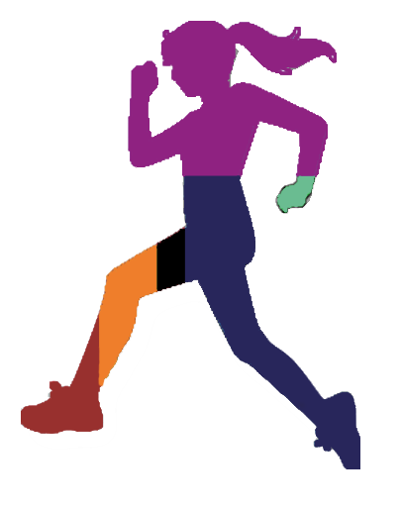
TASK
15 minutes
Notes:
Guidance notes:
Think of it as a heat map
Task – if workshop has 20 or less participants.
Use outline of woman and provide colouring pencils to match the colours of the values. Ask partners to colour in the women to show their values at that particular time.
Women will do for themselves
For males ask them to complete for a female friend, colleague, partner
Ask partners to feedback and explain their dominant values
If workshop has more than 20 participants print out signs with all 6 values and put them around the room. Ask your partners to stand next to their dominant value(s)
TIME: 10 minutes for colouring and 5 minutes for feedback

Slide 17
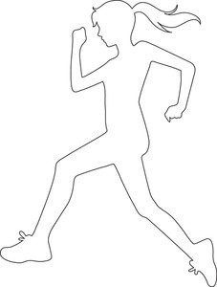
Notes:
Guidance notes:
Outline for printing

Slide 18
IN ORDER FOR SPORT TO ENGAGE WITH WOMEN IT MUST ALIGN ITSELF WITH THEIR VALUES
Notes:
Guidance notes:
In order for sport to engage women, it must align itself with their values
The fitness industry is currently very well positioned to the Looking Good and Feeling Good values – big marketing spend, high visibility and strategic communications from commercial providers
Sport is not very well positioned but we can align it much more effectively – we need to re-design and re-position sport and physical activity to the values and engage women and girls

Slide 19
How can you apply this to your work…
Strategy
Programming
Communications
THINK DO SAY
Notes:
Guidance notes:
Summary of section > different way of thinking: think about how women and girls think, the way you communicate, the way you present sport in general.
How can you apply this insight to your work?
The good news is that sport and physical activity can align itself with women’s values by showing women what’s in it for them and making women believe that sport is for them. Sport can align itself with women’s values through three key channels:
• Strategy
• Programming
• Communications
POLICY – referencing the values within strategies, plans and policies
PROGRAMMING – How are your sessions formatted: time, venue, single sex v mixed, skills v drills, time for chatting.
MARKETING AND COMMUNICATIONS – Do the types of images, language, channels you use align to the correct values
EXAMPLE TO BRING IT TO LIFE (page 10 of full report):
Laura’s story (27)
“I need a push… at school I got pushed to do certain things… now I have every excuse you could think of not to do something.”
Laura was ‘sporty’ at school and told she was good at hockey. In her late twenties she started to think about returning to the sport, to fulfil her dominant values at the time; Having Fun and Nurturing Friends and Family. Laura had started to prepare to return to hockey by signing up to her local hockey club mailing list, researching hockey sticks and planning her travel route to get to training. However, for some reason she hadn’t taken that next step and gone to a training session.
What could be stopping Laura?
Strategy: Women’s participation not a priority…
• Is women’s participation part of the club strategy?
• Does the club promote equal opportunities?
• Does the club consider the experience of participants like Laura within their policies?
Programming: Training times v busy life…
• Are training sessions a mix of fun skills, drills and match play?
• Are training sessions aimed at a variety of abilities?
• Is there a chance to meet and chat with other players?
• Are training sessions available at a suitable, or range of times?
Communications: How does the hockey club talk to Laura?
• How were the emails Laura received written - were they friendly and welcoming? Did they let Laura know what to expect and tell her what to bring?
• Were the images on the club website suitable for returning players or beginners?
• Did the club’s communications motivate Laura to want to go along to a session?
In order to align to Laura’s and other women and girls’ values the club needs to consider
all of the above.

Slide 20
TASK
What do you know about your audience?
What can you do to fill gaps in knowledge?
What does the CSP have to help you understand your audience?
Notes:
Guidance notes:
Open discussion: Getting partners to think about themselves as an organisation, do they use their insights?

Slide 21
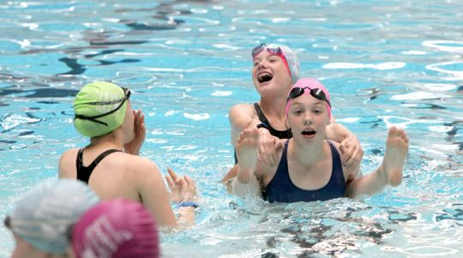
2. MARKETING AND COMMUNICATIONS
Notes:
Guidance notes:
Development effective marketing for your programmes is vital
This section will help you think differently about what you currently do to attract women and girls and offer some practical advice

Slide 22
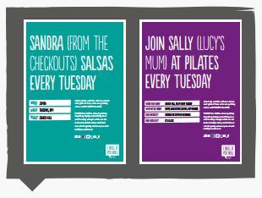
How do I… Choose the right communication method for my audience? Make our communication genuine and welcoming? Find a bank of images that I can use, that include local women?
Notes:
Guidance notes:
How do I ….. Choose right communication method:
It depends upon the target audience and how they like to interact - social media, at the school gates etc.
If the target audience spend less time of social media produce offline marketing materials to share in the community such as leaflets/posters in supermarkets, community centres and local businesses
If using social media add varied content regularly and use imagery as this is more likely to get people to engage
Key consideration: word of mouth is your friend
Make communications genuine:
Use the language locals use (with local images to back this up don't be afraid to show real images with sweat!) with a warm, friendly and professional tone as your sessions will be!
Bank of images:
Advise people to check out the practical guide, they can access images via the This Girl Can website once you are registered or via the Sport England website image bank

Slide 23
TASK
Review your marketing…
Who is the target audience?
What tone and imagery are used?
Is it aligned to any values?
15 minutes
Notes:
Guidance notes:
Give examples of what good is to help if needed.
IN ADVANCE: Ask your partners to bring an example of how they market their project/programme to the workshop: a poster, screen shot of their website, a Tweet.
Link back to the Understanding Women’s Lives research and the practical advice you have just shared – get partners to answer the questions in small groups.
How do you feel about doing this? Or is it something that your marketing team does, if you have one?
10 minutes for discussion and then feedback for 5 minutes as a whole group.

Slide 24
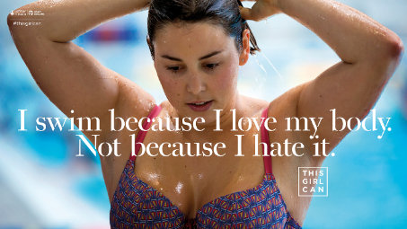
Notes:
Guidance notes:
Examples of using This Girl Can campaign: national, National Governing Body, City Council

Slide 25
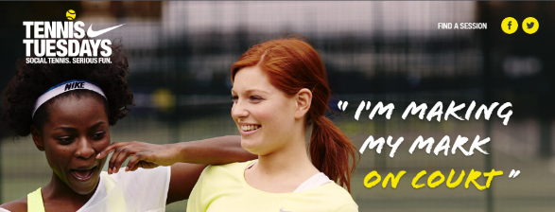
Notes:
Guidance notes:
Good practice examples from the industry.
Add local examples when delivering to partners to make it more relevant.

Slide 26
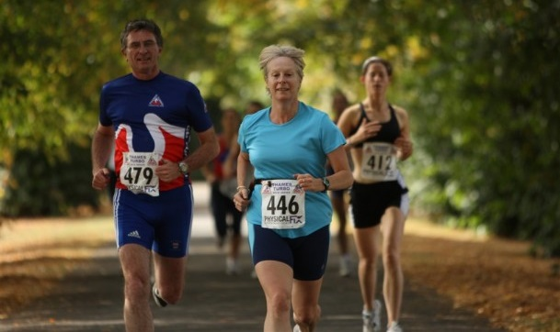
3. RUNNING YOUR SESSIONS
Notes:
Guidance notes:
This section will focus on how your sessions look – considerations for where, when, who and why.

Slide 27
TASK
Pick a ‘profile’ and discuss in groups: Applying the insight
15 minutes
Reflect on everything we have talked through:
How could you align the offer/journey for your profile to improve their experience? Think about the values!
Marketing
Activity
Venue
Timing
Workforce (venue staff, instructors, volunteers)
Notes:
Guidance notes:
Use profiles on slides 28, 29 and 30. Print out and hand to small groups.
Use ‘Offer wheel’ as prompt.
TIME: 10 minutes discussion, 5 minutes feedback

Slide 28
Profiles
Her values: Having Fun and Looking Good
Project:
Activity: Sportivate basketball session
Age group: 16 – 18 years
Level of activity: Semi-sporty
Environment: Urban
Her values: Feeling Good and Nurturing Friends and Family Project:
Activity: Outdoor gym session
Age Group: 45+ years
Level of activity: Inactive
Environment: Urban
Notes:
Printed out on slips and handed to groups.

Slide 29
Profiles
Her values: Having Fun and Developing Skills
Project:
Activity: Multi-sports satellite club
Age Group: 11 – 15 years
Level of activity: Semi-sporty
Environment: Urban
Her values: Looking Good and Achieving Goals Project:
Activity: Weightwatchers
Age Group: 25 – 35 years
Level of activity: Inactive
Environment: Rural
Notes:
Printed out on slips and handed to groups.

Slide 30
Profiles
Her values: Having Fun and Achieving Goals
Project:
Activity: Local hockey club session
Age Group: 16+ years
Level of activity: Active
Environment: Rural
Her values: Looking Good and Nurturing Friends and Family
Project:
Activity: Buggy run
Age Group: Mothers
Level of activity: Semi-sporty
Environment: Rural
Notes:
Printed out on slips and handed to groups.

Slide 31
Designing the experience – things to think about
Notes:
Guidance notes:
Offer wheel.

Slide 32
4. KEEPING THEM COMING BACK
Notes:
Guidance notes:
Retention – how to you ensure women and girls come back each week and develop a sustained habit for sport?

Slide 33
Behaviour change is a journey – and falling off the wagon is normal…
Pre-contemplation
‘I’d rather go out with mates thanks’
‘I’ve been thinking about maybe joining a gym but they’re so expensive!’
Contemplation
‘I’ve finally signed up to a local gym’
Preparation
1ST EXPERIENCE
Action
‘Trying to go to the gym once a week but doesn’t always go to plan!’
‘Having to work on a Sat morning – this is the first time I’ve missed my class in years!’
Maintenance
RELAPSE
What’s working?
What’s not working?
SOURCE: Prochaska and Diclemente Transtheoretical Model of Behaviour Change
Notes:
Guidance notes:
This is the ‘stages of change’ model which shows us the process for consciously trying to change a behaviour / build a habit. It’s a journey. It’s a sequential process, you can’t skip a step, although people may move through it at different speeds. The key point is that lapsing is normal, even from the maintenance stage.
Pre-contemplation – the thing you’re talking about is not even on my radar (or – I don’t want to hear about it because I’ve tried and failed in the past)
Contemplation – I can see that this might be relevant to me – so I’m thinking about what I might gain or what I might lose
Preparation – I think I’m going to have a go so I’m setting things up (e.g. joining a gym / buying some trainers etc.)
Action – I’m having a go but not quite managing to make it routine yet
Maintenance – I’m managing to build a habit and a routine around this
The other interesting thing is, when you compare sport to other behaviours and habits, there is not a ‘termination’ stage… this means that – when it comes to sport – there is never a point at which people stop having to work at maintaining any habit or routine. We can compare this to smoking cessation. There’s evidence from the NHS that people trying to stop smoking go through this process on average 14 times before they genuinely quit and their new habit and normal behavior is to not smoke, and this is now their automatic, unconscious behaviour.
However, for sport, there’s evidence that it is always a conscious effort.
Life gets in the way for even the most committed - whether it’s a friend visiting on the night your hockey team practices and unavailable at any other time or something more dramatic…

Slide 34
1ST EXPERIENCE
INFORMATION
Pre-activity
Follow up
EXPECTATIONS
Format
Ability level
Considerations
CUSTOMER SERVICE
Signage
Staff
FACILITIES
Changing rooms
Lockers
CURRENT PARTICIPANTS
Welcoming
Sharing knowledge
COACH/LEADER
Qualified
Friendly
Notes:
Guidance notes:
Share key considerations for the 1st experience.
One of or a combination of these elements can have a positive or negative impact.

Slide 35
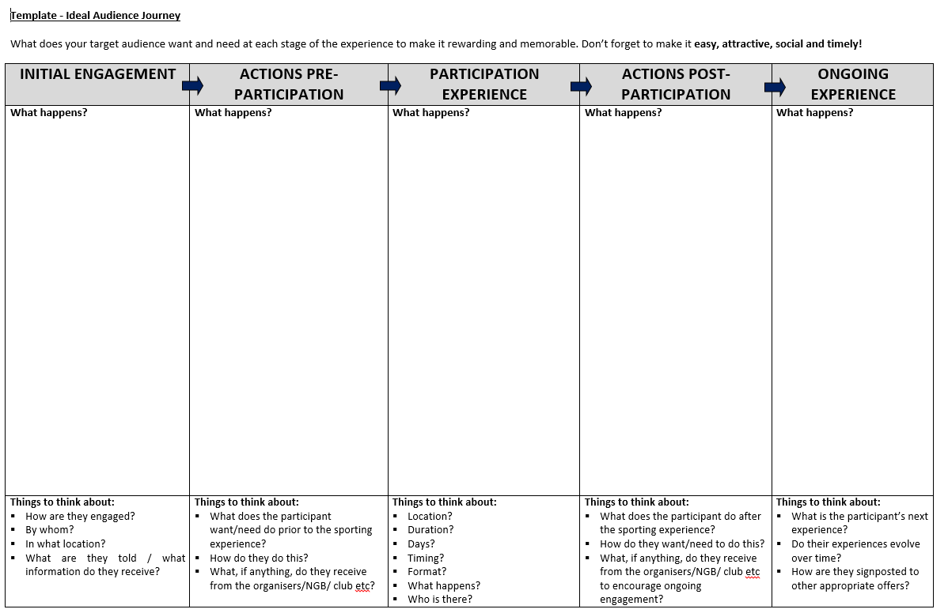
Source: Sport England
Notes:
Guidance notes:
You can use this useful audience journey template to begin to plan out the potential journey of the women and girls you are targeting. It’s important to make it specific!

Slide 36
ON-GOING CONVERSATION
Before:
Initial research to shape the programme and create interest
For the duration:
Continued conversation to ensure the programme is still fulfilling the values of the participants. What was their first experience like? What is/isn’t working for them?
Ensure participants feel important and part of a community
Notes:
Guidance notes:
In order to align programmes and ensure that first experience is a good one partners MUST consult with women and girls
Ask females in your local community what sport they would like to do, what are their dominant values, where do they want to do it and with who > this insight can help to shape your programme/sessions
Consultation must be continuous > as we know values change over time, so keep speaking to women to ensure your programme is still appealing and fulfilling their values.
It’s important that women and girls feel important, that their opinion matters

Slide 37
Feedback is vital!
Monitoring and evaluation can take many different forms, but there are key principles that always apply:
Combine multiple sources of information
Be practical about what you can achieve
Measure
Combine the lessons learned on a weekly basis
Change and adapt your approach
Take time to discuss the findings properly
Notes:
Monitoring and evaluation can take many different forms, but there are key principles that always apply:
Combine multiple sources of information (i.e. data and feedback from the women themselves, those running sessions and other similar projects) to get the best possible insight.
Be practical about what you can achieve and focus on answering the most useful questions that will be feasible to implement.
Measure and take on board the less positive outcomes as well as the good.
Combine the lessons learned on a weekly basis with more formal measurement at key milestones.
Change and adapt your approach to monitoring and evaluation as you go and learn from what’s working for you.
Take time to discuss the findings properly so that feedback becomes central to what you do, not just an add on.

Slide 38
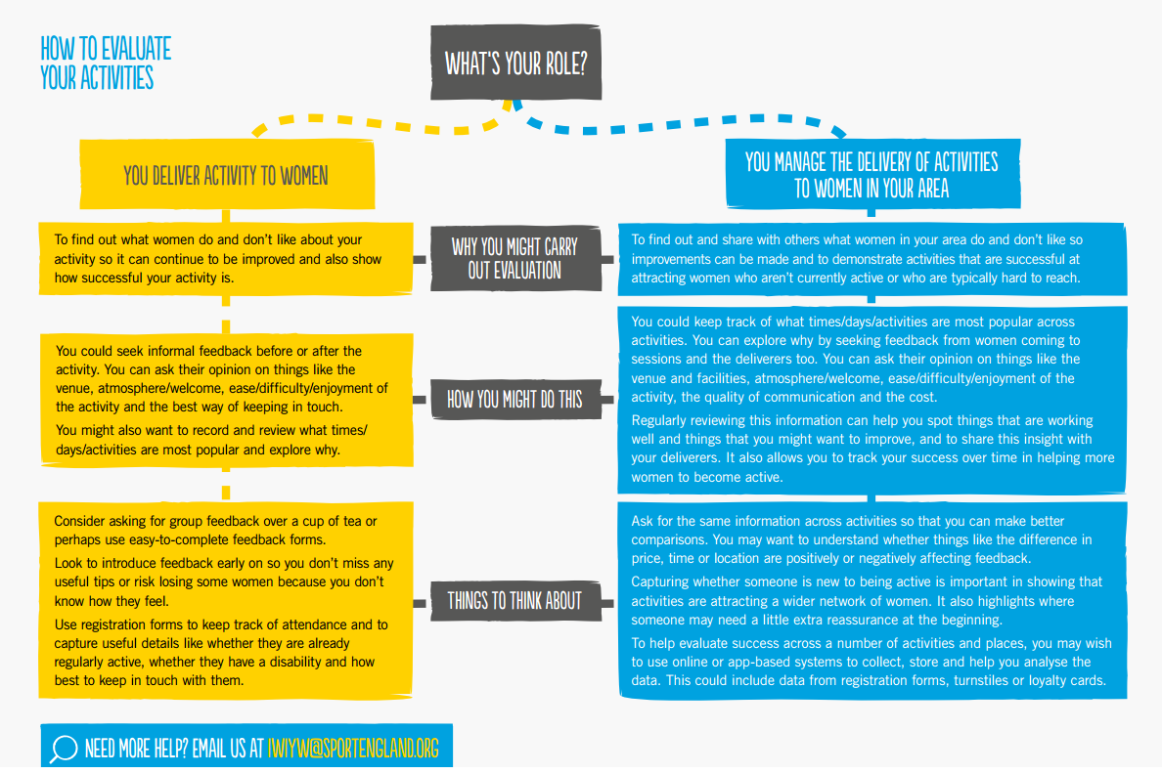
Notes:
Guidance notes:
This diagram is a useful starter in thinking about what type of data, feedback or evaluation you might need and how you might go about it. There are lots of ways of measuring the performance of the work you are doing so it’s always best to start with what you want to prove or what would help you to improve your offer.
For any more information on how best to evaluate your activities feel free to get in touch on IWIYW@SPORTENGLAND.ORG

Slide 39
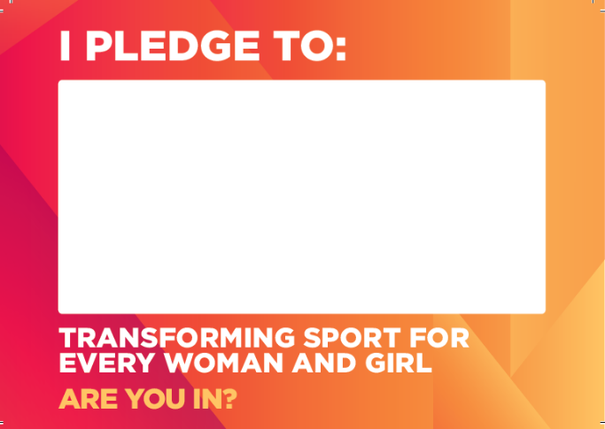
TASK
Let’s pledge together!
Notes:
Guidance notes:
At the end of the session it is useful for partners to revisit what they have learnt
Ask partners to write down 1 or 2 key things they will take away and act on
CSPs can keep these and use to follow up post workshop
CSPs can also use these with partners in larger settings/conferences to create conversation about next steps

Slide 40
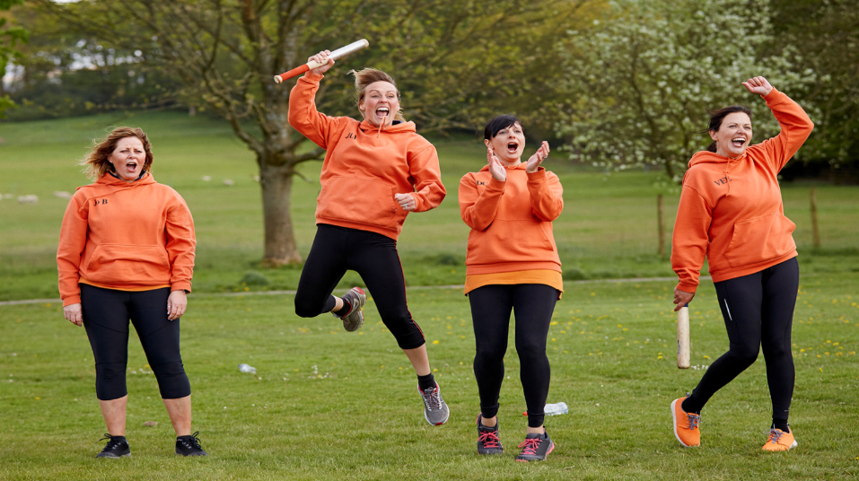
THANK YOU!

