Slide 1
Understanding the London specific barriers to girls and women getting active
Final report
April 2015
Alex Oliver
Oliver Boo Ltd

Slide 2
Contents
Project overview and research approach
Recap of national picture: barriers and enablers
Women’s participation patterns in London
Barriers to sport and activity for women in London
Industry highlights
This Girl Can
More opportunities to explore

Slide 3
Project overview and research approach

Slide 4
Background and objectives
London Sport has been commissioned by Sport England alongside eight other cities in England to activate the This Girl Can campaign on a local level in order to help address the gender gap that still exists in terms of sports and physical activity.
Building on the insight recently generated through the This Girl Can campaign, this insight project was designed to focus on women and girls in London and the specific barriers that they face when it comes to participation.
A small scale research project to generate initial hypotheses regarding any London and industry or sector specific barriers that women face.
New insight to work with sport and physical activity providers and employers to help them to get women and girls to become active.

Slide 5
Project overview
Understanding the London specific barriers to girls and women getting active
1
Project set up
2
Scoping and review of existing research
3
Qualitative research
4
Analysis and reporting

Slide 6
Qualitative research
We spoke to a broad spread of women aged 16-40(+) working across 4 different industry sectors in London:
Sector | Method and sample
Private sector (The Futures Company) | 1 x focus group in London Bridge with 6 women working in consultancy 3 inactive; 3 active (ranging from once a mth to 2+ per week)
Charity sector (Crisis) | 1 x focus group in East London with 9 women from the non-profit sector 6 inactive or low active; 3 active at least once per week
Public sector (mix) | 4 depth interviews: one government official at Department of health; 3 teachers (2 full time; 1 part time), plus LinkedIn Discussion Forum 2 inactive; 2 low active
Service sector (mix) | 10 intercept interviews with women in 3 different areas of London - Brixton, London Bridge and Bloomsbury - working in retail (2), catering (6) and laundry (1) 7 inactive; 3 active
In total, 29 women participated in the research across the 4 different sectors.
A mix of demographics (ethnicity, socio demographic and ages 18-40+) included.
This is a small sample, hence findings cannot be considered robust and hypotheses may need further testing.

Slide 7
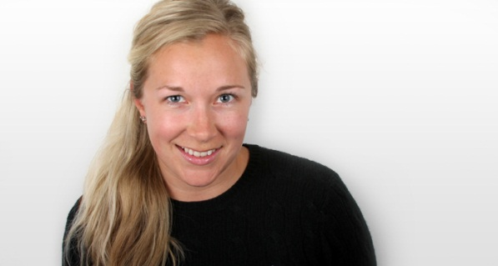
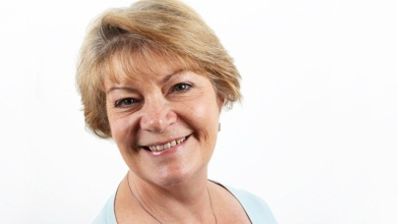
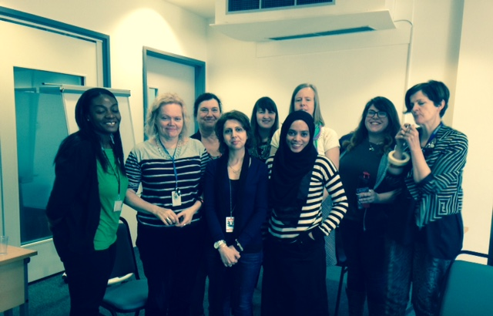
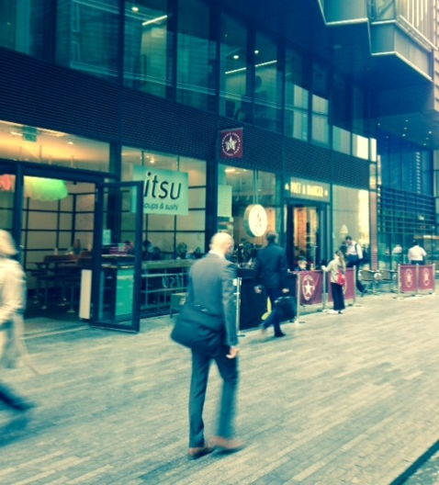
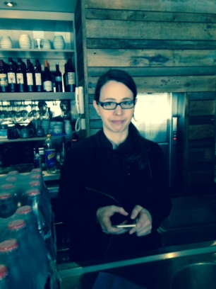
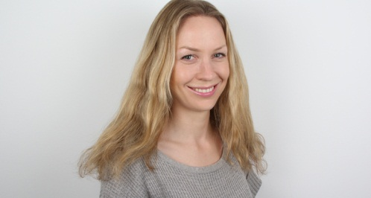
A broad range of women and organisations were sampled

Slide 8
Recap of national picture: barriers and enablers

Slide 10
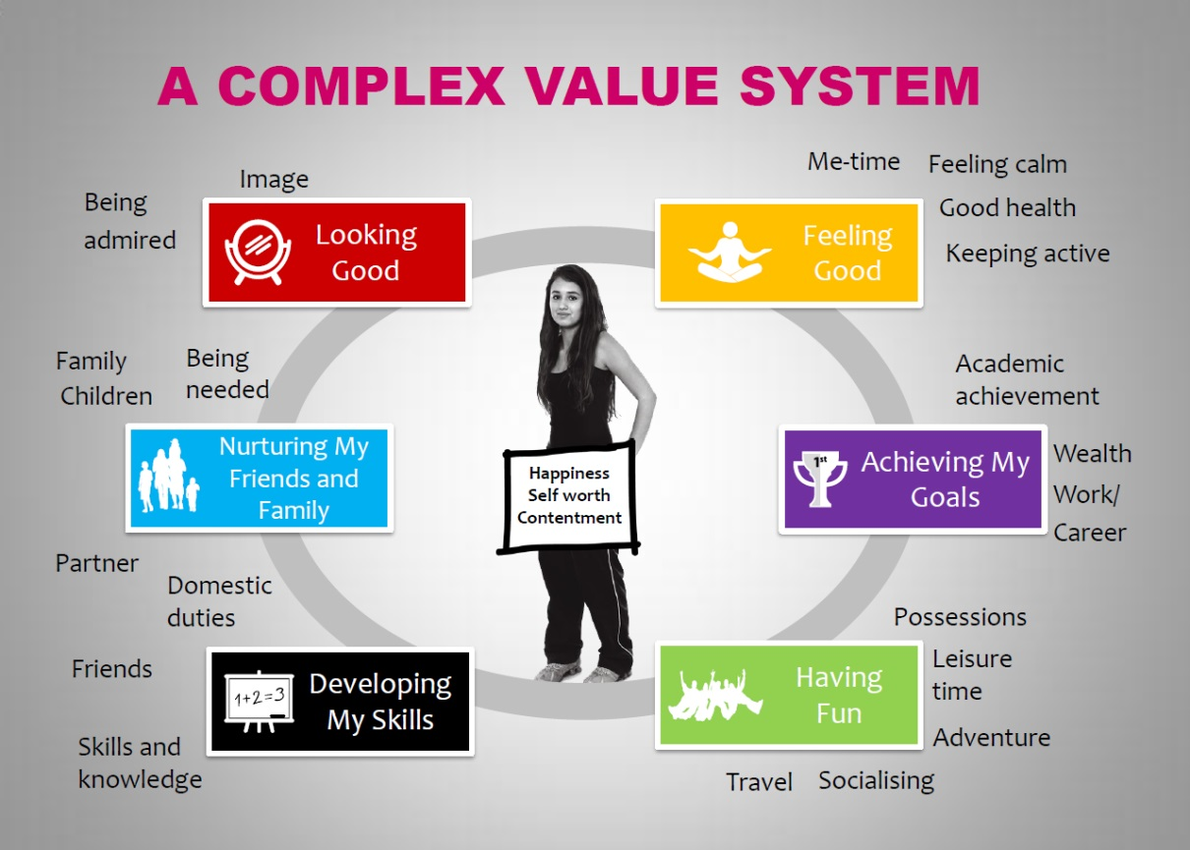
Sport and exercise does not always feel relevant or a priority
Most women have rich and complex lives.
But sport / exercise is not always felt to be something that fulfils women’s core values or reflects what is important to them.
Women in Sport’s research - Understanding Women’s Lives - identified 6 core values which determine how women prioritise and make decisions on how to spend their time day to day. The importance of each will vary for different women, including the disabled, at different times of their lives. It’s important to consider how sport can fulfil these values and align with them to be genuinely customer–centric.
Source: Understanding Women’s Lives in 2013& the role of sport and physical activity (Women in Sport)
Notes:
Additional research carried out by EFDS has found that women with disabilities have a similar value system. This suggests that attempts to engage this target audience still needs to be mindful of their priorities and how these will generally not include put being active top of the list.

Slide 11
Understanding the customer journey
Pre-contemplation
Contemplation
Preparation
Action
Routine
Trigger
Motivation shifts from negatively to positively framed.
Barriers often diminish once patterns of activity become established.
Women and girls go through different stages to develop a sporting and exercise habit.
It’s important to understand this journey and the barriers that women face as well as what motivates them to move forward on the journey.

Slide 12
Understanding the factors stopping women
Women cite a whole range of reasons why they are not as active as they would like to be.
Lack of time is the most frequently mentioned but this can mask more fundamental issues including lack of confidence and fear of being judged.
FCB Inferno’s research found that ‘fear of being judged’ is for many an important all-encompassing concern, which then surfaces re-articulated in the form of another more ‘acceptable’ barrier.
Personal barriers
Practical barriers
Fear of being judged
Fear of being judged
Source: FCB Inferno This Girl Can Qual Research (2014)

Slide 13
Personal barriers and fear of being judged can be deeply rooted
A fundamental personal concern is the fear of being judged. Perceived judgement can come from all angles: immediate friends / family (not living up to their expectations); other women (not matching up to their standards) and men (dismissive of their ability).
Fear of judgement remains relevant even amongst more sporty women who fear they can’t perform as well as they used to.
Many women have worries about appearance – having to reveal their body and / or what they look like when they exercise (no make-up, hot, sweaty etc.).
Social confidence is another barrier. Women often are put off by the idea of having to try something new on their own or may have worries that they won’t fit in.
Concerns about ability, whether founded or not, also get in the way.
Throwing yourself around in lycra? I would feel embarrassed, I just would. The instructors are all size 6 with not a bead of sweat on them. Then there’s me, just flagging.*
I’m self-conscious going to a gym. There are fit women on the treadmill and big men.*
I don’t dare go to the weights section – it is really intimidating.*
Sources: FCB Inferno This Girl Can Qual Research (2014) , Bury Proposition Testing Research (2013)

Slide 14
Practical barriers are more easily articulated
Time and cost are often given as the main reasons preventing women from taking part in sport and exercise, but in reality, it’s often a question of prioritisation, with other activities (socialising, shopping, family time etc.) being favoured.
It is revealing that (busy) working women are more active overall.
Women, in particular mothers, can feel bad about being away from their family and spending time on themselves.
Lack of information is another commonly cited barrier, compounded by lack of time to find the information.
Major life changes (like getting married, changing jobs or having a baby) can be key milestone events when these practical barriers converge and the sporting habit is lost.
“It’s not that I don’t want to do it, it’s just very difficult to fit in.”
“I’m going to go back to work part-time and it may end up clashing....”
“It can be 9 o’clock by the time we’ve eaten and got the kids the bed, then she doesn’t want to go out.”
Sources: Bury Proposition Testing Research (2013)

Slide 15
In terms of what motivates, social and cultural enablers are key
Women will be motivated by different factors according to their characters and values – e.g. for some it’s ‘something new’, for others ‘support and friendship’ and some focus on performance.
Beyond these nuances there’s a need to frame exercise positively to drive up levels of motivation – i.e.
  It is sociable – an opportunity to be with friends and to make friends.
  Engaging in sport and exercise is worthwhile and offers a sense of achievement.
  There is fun to be had – do something different!
I like doing my sports in a team. If I’m on my own, I get bored. I just love being part of a gym. That’s my social side – seeing all my friends at the gym.*
If you’ve got a goal it does help you to get out of the door.*
You always feel better after it.*
Active women find that exercise brings its own inherent rewards: the motivations that keep women exercising are often different to those which caused them to start.
Sources: Bury Proposition Testing Research (2013)

Slide 16
Triggering action
Addressing barriers and motivators will help to reduce resistance and ensure that women feel that taking part in sport and exercise is an acceptable and rewarding thing to do.
Even then, a trigger is often needed to create the momentum to take part at a specific point in time.
This will help to move the target audience beyond good intentions into making concrete plans.
Manchester 10k was a motivating goal to work towards. You’ve got people sponsoring you for a charity and it spurs you on.*
You can put in as many leaflets as you like, people don’t necessarily pick them up. You need to see something, watch something that inspires you.*
Sources: Bury Proposition Testing Research (2013)

Slide 17
Overall patterns in London

Slide 21

Other quantitative sources point to some particular challenges in London
Islington’s consultation highlighted some key themes which would encourage more participation:
65% of all respondents said reduced cost . Young women (16-18) in particular cited difficulties in finding money to pay for activities outside school (which appeal more).
1/3 of all respondents said greater flexibility was important (with a reluctance to sign up for monthly subscriptions).
Sessions for different abilities and female only sessions ranked very high.
Over half of mothers with dependent children said ‘mother and child sessions’ would encourage them to take part.
Lack of information in particular for younger women leaving school was cited as a barrier.
Location could also be problematic: young women had safety concerns about venues next to park; reluctance to travel across borough due to disputes/gangs.
Travelling to and from activities also came up – public transport is good but not as convenient as driving.
Consultation on increasing participation in sport among women and girls
Notes:
65% of all respondents said reduced cost. Young women (16-18) in particular cited difficulties in finding money to pay for activities outside school (which appeal more ).
Sessions for different abilities (particularly for non-active respondents) and female only sessions (particularly for religious reasons) ranked 2nd and 3rd
1/3 of all respondents said greater flexibility was important (with a reluctance to sign up for monthly subscriptions)
Over half of mothers with dependent children said ‘mother and child sessions’ would encourage them to take part.
Lack of information and in particular ‘drop off in information on local services and activities received by young people when they leave school’ – may partly account for high levels of latent demand / low activity amongst younger women.
Location can be problematic: young people have safety concerns about venues next to park; reluctance to travel across borough due to disputes/gangs; lack of activities during school hours)
Anything about challenge of travelling to an

Slide 22
Barriers to sport and physical activity for women in London
Notes:
What makes it particularly hard in London – how can we account for the lower levels of participation – particularly amongst the youngest group of women – and the higher than average levels of latent demand?

Slide 23
It’s not about a lack of opportunity…
Across sectors and demographics, women agreed that there was no lack of opportunity to be active in London.
The city offers a wide array of different activities and sports for all abilities, ages and interests.
London’s beautiful parks and green spaces – as well as architecture – offer multiple possibilities for outdoor sport and activity, especially in the warmer months.
Although some countryside options are more limited (e.g. horse riding, hill walking), for those who are motivated to be active, the opportunities are plenty.
There are lots of opportunities. For me personally there are plenty of pools around that open early and til late. We’re very lucky around here, we’ve got loads of parks and stuff…lots of clubs and lots going on.
(Amanda, teacher, Dulwich)
It’s easy to be active in London because there are so many parks in all the boroughs. (Victoria, waitress, London Bridge)
There are so many climbing gyms– 3 in one square kilometre…it’s not hard to be active in London if you have that passion. (Ola, waitress, London Bridge)
Notes:
Those new to London are particularly appreciative of London’s parks and architecture.

Slide 24
But hectic London lifestyles exacerbate time and energy barriers
Life for women working in London can be particularly intense.
Across sectors, long commutes mean the working day is often extended by 2 hours+.
Commuting and the pressure of work takes its toll in terms of time, energy and motivation.
It’s transport – the time it takes when you could be doing other things – that’s the problem. And working days are quite long.
(Suzanne, teacher, Dulwich)
I work full time and long hours and I live 45 minutes away in Hackney, so I get really tired from my job.
(Pinar, waitress, Bloomsbury)
London is a big city and time just goes. In London we’re just running all the time. We’re exhausted just being in London
(Crisis, non profit)
Tiredness reduces your motivation and we’ve all got quite stressful jobs. (Crisis, non profit)
The commute times have a big impact because if you’re spending 2 hours a day going in and out, plus the buffer time at either end... Where could you possibly fit it in? I’m not going to do it before work and it’s unlikely that I’m going to do it at the end of the day because it’s often really quite late. (Futures Company, private sector)
Notes:
Commuting feels more exhausting in London because of public transport which is often so crowded. Outside London, people more often drive to work so can take short detours to go to the gym before or after work and just dump their gym stuff in a bag in the boot. It just feels easier and more manageable. (This was explained by a woman at Futures Company who previously worked in Cambridge and drove to work.)

Slide 25

High costs can create a particular barrier in London
For some women on low incomes in London, the high perceived cost of sport in London puts them off.
Memberships can feel restrictive and do not offer value to women whose working lifestyles, or family situations mean more flexibility is needed.
But pay-as-you-go (PAYG) is not necessarily the answer if session costs are prohibitively high.
Public facilities are more affordable but awareness of what’s available is not always high.
Case study
    Samuella is in her late 30s and works as a store manager in M&S in London Bridge. She used to use a public swimming pool but can’t get there now because of long working hours and local gyms are way too expensive.
I don’t like commitments. Especially if something is in the evening I can never guarantee that John will be home. (Amanda, teacher, Dulwich)
The issues with PAYG… it needs to be affordable still. Some of the fancy dancing yoga, the classes are £15-20 per session. (Crisis, non profit)
It’s not worth joining a gym because I may be aware for 2 months a year, so I’m not getting the value.
(Futures Company, consultancy)
Flexible subscriptions – e.g. with the option to have 1 or 2 months off for busy work periods – could be appealing.
Gym memberships should be flexible – for access close to work or home.
Awareness of affordable public facilities need to be raised.
Notes:
Also a key finding in Islington research:
Reduced cost: Most commonly selected factor that would encourage participation (65% among all respondents)
Greater flexibility in signing up to sessions: 33% of all respondents
Young women: difficulties in finding money to pay for activities outside of school that hold greater appeal than those offered in school (Zumba; Pilates etc.)

Slide 26
It can be hard to find the activities that suit you
Opinion was divided as to whether lack of information was a particular barrier.
Most agreed that information was there if you searched for it – but that requires effort too.
And ironically, because there is so much going on, it can be hard to navigate to find the opportunity that meets your needs.
Information on public facilities seems to be particularly lacking.
Case studies
    Amanda (41, teacher) would like to join a women’s cycling group so that she can build her confidence and explore new routes, but is not aware of any provision locally.
    Claire (early 20s, analyst / consultant) spent weeks searching for a local netball team that suited her level.
You know if you sat down with the internet you’d find something, but you have to have the motivation to do that. (Amanda, teacher, Dulwich)
There are no groups to join, or they’re not publicised, otherwise I would go. (Rose, book shop assistant)
You only really see the Virgins and Fitness Firsts …. You think, ‘if there were more public gyms, or if I knew about them…’
(Futures Company, private sector.)
Communication needs to be well targeted – e.g. more local advertising for activities available within communities / parks etc.
Information on what is available needs to be quickly and easily accessible.

Slide 27
Confidence is a barrier for women in London too
Low active / inactive women can feel nervous taking part in certain activities or joining a new group, particularly if others are much fitter.
But even the fittest women feel intimidated in certain situations – particularly in male-dominated gyms.
It’s intimidating with the guys staring at you. It puts you off so I don’t go on certain machines. (Angela, coffee shop, Brixton)
Out of 40 women, 32 of tem were under 25 and slim…I would have loved to have been in a group who were overweight and over 40. (Crisis, non profit)
Women only sessions for gym, exercise classes and particularly swimming are vital to get more women participating. I myself do not like to go swimming in mixed sessions as I find it very uncomfortable, this is not on religious grounds.
(Islington consultation)
“If I’m honest, I’m daunted by the thought of being in a swimsuit in public.”
(Sylvia, teacher)
Sometimes with women you’re more comfortable. Like when you’re just sweaty. (Crisis, non profit)
Women only sessions – particularly gyms (weights), classes, and swimming - could appeal to many, not only for religious reasons.
There must be availability (and information) for all levels of fitness, with instructors ready to reach out and reassure as needed.
Notes:
Futures Company quote: “I’ve recently started to do a lot of weights in the gym and all the men are looking at you and I think ‘I am allowed to do weights’ and you do get that bit of, ‘they’re judging me’”.
Café worker, Brixton: “When I joined the gym I felt like I was being stared at quite often by other males, though who also work at the gym would stare. The mirrors were positioned badly to make it easier for men to watch. When I left I stated that this was one of the reasons why I didn't like the gym and he said that a lot of women had complained of this. Therefore, 'female friendly' gyms for those who may not feel as comfortable working out in a male dominated gym.”
Futures Company: “It’s so important to feel included and it’s men as well as women that can play that role. Women of every level of ability need to support each other on that journey.”
Other ideas from Adam Gold’s (Unbound) research in London:
Encourage swimming pools to run women-only classes before or after work, for those who are a bit more self-conscious

Slide 28
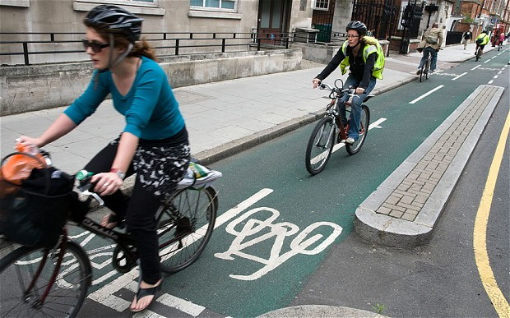
And safety is a fundamental concern which deters certain activities
Personal security is a key consideration which puts many women off running alone, particularly early mornings and evenings.
Many women would love to cycle more – particularly to ease the dreaded commute and to save time and money – but are put off by accidents and the lack of safe cycle routes
Case study
    Suzanne (late 30s, teacher) used to run regularly and completed the Great North Run in her 20s. But after a bad experience being hassled by ‘white van man’ she now would not consider running outside alone – day or night.
Psychologist Doug Macdonald says: “There is evidence to suggest that female cyclists prefer to cycle in lanes away from motorised traffic. This is likely to be an important factor in encouraging women to cycle. It's consistent with the existing research around risk, which finds that females are generally more risk averse than males.
We could do with more cycling lanes. I could cycle to Forest Hill [for work] but the cycle lane that runs near the Horniman just stops. (Amanda, teacher, Dulwich)
You feel a bit vulnerable in a dimly lit street or if you’re running in a park at 6 in the morning. It is an issue…Women just don’t have the same level of safety as men. (Crisis, non profit)
Daily Telegraph August 2014: Men are three times more likely to cycle than women.
‘Buddy up’ schemes may be worth exploring – e.g. women living / working nearby cycling / running together.
Safe cycling routes to work are likely to be particularly important for women.
Notes:
Café worker Brixton said: “due to some areas (particularly where I currently rent), I would not like to be working out at certain times of the day outside of my home or the gym…The area has a lot of gangs of people who hang around and are quite intimidating, I would feel worried about jogging in certain areas.”
Other ideas from Adam Gold’s (Unbound) research in London:
Buddy up for gym classes (colleagues, next-door neighbours, MeetUp.com) or outdoor sessions such as runs. If I say I’m going for a run on my own after work, will I actually do it? If my next-door neighbour is waiting for me with her running kit on, will I be more likely to in that instance?
Look at how to incentivise women to buy wearable tech which monitors how they’re doing, and can be used for women to see how each other are doing and encourage each other. As well as gear like http://theflipbelt.co.uk/ which makes running with keys or phone easier

Slide 29
Sector highlights

Slide 30
Work pressure and time squeeze can be intense in most sectors
Working women in London across sectors can be time constrained for a range of reasons.
In consultancy, a regular week day commitment felt like an unrealistic aspiration.
But in the non-profit sector and others, pressure can be intense too.
For me it [hockey] was a hobby and at the end of the day I’m getting paid to go to work and I’m not getting paid to play hockey, so you’ve got to draw that line…There was no way I could just walk out of a meeting or just leave work to go to training.
(Futures Company, consultancy)
I started a new job at the beginning of October which was a huge project to deliver. You’re doing about 6 days a week, at least 10 hours a day. You don’t have time to do your laundry to be honest.”
(Crisis, non profit)
I already have one regular extracurricular activity, so I’ve used up my points in terms of the balance with my husband looking after the kids in the evening. (Helen, Department of Health official)
For a teacher, anything during the day would be impossible because of preparing the classes. In theory there’s more flexibility at the end of the day but in reality you’re setting things up for the next day.
(Suzanne, teacher, Dulwich)

Slide 31
Standing jobs can be particularly exhausting
Waitresses and sales assistants say finding the motivation to exercise after a day on their feet can be particularly hard…
…But some do manage it!
I work in a café. I’m standing all day long, so I want to sit down at the end of the day. If I had an office job I would go to the gym straight away.
(Ramona, café worker, London Bridge)

Slide 32
Large employers – public or private sector – are often more likely to offer gym membership
Gym membership or reduced gym subscriptions are often bundled into the salary packages of workers in large private sector organisations.
The public sector – in particular central and local government – also often offers support with fitness and well being services.
Employees of smaller organisations, including in the service sector, may not have such easy access to these benefits.
Case study
    Helen, 35, government official at Department of Health, says that her employer is very supportive of lunch time sessions. There is a leisure and social sports club that people can join for £1 per month and a variety of classes and use of equipment is offered.
London might be more expensive, but if you’re employed by a large organisation they offer discounts for staff and gym membership.
(Helen, Department of Health official)

Slide 33
This Girl Can

Slide 34
This Girl Can was almost universally popular
Case study
Most women had seen the campaign in posters, TV etc. and (almost all) completely love it.
Many first thought it was a Nike campaign.
Many had been inspired to take part in some sport or activity as a result.
A small minority disliked the term ‘girl’.
    Molly (age 10) had heard about the campaign at Girl Guides and gone home to tell her Mum, Amanda, about it. As a result, she was lobbying her Mum to get involved in Saturday morning Park Run together.
I think it’s good because it’s trying to break down the barriers – ‘no matter what size or shape you are you can benefit from exercise’. It sort of normalises it. It’s quite a strong message.
(Amanda, teacher, Dulwich)
It shows older women running. It doesn’t matter your age, you can still do it. It doesn’t matter how good you look.
(Ramona, café worker, London Bridge)
I didn’t feel it was talking to me, because of this ‘girl’ can
(Crisis, non profit)
It’s a bit fluffy and unrealistic but it’s quite nice and rousing and I like the idea of all different shapes and sizes. (Crisis, non profit)
Notes:
At TFC - All love TGC – “it’s a case not just of confidence but celebrating the fact that you are exercising no matter what shape you are. I think that’s quite powerful. Because that’s what stops and inhibits a lot of people. It’s just about having fun and enjoying exercise in the moment because you feel so much better afterwards.”

Slide 35
More opportunities to explore

Slide 36
1. Build exercise into the working day
Case study
Because London lifestyles are so intense and fast-paced, exercise has to be easy and accessible, with opportunities to hand at either end of the working day, so local to work or home.
Bite-sized activities during the working day would appeal to many.
These activities can be at work or near work, but the impact on the length of the working day / time away from partner / kids etc. must be minimal.
    Susie (consultant, Futures Company) is a member of Virgin Active in Ealing but she uses it very rarely because of the time she spends at work and away travelling. There is a Virgin Active near her work in London Bridge but her membership package doesn’t allow her to access other gyms without paying an ‘extortionate’ amount of money.
Where you do sport is relative to the 2 ends of your commute. It’s less to do with accessibility - because there are plenty of options - and it’s more about where you slot it in to either end of your daily commute.
(Futures Company, consultancy)
Gym membership offers should enable women to attend classes / sessions at gyms near work and home.
Lunch time sessions must be ‘bite-sized’ – even 20-30 minutes – to give women time to get changed and to / from work.
A range of activities local to work could appeal – inside and outside.
Notes:
E.g. More London lunch time walks / runs.

Slide 37
2. Work with employers
Many (larger) employers in public and private sectors already offer fitness and exercise opportunities via gym memberships etc.
Many women working in other sectors would welcome an employer led offer to subsidise and / or support activity close to work.
An offer from employers to give you a discount at the gym…that would be brilliant. (Crisis, non profit)
If there was a way of working with employers – stressing the importance of physical activity and tailoring it to them [women].
(Helen, Department of Health official)
Work with employers to help communicate messages about the benefits of exercise and physical activity to all women.
Could (smaller) employers join a community group scheme to offer local exercise discounts and incentives to their employees?
Notes:
Liz Walking, TFC HR Director, would support this if involving a range of employers and didn’t seem like TFC had to arrange it entirely themselves (= time and money) and / or be seen to be imposing it on employees.
Other ideas from Adam Gold’s (Unbound) research in London:
Employer flexibility start time to allow parents to deliver kids to childcare and then cycle/run to work
Somewhere to safely store bike at work
Somewhere to shower (either in office or subsidised gym membership). If shower at work, ensure sufficient mirror facilities and shared good quality, high-powered hairdryer so getting ready is a comfortable experience
A buddy system of colleagues having run-commute or cycle-commute in common, using apps like Strava or MyFitnessPal to log each other’s action and speed
Colleagues who start cycling or running to work regularly sign up for a running or cycling event (10k run etc), which gives them a goal to aim for and gives them something to discuss as part of office culture
Staff benefits for packages of gear, bike, helmet, high vis clothing, cycling outfit, running trainers to come out of salary at subsidised rate (with the likes of http://www.wiggle.co.uk/)
Content on how to organise lunchtime run in the park with colleagues
Listings of classes in your area, e.g. Zumba, spinning, yoga, t’ai chi, and encourage women to invite 1-2 other women from office to attend so they bond over it, as well as getting fit
Employer’s to allow flexibility of lunch hour. Allowing for time it takes to get to class, get changed, take part, shower and get ready, and get back to work. This is especially important for women who want to take time to do their hair and make-up
Employers to encourage movement such as walking meetings (round the block), and hourly screen breaks
Employers to encourage mid-morning break to buy lunch, so that the lunch break filled with exercise is not over-extended by shopping for lunch

Slide 38
3. Use London’s green spaces
Londoners, new and old, love London’s green space and want to take advantage of it to enjoy activities including sport outdoors.
Many women said they would love to join in community based (either work or home) informal sports in the local parks – e.g. walks, running, team sports, bike rides etc.
As well as being able to take part with friends and family, they also saw this as an opportunity to meet people and to become more integrated in their communities.
Case study
    Rose (shop assistant, Bloomsbury), was excited to see the tennis courts in her local park being renovated, but was disappointed that there was no event to mark their re-opening. She observes that the courts are often unused. She’d love to play but knows no one locally to play with.
Getting involved in something has to have some other kind of benefit. I’ve just moved into a new neighbourhood and started doing some community related stuff. If there was a way for me to meet other people in the park around the corner, something that was community and affordable, it would offer the benefit of meeting more people and fit in to my routine. In fact I’m going to go and start that! (Futures Company, consultancy)
If there was a park round here where you could just whack a ball or play a bit of netball, then you could just join in for 20 minutes.
(Crisis, non profit)
Could public and private providers take advantage of the warmer months to design and promote park based, day time, evening and weekend activities to suit different abilities?
Activities need to be advertised locally, including on public transport, with employers also engaged in the promotion.
Notes:
People move in and out of neighbourhoods fast in London so it’s easy to feel disconnected.
People liked the idea of sport as a way to help them to feel more integrated.
Other ideas from Adam Gold’s (Unbound) research in London:
Opportunity for Barry’s Bootcamp, British Military Fitness, personal trainers etc to run lunchtime sessions in parks around London (using MeetUp.com or EventBrite for users to pay in advance). If it’s more of a strength/circuit session that women want (especially those who do their aerobic workout during their commute)
Taking part in events (local 10k runs etc) or Parkrun, with friends as an organised activity that's fun as well as gets you fit. Build up frequency from a couple a year to maybe one a month (budget depending)

Slide 39
4. More family friendly activities
Some Mums we spoke to were conscious of the importance of embedding good sporting habits in their kids from a young age.
They were highly motivated to find opportunities for their kids to be active – even if they themselves were not.
More family friendly activities could encourage more Mums to take part with their children.
Consider more family friendly membership or activity offers – e.g. kids go free with 2 or more adults?
Offer access to sports sessions for mums while they wait for their children taking part in after school sports.
Take advantage of London’s green space to promote family activities.
Communicate messages about the importance of Mums acting as positive role models to their daughters.
Notes:
Role modelling of mothers to daughters can be particularly important.

Slide 40
In conclusion, final words to London Sport…

Slide 41
Carry on with TGC – keep up the imagery of normal women doing sport at different levels so that all the images we have are not just elite athletes. Represent someone who is juggling so that people think ‘maybe I can fit it in’. Just show people someone they can relate to.
(Suzanne, teacher, Dulwich)
I think information is quite a key thing. Making it much more transparent and accessible. Maybe just bringing it to the front of people’s mind. TGC is a very effective way of delivering a message so maybe just making it clear where you can go to do those things – running, cycling, swimming, horse riding. Maybe with a number where you can get information on different groups. I think it’s just getting people to realise how important it is and how easy it can be.
(Amanda, teacher, Dulwich)
More activities like Park Run – informal, friendly, low commitment, encouraging. Make better use of the green spaces of London in the Summer. There are so many little bits of green space around that could be re-engaged as community hubs. (Crisis, non profit)
Bridge the gap, address the disconnect that people feel with sport. Get in front of us and make it hard to say no.
(Futures Company, Consultancy)

Slide 42
Appendices
Alex Oliver
+ 44 (0) 7768 032 088
@alexoliverboo
www.oliverboo.com

Slide 43
Desk research sources
Source | Document
Sport England | Women’s Campaign Insight Pack, 2014
Sport England | Women & Girls Sport - Deliver What Your Audience Want (presentation by Lisa O’Keefe)
Sport England | Active People Survey data to October 2014
FCB Inferno | Sport England Qual Research Debrief for This Girl Can, August 2014
Women in Sport | Summary of Understanding Women’s Lives in 2013 and the role of sport and physical activity
Bury Council | Proposition Testing, August 2013
Sport England | Women’s Participation Golden Rules Insight Pack
Sport England | Project Temple Insight Summary, May 2013

Slide 44
Acknowledgements
A very big thank you to…
Sport England for their permission for us to use desk research materials sourced for their work on ‘Go Where Women Are’
Adam Gold for contributing ideas and insights from interviews with women in London for the development of the Unbound website - http://unboundlife.com
The Futures Company and Crisis for organising focus groups in their respective offices and to the women there for giving up their time to talk to us.

Slide 45
Alex Oliver
+ 44 (0) 7768 032 088
@alexoliverboo
www.oliverboo.com

