Slide 1
Patterns and trends in adult physical activity
A presentation of the latest data on adult physical activity levels
Notes:
These PowerPoint slides present key data and information on adult physical activity in clear, easy to understand charts and graphics. These can be used freely with acknowledgement to Public Health England. These slide sets are supported by PHE physical activity factsheets which provide more detailed summaries of the data (www.noo.org.uk/NOO_pub/Key_data)

Slide 2
Adult physical activity levels Health Survey for England 2012 (base aged 16 and over)
Two thirds of men meet national physical activity recommendations* (67%)
Around half of women meet national physical activity recommendations* (55%)
*150 minutes of moderate intensity physical activity per week
Notes:
Data from the Health Survey for England report, 2012, published by the Health and Social Care Information Centre www.hscic.gov.uk/catalogue/PUB13218
The Chief Medical Officer’s report (2011) recommends that adults aged 19-64 years undertake 150 minutes of moderate intensity physical activity per week in bouts of 10 minutes or more www.gov.uk/government/uploads/system/uploads/attachment_data/file/213740/dh_128145.pdf

Slide 3
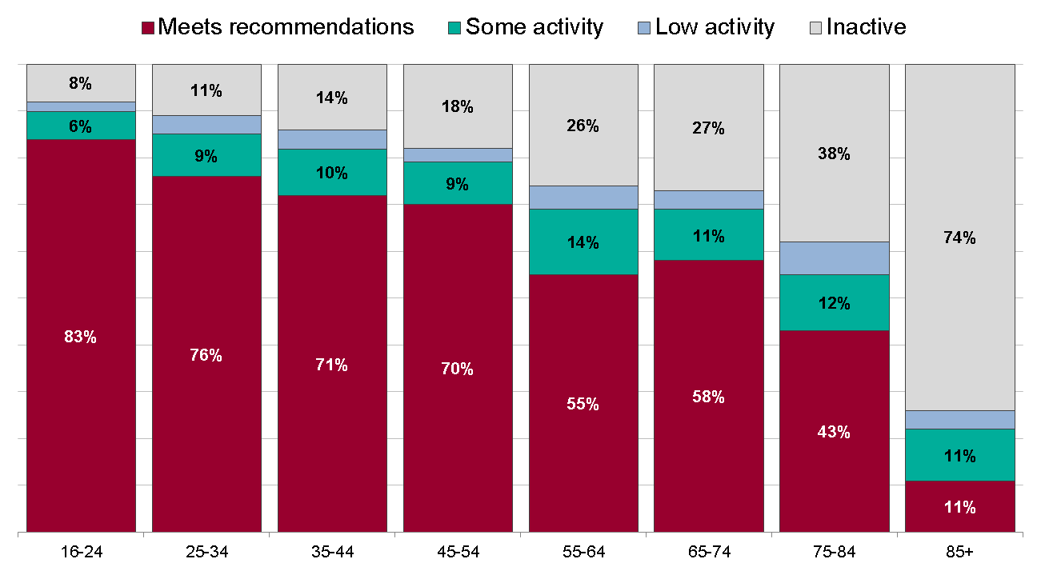
Adult physical activity levels by age Health Survey for England 2012 (base aged 16 and over)
Men
Meets recommendations: 150 minutes of MVPA per week Some activity: 60-149 minutes of MVPA per week
Low activity: 30-59 minutes of MVPA per week Inactive: less than 30 minutes of MVPA per week
MVPA is calculated as minutes of moderate intensity activity or double the minutes of vigorous intensity activity
Notes:
Meets recommendations
A minimum of 150 minutes of moderate intensity physical activity (MPA) per week, or 75 minutes of vigorous intensity physical activity (VPA) per week or an equivalent combination of the two
Some activity
60-149 minutes per week of MPA, 30-74 minutes per week of VPA, or an equivalent combination of these
Low activity
30-59 minutes per week of MPA, 15-29 minutes per week of VPA, or an equivalent combination of these
Inactive
Less than 30 minutes per week of MPA, less than 15 minutes per week of VPA, or a combination of these
The proportion of men meeting the recommendations declines steeply with age from 16–24 through to 85 years and over. Among women, the highest proportion meeting recommendations are aged 35–44 years.
Data from the Health Survey for England report, 2012, published by the Health and Social Care Information Centre www.hscic.gov.uk/catalogue/PUB13218
The Chief Medical Officer’s report (2011) recommends that adults aged 19-64 years undertake 150 minutes of moderate intensity physical activity per week in bouts of 10 minutes or more www.gov.uk/government/uploads/system/uploads/attachment_data/file/213740/dh_128145.pdf

Slide 4
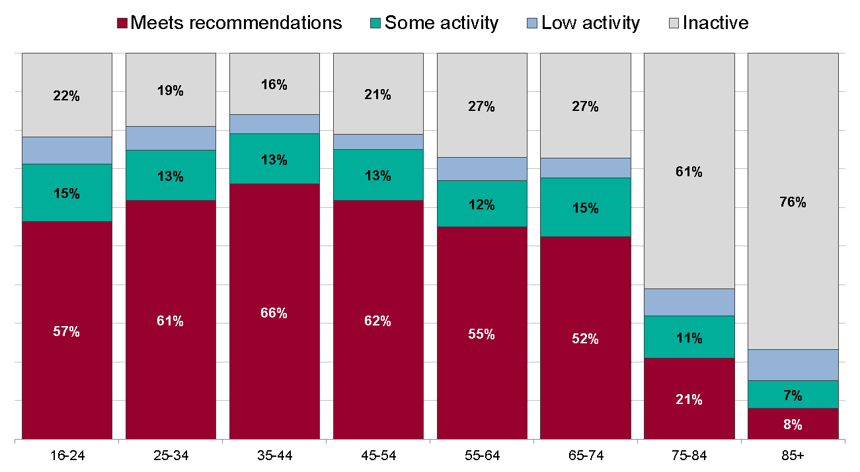
Adult physical activity levels by age Health Survey for England 2012 (base aged 16 and over)
Women
Meets recommendations: 150 minutes of MVPA per week Some activity: 60-149 minutes of MVPA per week
Low activity: 30-59 minutes of MVPA per week Inactive: less than 30 minutes of MVPA per week
MVPA is calculated as minutes of moderate intensity activity or double the minutes of vigorous intensity activity
Notes:
Meets recommendations
A minimum of 150 minutes of moderate intensity physical activity (MPA) per week, or 75 minutes of vigorous intensity physical activity (VPA) per week or an equivalent combination of the two
Some activity
60-149 minutes per week of MPA, 30-74 minutes per week of VPA, or an equivalent combination of these
Low activity
30-59 minutes per week of MPA, 15-29 minutes per week of VPA, or an equivalent combination of these
Inactive
Less than 30 minutes per week of MPA, less than 15 minutes per week of VPA, or a combination of these
The proportion of men meeting the recommendations declines steeply with age from 16–24 through to 85 years and over. Among women, the highest proportion meeting recommendations are aged 35–44 years.
Data from the Health Survey for England report, 2012, published by the Health and Social Care Information Centre www.hscic.gov.uk/catalogue/PUB13218
The Chief Medical Officer’s report (2011) recommends that adults aged 19-64 years undertake 150 minutes of moderate intensity physical activity per week in bouts of 10 minutes or more www.gov.uk/government/uploads/system/uploads/attachment_data/file/213740/dh_128145.pdf

Slide 5
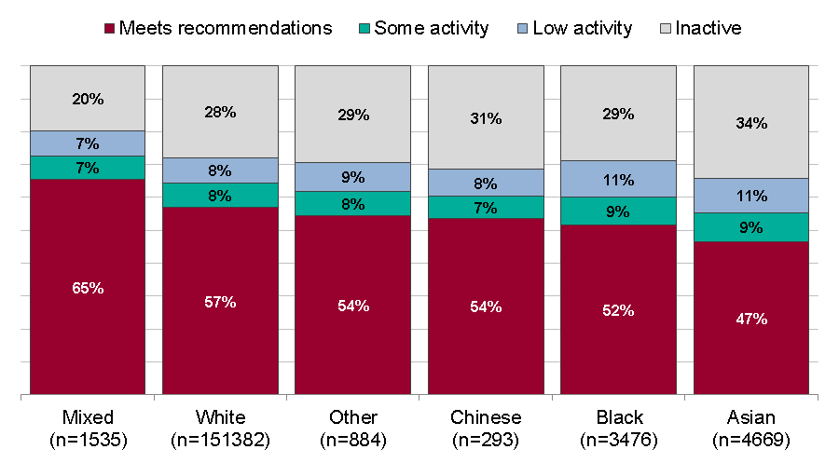
Adult physical activity levels by ethnicity Active People Survey Jan 2013 - Jan 2014 (base aged 16 and over)
Meets recommendations: 150 minutes of MVPA per week Some activity: 90-149 minutes of MVPA per week
Low activity: 30-89 minutes of MVPA per week Inactive: less than 30 minutes of MVPA per week
MVPA is calculated as minutes of moderate intensity activity or double the minutes of vigorous intensity activity
Notes:
Meets recommendations
A minimum of 150 minutes of moderate intensity physical activity (MPA) per week, or 75 minutes of vigorous intensity physical activity (VPA) per week or an equivalent combination of the two
Some activity
90-149 minutes per week of MPA, 45-74 minutes per week of VPA, or an equivalent combination of these
Low activity
30-89 minutes per week of MPA, 15-44 minutes per week of VPA, or an equivalent combination of these
Inactive
Less than 30 minutes per week of MPA, less than 15 minutes per week of VPA, or a combination of these
Respondents of mixed ethnicity had the highest proportion meeting the recommended levels and Asian respondents had the lowest. These figures are not age standardised, so some of the differences between ethnic groups may be due to differences in the age structure.
Data from the Active People Survey (7/8) mid January 2013 – mid January 2014. A known ethnicity was recorded for 97% of respondents.

Slide 6
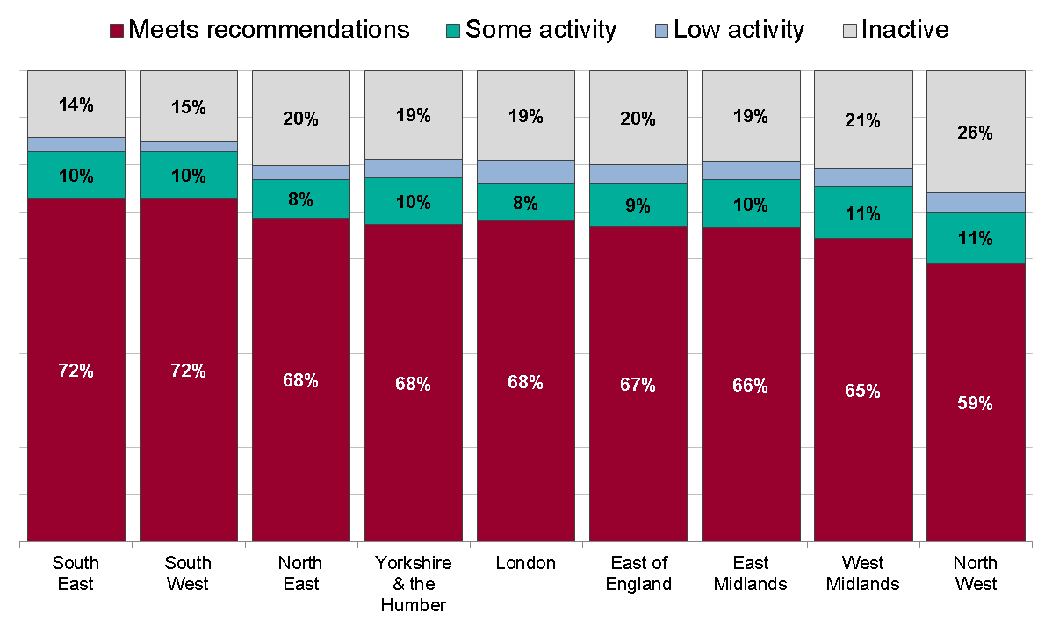
Adult physical activity levels by region Health Survey for England 2012 (base aged 16 and over)
Men
Meets recommendations: 150 minutes of MVPA per week Some activity: 60-149 minutes of MVPA per week
Low activity: 30-59 minutes of MVPA per week Inactive: less than 30 minutes of MVPA per week
MVPA is calculated as minutes of moderate intensity activity or double the minutes of vigorous intensity activity
Notes:
Meets recommendations
A minimum of 150 minutes of moderate intensity physical activity (MPA) per week, or 75 minutes of vigorous intensity physical activity (VPA) per week or an equivalent combination of the two
Some activity
60-149 minutes per week of MPA, 30-74 minutes per week of VPA, or an equivalent combination of these
Low activity
30-59 minutes per week of MPA, 15-29 minutes per week of VPA, or an equivalent combination of these
Inactive
Less than 30 minutes per week of MPA, less than 15 minutes per week of VPA, or a combination of these
South East England has the highest percentage of both men and women meeting recommended levels of physical activity, while North West England had the lowest percentages. In all regions levels of inactivity are higher among women than men.
Data from the Health Survey for England report, 2012, published by the Health and Social Care Information Centre www.hscic.gov.uk/catalogue/PUB13218
The Chief Medical Officer’s report (2011) recommends that adults aged 19-64 years undertake 150 minutes of moderate intensity physical activity per week in bouts of 10 minutes or more www.gov.uk/government/uploads/system/uploads/attachment_data/file/213740/dh_128145.pdf

Slide 7
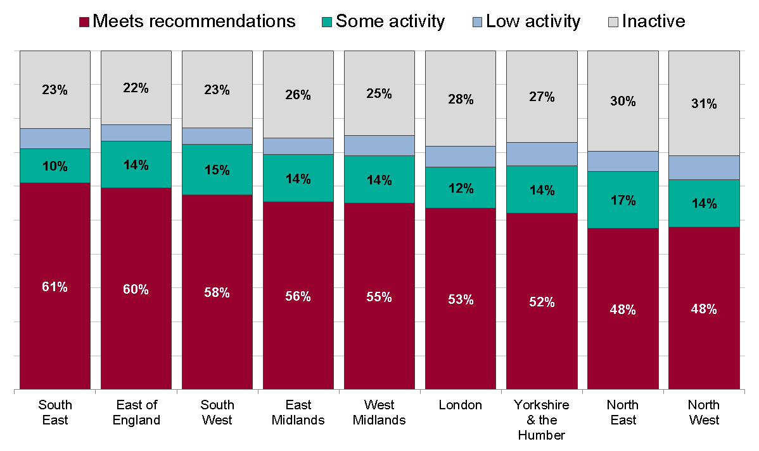
Adult physical activity levels by region Health Survey for England 2012 (base aged 16 and over)
Women
Meets recommendations: 150 minutes of MVPA per week Some activity: 60-149 minutes of MVPA per week
Low activity: 30-59 minutes of MVPA per week Inactive: less than 30 minutes of MVPA per week
MVPA is calculated as minutes of moderate intensity activity or double the minutes of vigorous intensity activity
Notes:
Meets recommendations
A minimum of 150 minutes of moderate intensity physical activity (MPA) per week, or 75 minutes of vigorous intensity physical activity (VPA) per week or an equivalent combination of the two
Some activity
60-149 minutes per week of MPA, 30-74 minutes per week of VPA, or an equivalent combination of these
Low activity
30-59 minutes per week of MPA, 15-29 minutes per week of VPA, or an equivalent combination of these
Inactive
Less than 30 minutes per week of MPA, less than 15 minutes per week of VPA, or a combination of these
South East England has the highest percentage of both men and women meeting recommended levels of physical activity, while North West England had the lowest percentages. In all regions levels of inactivity are higher among women than men.
Data from the Health Survey for England report, 2012, published by the Health and Social Care Information Centre www.hscic.gov.uk/catalogue/PUB13218
The Chief Medical Officer’s report (2011) recommends that adults aged 19-64 years undertake 150 minutes of moderate intensity physical activity per week in bouts of 10 minutes or more www.gov.uk/government/uploads/system/uploads/attachment_data/file/213740/dh_128145.pdf

Slide 8
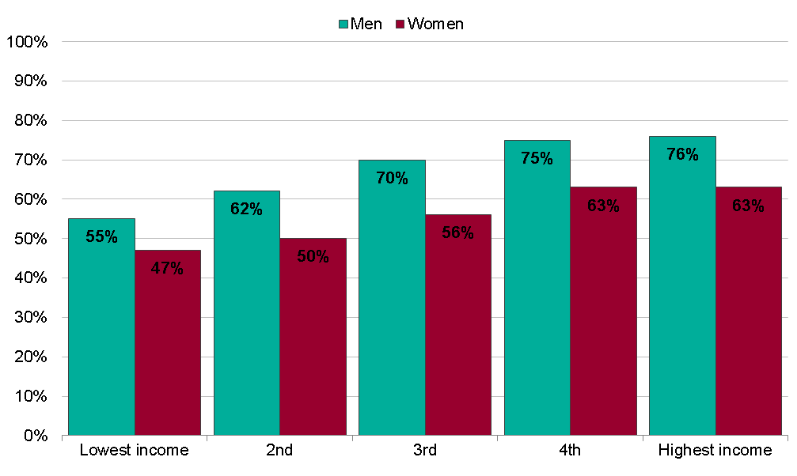
Adults meeting recommended physical activity levels* by equivalisedª household income and sex Health Survey for England 2012, (base aged 16 and over)
ª Equivalised household income is a measure that takes account of the number of people in the household. For this analysis, households were split into five equal-sized groups banded by income level (income quintiles). Physical activity levels were compared between these groups.
*150 minutes of moderate intensity physical activity per week
Notes:
There is a clear trend with the highest proportion meeting the recommendations in the highest income group, and the lowest in the lowest income group. Men in all income groups were more likely than women to meet the 150 minutes per week recommendation.
Data from the Health Survey for England report, 2012, published by the Health and Social Care Information Centre www.hscic.gov.uk/catalogue/PUB13218
The Chief Medical Officer’s report (2011) recommends that adults aged 19-64 years undertake 150 minutes of moderate intensity physical activity per week in bouts of 10 minutes or more www.gov.uk/government/uploads/system/uploads/attachment_data/file/213740/dh_128145.pdf

Slide 9
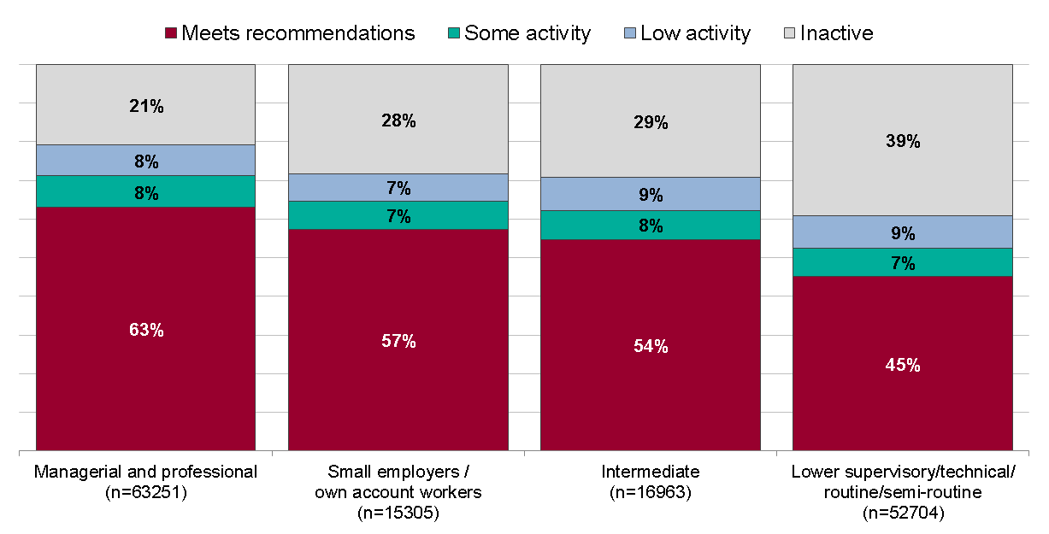
Adult physical activity levels by social class Active People Survey Jan 2013 - Jan 2014 (base aged 16 and over)
Meets recommendations: 150 minutes of MVPA per week Some activity: 90-149 minutes of MVPA per week
Low activity: 30-89 minutes of MVPA per week Inactive: less than 30 minutes of MVPA per week
MVPA is calculated as minutes of moderate intensity activity or double the minutes of vigorous intensity activity
Notes:
Meets recommendations
A minimum of 150 minutes of moderate intensity physical activity (MPA) per week, or 75 minutes of vigorous intensity physical activity (VPA) per week or an equivalent combination of the two
Some activity
90-149 minutes per week of MPA, 45-74 minutes per week of VPA, or an equivalent combination of these
Low activity
30-89 minutes per week of MPA, 15-44 minutes per week of VPA, or an equivalent combination of these
Inactive
Less than 30 minutes per week of MPA, less than 15 minutes per week of VPA, or a combination of these
Social class is a classification of occupational groups based on skill levels, ranging from ‘professional’ to ‘lower supervisory/technical/ routine /semi-routine/never- worked /long-term unemployed’. There is a general trend of a decreasing percentage of people being physically active with decreasing occupational skill level, from professional occupations to unskilled manual occupations.
Data from the Active People Survey (7/8) mid January 2013 – mid January 2014.

Slide 10
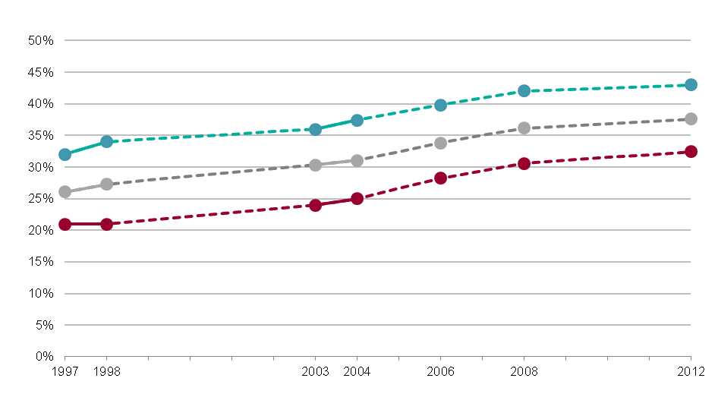
Trend in adults undertaking 30 mins of moderate intensity activity 5 times per week Health Survey for England 2012 (base aged 16 and over)
Data collected only for the years presented
Notes:
Previous adult physical activity recommendations were: 30 minutes of moderate activity, five times per week. In order to look at trends of physical activity, the latest data from the HSE has also been analysed using the previous recommended levels.
Percentages of men and women meeting physical activity recommendations has risen steadily between 1997 and 2012.
Data from the Health Survey for England report, 2012, published by the Health and Social Care Information Centre www.hscic.gov.uk/catalogue/PUB13218
The Chief Medical Officer’s report (2011) recommends that adults aged 19-64 years undertake 150 minutes of moderate intensity physical activity per week in bouts of 10 minutes or more www.gov.uk/government/uploads/system/uploads/attachment_data/file/213740/dh_128145.pdf

Slide 11
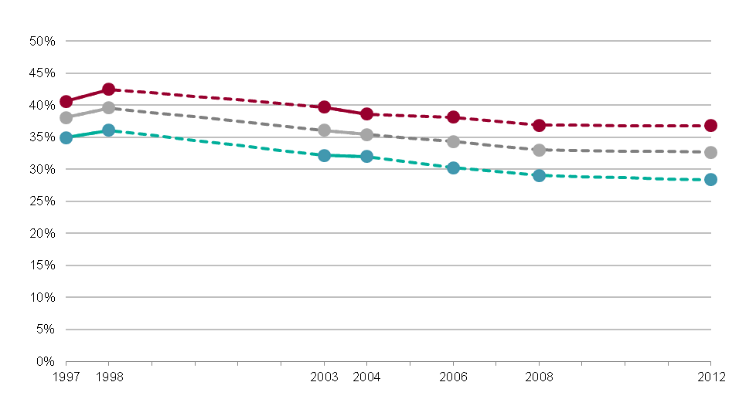
Trend in adults with low levels of physical activity* Health Survey for England 2012, (base aged 16 and over)
Data collected only for the years presented
*less than 30 minutes of moderate intensity physical activity 1-4 times per week
Notes:
Previous physical activity categories classified low activity as less than 30 minutes of moderate intensity activity, between one and four times per week. In order to look at trends of physical activity, the latest data from the HSE has also been analysed using the previous recommended levels.
Percentages of men and women meeting classified in the low activity group has declined between 1997 and 2012.
Data from the Health Survey for England report, 2012, published by the Health and Social Care Information Centre www.hscic.gov.uk/catalogue/PUB13218
The Chief Medical Officer’s report (2011) recommends that adults aged 19-64 years undertake 150 minutes of moderate intensity physical activity per week in bouts of 10 minutes or more www.gov.uk/government/uploads/system/uploads/attachment_data/file/213740/dh_128145.pdf

Slide 12
Trend in adults participating in sport and active recreation* by sex Active People survey, (base aged 16 and over)
*at least 30 minutes participation in sport and active recreation at moderate intensity per week
Notes:
In all years, a higher proportion of men than women were reported to be participating in at least 30 minutes of moderate intensity activity per week. Rates of participation have been stable since 2005.
The percentage of adults that participate in one session of sport and active recreation (at least 30 minutes) per week from each of the APS surveys conducted between 2005 and 2013. This measure is used for trend data (rather than participation in physical activity at recommended levels) as the physical activity measures are only available from 2012.
Data from the Active People Survey mid January 2013 – mid January 2014.

Slide 13
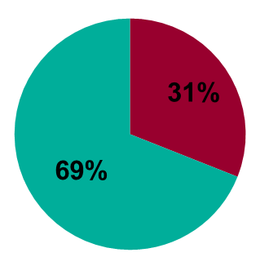
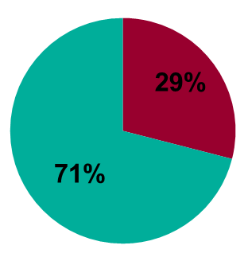
Time spent being sedentary in leisure time, by sex Health Survey for England 2012 (base aged 16 and over)
Weekdays
Weekends
Men
Women
Notes:
Sedentary behaviour is defined as any activity spent primarily sitting or lying down, which involves expenditure of less than 1.5 metabolic
equivalents (METs). 31% of men and 29% of women spend at least six hours being sedentary on weekdays. This increased to 40% for men and 35% for women at weekends.
Data from the Health Survey for England report, 2012, published by the Health and Social Care Information Centre www.hscic.gov.uk/catalogue/PUB13218. Questions designed to find out how much leisure time, on average, people spend watching television and on other sedentary activities such as reading, eating, studying, drawing, using a computer or playing video games.
The Chief Medical Officer’s report (2011) recommends that adults aged 19-64 years should minimise the amount of time spent sedentary www.gov.uk/government/uploads/system/uploads/attachment_data/file/213740/dh_128145.pdf

Slide 14
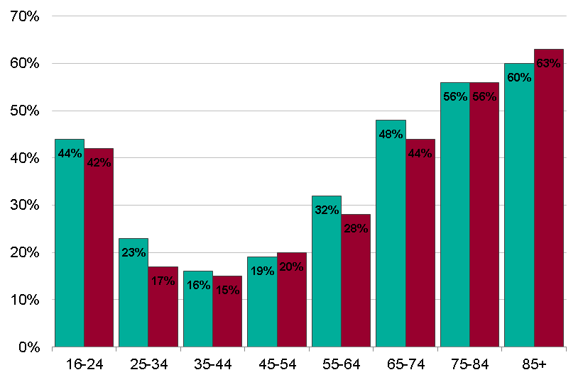
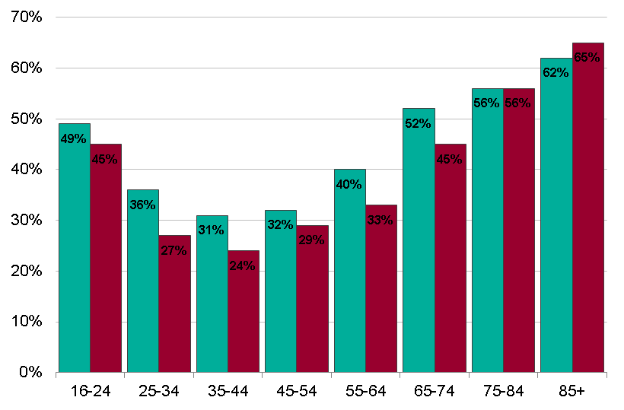
Time spent sedentary in leisure time by age and sex Health Survey for England 2012 (base aged 16 and over)
Proportion of adults who spend six hours or more being sedentary per day
Weekdays
Weekends
Notes:
Sedentary behaviour is defined as any activity spent primarily sitting or lying down, which involves expenditure of less than 1.5 metabolic
equivalents (METs). People aged 25-64 years are less likely than those under 25 or over 65 years to spend 6 hours or more per day being sedentary. The pattern is very similar for men and women during the week, but men of most ages are slightly more likely to be sedentary at the weekend.
Data from the Health Survey for England report, 2012, published by the Health and Social Care Information Centre www.hscic.gov.uk/catalogue/PUB13218. Questions designed to find out how much leisure time, on average, people spend watching television and on other sedentary activities such as reading, eating, studying, drawing, using a computer or playing video games.
The Chief Medical Officer’s report (2011) recommends that adults aged 19-64 years should minimise the amount of time spent being sedentary www.gov.uk/government/uploads/system/uploads/attachment_data/file/213740/dh_128145.pdf

Slide 15
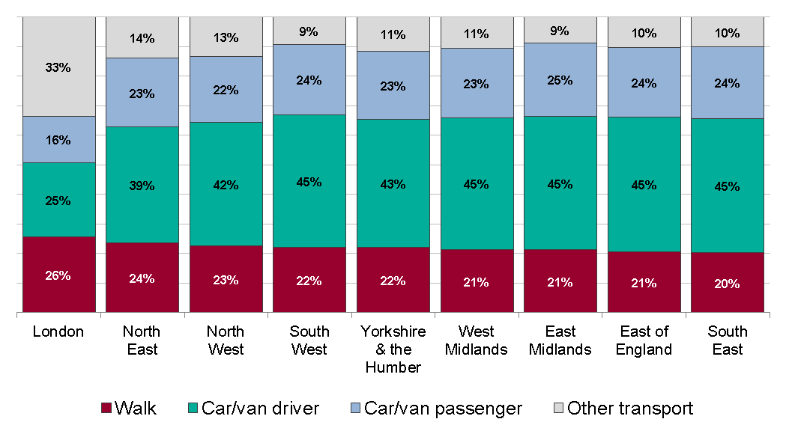
Average trips by mode of transport by region National Travel Survey 2012/13
Notes:
The majority of trips (39%-45%) were made by car or van drivers, with the exception of London, where a third of people used other transport, including buses, bicycles, motorcycles, London Underground, surface rail and taxis or minicabs.
Data from the National Travel Survey 2013 www.gov.uk/government/statistics/national-travel-survey-2013

Slide 16
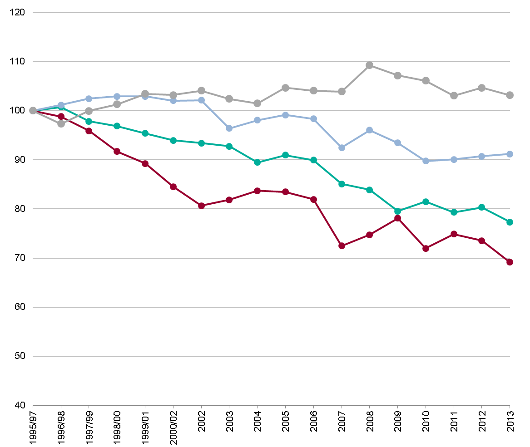
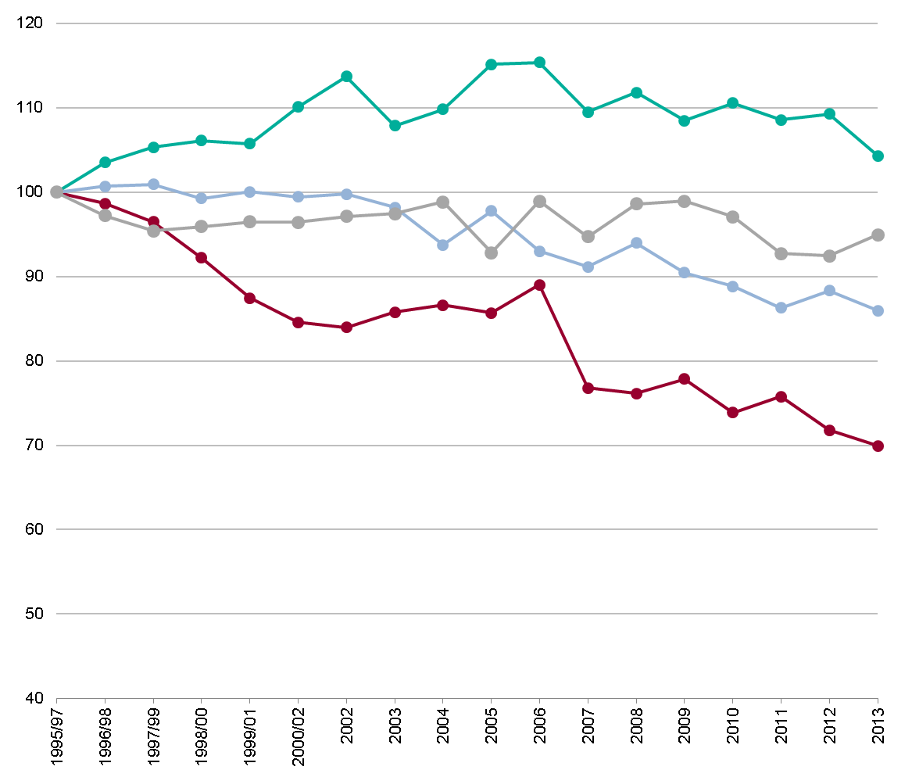
Trend in average trips by mode of transport, by sex National Travel Survey, England 1995/97- 2013
Men
Women
Index 1995/97 = 100
Notes:
Trends since 1995 have shown a decrease in the average number of walking trips for both men and women. Men have also seen a decrease in the average number of trips by car or van as drivers and passengers and an increase in the use of other transport. Women have seen an increase in the average number of trips made as car or van drivers, but a decrease in the average number of trips made as passengers and by other modes of transport.
Data from the National Travel Survey 2013 www.gov.uk/government/statistics/national-travel-survey-2013

Slide 17
Adult physical activity factsheet
www.noo.org.uk
Notes:
These slide sets are supported by PHE physical activity factsheets which provide more detailed summaries of the data (www.noo.org.uk/NOO_pub/Key_data)

Slide 18
Other useful PHE physical activity resources
Everybody active, every day: an evidence-based approach to physical activity
Everybody active, every day: what works, the evidence
Obesity and the environment: increasing physical activity and active travel
Active travel briefings for local authorities
Standard evaluation framework for physical activity interventions
Guide to physical activity data sources
Guide to online tools for valuing physical activity, sport and obesity programmes
E-learning modules on physical activity and health
Change4Life campaign resources
PHE obesity website - www.noo.org.uk
Notes:
Everybody active, every day: an evidence-based approach to physical activity www.gov.uk
www.gov.uk/government/publications/everybody-active-every-day-a-framework-to-embed-physical-activity-into-daily-life
Everybody active, every day: what works, the evidence
Obesity and the environment: increasing physical activity and active travel
www.gov.uk/government/publications/obesity-and-the-environment-briefing-increasing-physical-activity-and-active-travel
Active travel briefings for local authorities
www.noo.org.uk/slide_sets/activity
Standard evaluation framework for physical activity interventions
http://www.noo.org.uk/core/frameworks/SEF_PA
Guide to physical activity data sources
http://www.noo.org.uk/data_sources/physical_activity
Guide to online tools for valuing physical activity, sport and obesity programmes
http://www.noo.org.uk/securefiles/150629_1236//online_tools_briefing_13011_%20FINAL.PDF
E-learning modules on physical activity and health
http://learning.bmj.com/learning/course-intro/physical-activity.html?courseId=10051913
Change4Life campaign resources
http://www.nhs.uk/change4life/pages/resource-casestudy.aspx
PHE Obesity website
www.noo.org.uk

Slide 19
for more information:
www.noo.org.uk
info@noo.org.uk follow us on twitter @PHE_obesity
PHE Publications gateway number: 2015143
Patterns and trends in adult physical activity

