Slide 1
Patterns and trends in
child physical activity
A presentation of the latest data on child physical activity
Notes:
These PowerPoint slides present key data and information on child physical activity in clear, easy to understand charts and graphics. These can be used freely with acknowledgement to Public Health England. These slide sets are supported by PHE physical activity factsheets which provide more detailed summaries of the data (www.noo.org.uk/NOO_pub/Key_data)

Slide 2




Physical activity among children
Health Survey for England 2012
Around two in ten children aged 5-15 years meet the government recommendations* for physical activity (boys 21%, girls 16%)
*Child recommendations for physical activity in CMO report 2011 – one hour moderate activity per day
HSE reports at least 60 minutes of moderate to vigorous activity on all seven days in the last week
Notes:
Data from the Health Survey for England report, 2012, published by the Health and Social Care Information Centre www.hscic.gov.uk/catalogue/PUB13218/HSE2012-Ch3-Phys-act-child.pdf
The Chief Medical Officer’s report (2011) recommends that children aged 5-15 years should engage in at least 60 minutes and up to several hours physical activity per day www.gov.uk/government/uploads/system/uploads/attachment_data/file/213739/dh_128144.pdf

Slide 3
Physical inactivity among children
Health Survey for England 2012
Around four in ten children aged 5-15 years are physically inactive*
(boys 39%, girls 45%)
*Fewer than 30 minutes of moderate to vigorous activity on each day
or 60 minutes or more on fewer than seven days in the last week
Notes:
Data from the Health Survey for England report, 2012, published by the Health and Social Care Information Centre www.hscic.gov.uk/catalogue/PUB13218/HSE2012-Ch3-Phys-act-child.pdf

Slide 4
Physical activity among young children
Health Survey for England 2012
Around one in ten children aged 2-4 years meet the government recommendation* for physical activity (boys 9%, girls 10%)
*At least 180 minutes (3 hours) of physical activity on all seven days in the last week
Notes:
Data from the Health Survey for England report, 2012, published by the Health and Social Care Information Centre www.hscic.gov.uk/catalogue/PUB13218/HSE2012-Ch3-Phys-act-child.pdf
The Chief Medical Officer’s report (2011) recommends that children aged 2 -4 years should engage in at least 180 minutes activity spread throughout the day www.gov.uk/government/uploads/system/uploads/attachment_data/file/213738/dh_128143.pdf

Slide 5
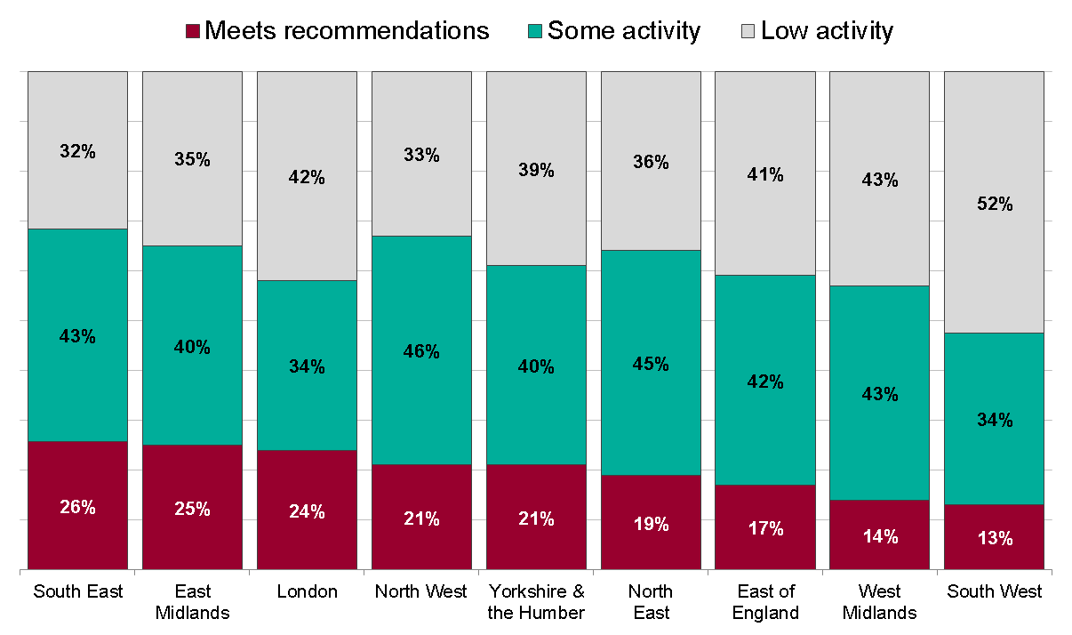
Physical activity by region
Health Survey for England 2012, boys aged 5-15 years
Low activity: <30 minutes of MVPA on each day, or MVPA of 60+ minutes on less than seven days in the last week
Some activity: 30-59 minutes of MVPA on all seven days in the last week
Meets recommendations: At least 60 minutes of moderate to vigorous (MVPA) on all seven days in the last week
MVPA = moderate to vigorous intensity physical activity
Notes:
There is variation in physical activity levels across the country, and percentages meeting recommendations in regions differ between boys and girls.
Data from the Health Survey for England report, 2012, published by the Health and Social Care Information Centre www.hscic.gov.uk/catalogue/PUB13218/HSE2012-Ch3-Phys-act-child.pdf
Regions are ranked from highest to lowest by percentage of children meeting the physical activity recommendations.

Slide 6
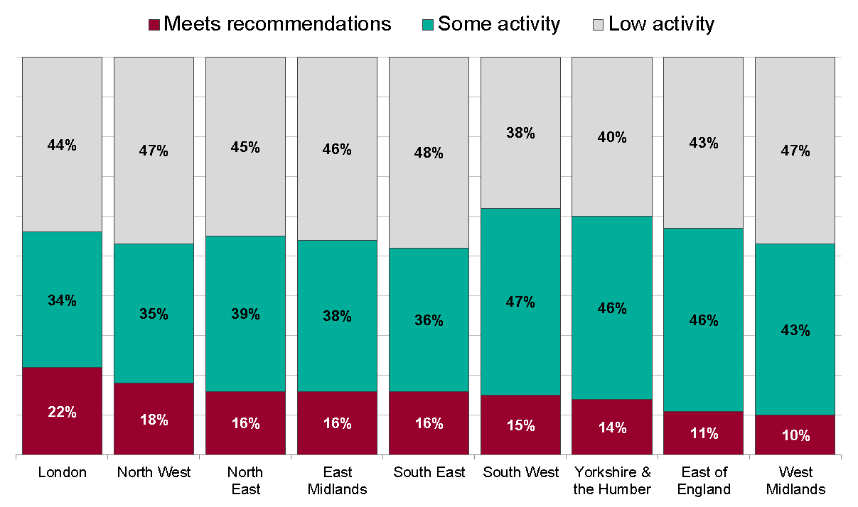
Physical activity by region
Health Survey for England 2012, girls aged 5-15 years
Low activity: <30 minutes of MVPA on each day, or MVPA of 60+ minutes on less than seven days in the last week
Some activity: 30-59 minutes of MVPA on all seven days in the last week
Meets recommendations: At least 60 minutes of moderate to vigorous (MVPA) on all seven days in the last week
MVPA = moderate to vigorous intensity physical activity
Notes:
There is variation in physical activity levels across the country, and percentages meeting recommendations in regions differ between boys and girls.
Data from the Health Survey for England report, 2012, published by the Health and Social Care Information Centre www.hscic.gov.uk/catalogue/PUB13218/HSE2012-Ch3-Phys-act-child.pdf
Regions are ranked from highest to lowest by percentage of children meeting the physical activity recommendations.

Slide 7
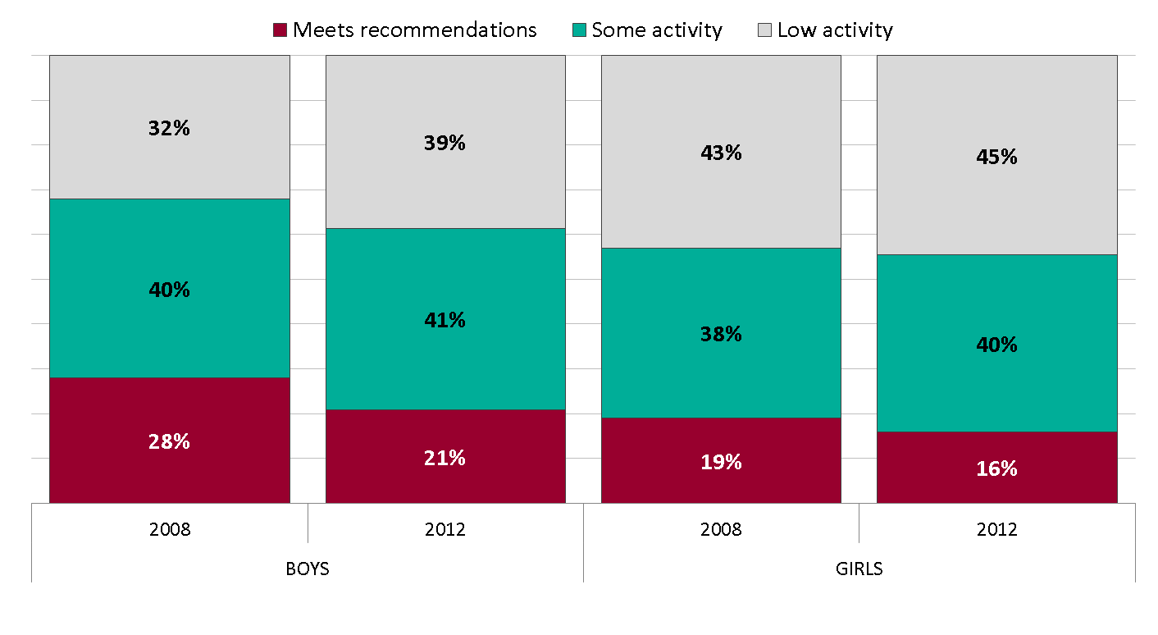
Trends in physical activity
Children aged 2-15years; Health Survey for England 2008-2012
Low activity: <30 minutes of MVPA on each day, or MVPA of 60+ minutes on less than seven days in the last week
Some activity: 30-59 minutes of MVPA on all seven days in the last week
Meets recommendations: At least 60 minutes of moderate to vigorous (MVPA) on all seven days in the last week
MVPA = moderate to vigorous intensity physical activity
Notes:
Levels of physical activity dropped between 2008 and 2012 for both boys and girls.
Data from the Health Survey for England report, 2012, published by the Health and Social Care Information Centre www.hscic.gov.uk/catalogue/PUB13218/HSE2012-Ch3-Phys-act-child.pdf

Slide 8
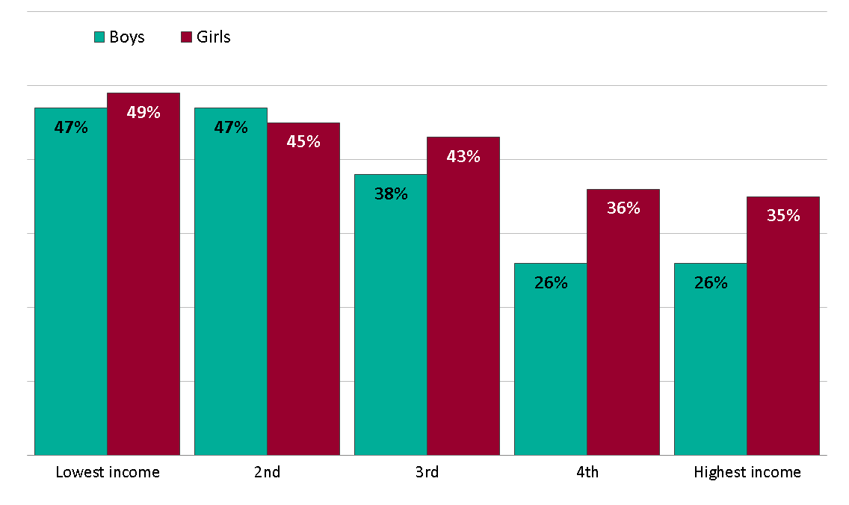
Physical inactivity by household income^{ª}
Children aged 2-15years; Health Survey for England 2012
ª Equivalised household income is a measure that takes account of the number of people in the household. For this analysis, households were split into five equal-sized groups banded by income level (income quintiles). Physical activity levels were compared between these groups
Notes:
Low levels of physical activity are related to household income. More boys and girls in the lowest income households were classified in the low activity group than in the highest income households. However, the proportions of children meeting the recommended guidelines did not show a clear trend relating to household income.
Data from the Health Survey for England report, 2012, published by the Health and Social Care Information Centre www.hscic.gov.uk/catalogue/PUB13218/HSE2012-Ch3-Phys-act-child.pdf

Slide 9
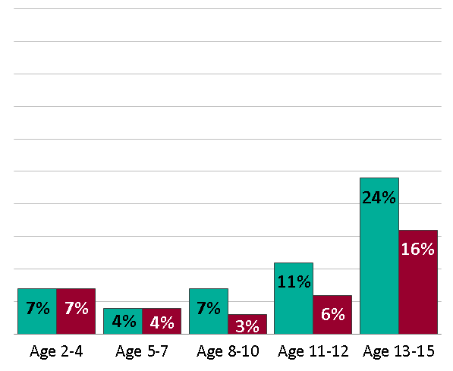
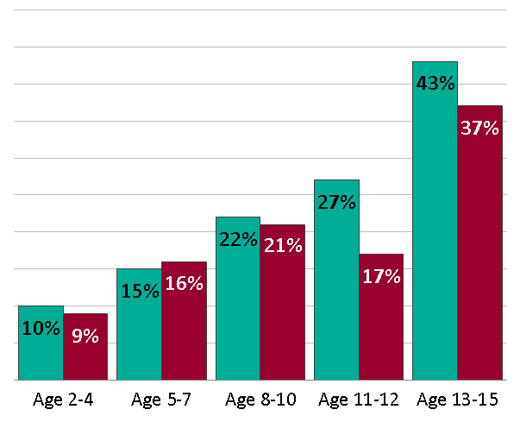
Time spent sedentary in leisure time
Children aged 2-15 years; Health Survey for England 2012
Proportion of children who spent six or more hours being sedentary per day by age group
Weekdays
Weekends
Notes:
Sedentary behaviour is defined as activity with very low energy expenditure, undertaken primarily sitting or lying down. Sedentary behaviours are undertaken in a range of settings, including school, home, travel, and in leisure time, and include screen-time (watching television, computer use, video games), motorised transport, and sitting to read, talk, do homework, or listen to music.
On weekdays, fewer than 10% of children under 10 are sedentary for six hours or more. The proportion of children aged 13-15 years is much higher at 24% for boys and 16% for girls. At weekends, there is a steady increase from the youngest age group (around 10%) to the oldest (43% of boys and 37% of girls).
Data from the Health Survey for England report, 2012, published by the Health and Social Care Information Centre www.hscic.gov.uk/catalogue/PUB13218/HSE2012-Ch3-Phys-act-child.pdf
The Chief Medical Officer’s report recommends that the amount of time spent being sedentary should be minimised.
For all age groups and both sexes, levels of sedentary time are elevated at weekends compared to weekdays.

Slide 10
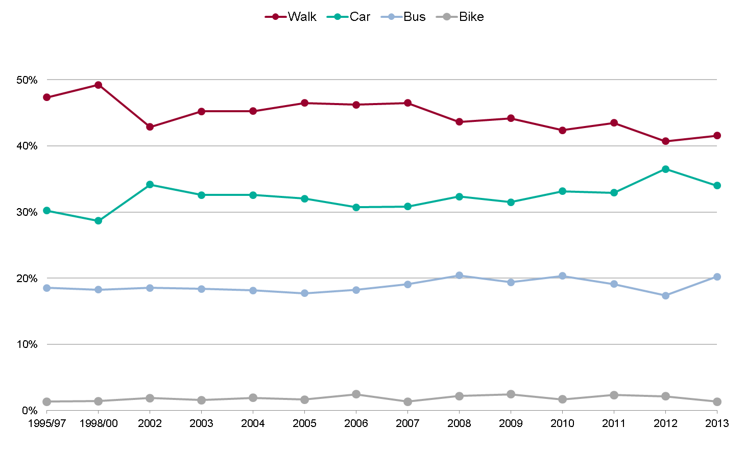
Trends in travel to school
Children aged 5-16years; National Travel Survey, Great Britain 1995/97-2013
Data includes trips of less than 50 miles only
Notes:
Most children reported walking to school in 2013. These figures have remained very similar for the last nine years, although there has perhaps been a slight drop in the number walking and a corresponding small increase in car journeys since 1995/97.
Data from the National Travel Survey, 2013 www.gov.uk/government/statistics/national-travel-survey-2013

Slide 11

Child physical activity factsheet
www.noo.org.uk
Notes:
These slide sets are supported by PHE physical activity factsheets which provide more detailed summaries of the data (www.noo.org.uk/NOO_pub/Key_data)

Slide 12
Other useful PHE physical activity resources
Everybody active, every day: an evidence-based approach to physical activity
Everybody active, every day: what works, the evidence
Obesity and the environment: increasing physical activity and active travel
Active travel briefings for local authorities
Standard evaluation framework for physical activity interventions
Guide to physical activity data sources
Guide to online tools for valuing physical activity, sport and obesity programmes
E-learning modules on physical activity and health
Change4Life campaign resources
PHE obesity website - www.noo.org.uk
Notes:
Everybody active, every day: an evidence-based approach to physical activity www.gov.uk
www.gov.uk/government/publications/everybody-active-every-day-a-framework-to-embed-physical-activity-into-daily-life
Everybody active, every day: what works, the evidence
Obesity and the environment: increasing physical activity and active travel
www.gov.uk/government/publications/obesity-and-the-environment-briefing-increasing-physical-activity-and-active-travel
Active travel briefings for local authorities
www.noo.org.uk/slide_sets/activity
Standard evaluation framework for physical activity interventions
http://www.noo.org.uk/core/frameworks/SEF_PA
Guide to physical activity data sources
http://www.noo.org.uk/data_sources/physical_activity
Guide to online tools for valuing physical activity, sport and obesity programmes
http://www.noo.org.uk/securefiles/150629_1236//online_tools_briefing_13011_%20FINAL.PDF
E-learning modules on physical activity and health
http://learning.bmj.com/learning/course-intro/physical-activity.html?courseId=10051913
Change4Life campaign resources
http://www.nhs.uk/change4life/pages/resource-casestudy.aspx
PHE Obesity website
www.noo.org.uk

Slide 13
for more information:
www.noo.org.uk
info@noo.org.uk
follow us on twitter @PHE_obesity
PHE Publications gateway number: 2015143
Patterns and trends in child physical activity

