Slide 1

Get Out Get Active
Final Report Overview
March 2020

Slide 2

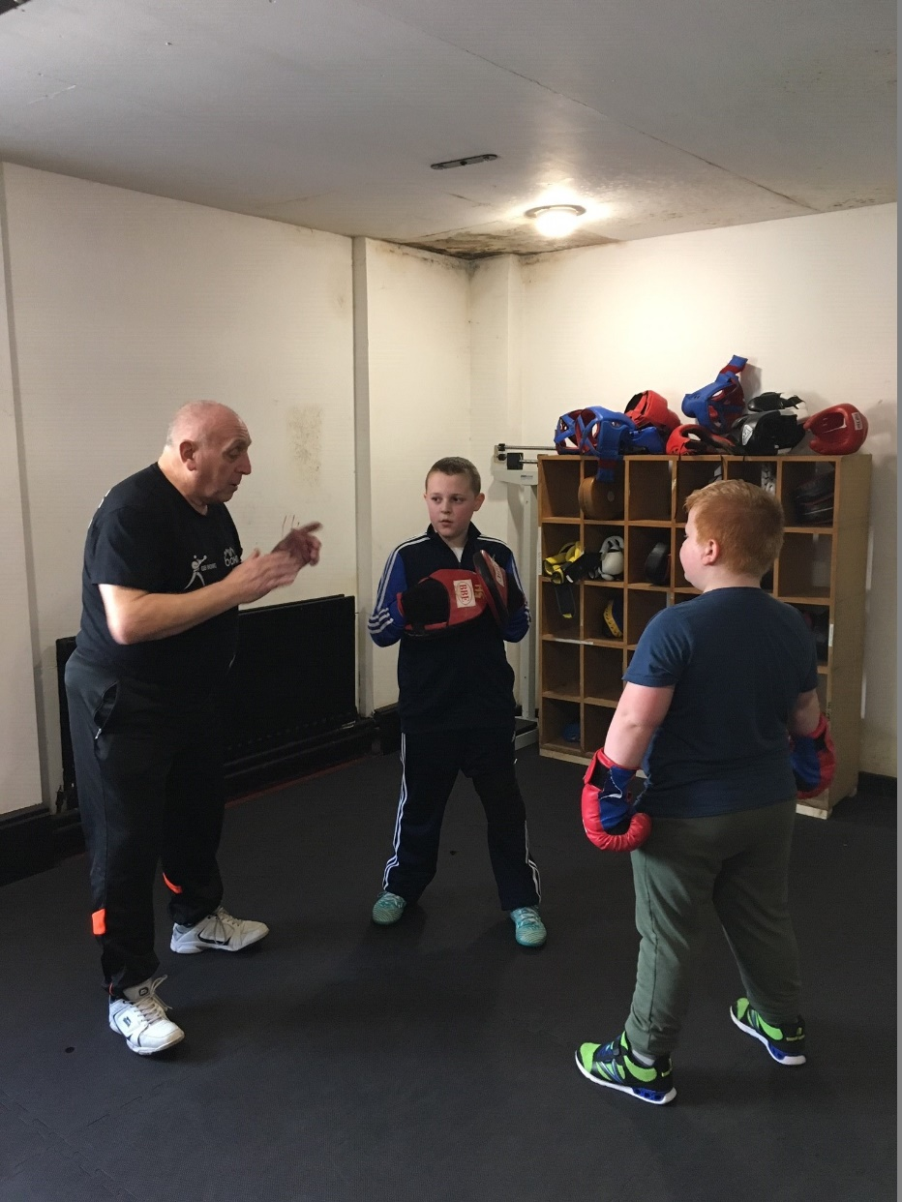
Overview
Impacting
Delivering
Sustaining
Learning

Slide 3
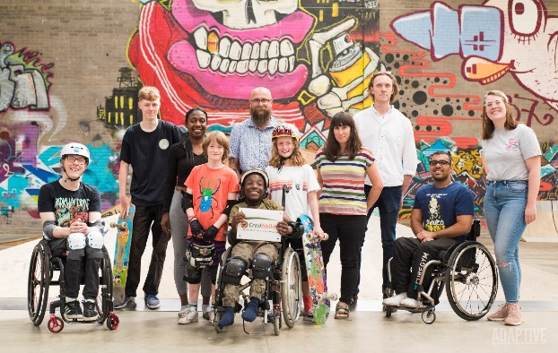
Impacting (1)
Not solely focussed on the numbers, but….
Key Performance Measure | Target | Achieved | % Achieved
Individual Participants | 16,500 | 20,000 | 121
GOGA Activities | 550 | 2,400 | 436
GOGA Events Held | 100 | 227 | 227
Attendance at GOGA events | 12,000 | 17,140 | 143
Volunteers | 2,300 | 2,779 | 121
People Trained | 4,500 | 2,000 | 44
Training Sessions | 500 | 196 | 39
% participants sustaining activity 6 + months | 40% | 65% | + 25 percentage points
Source: GOGA Monitoring Data to Q3 2019/2020 and Participant Tier 2b survey data.

Slide 4
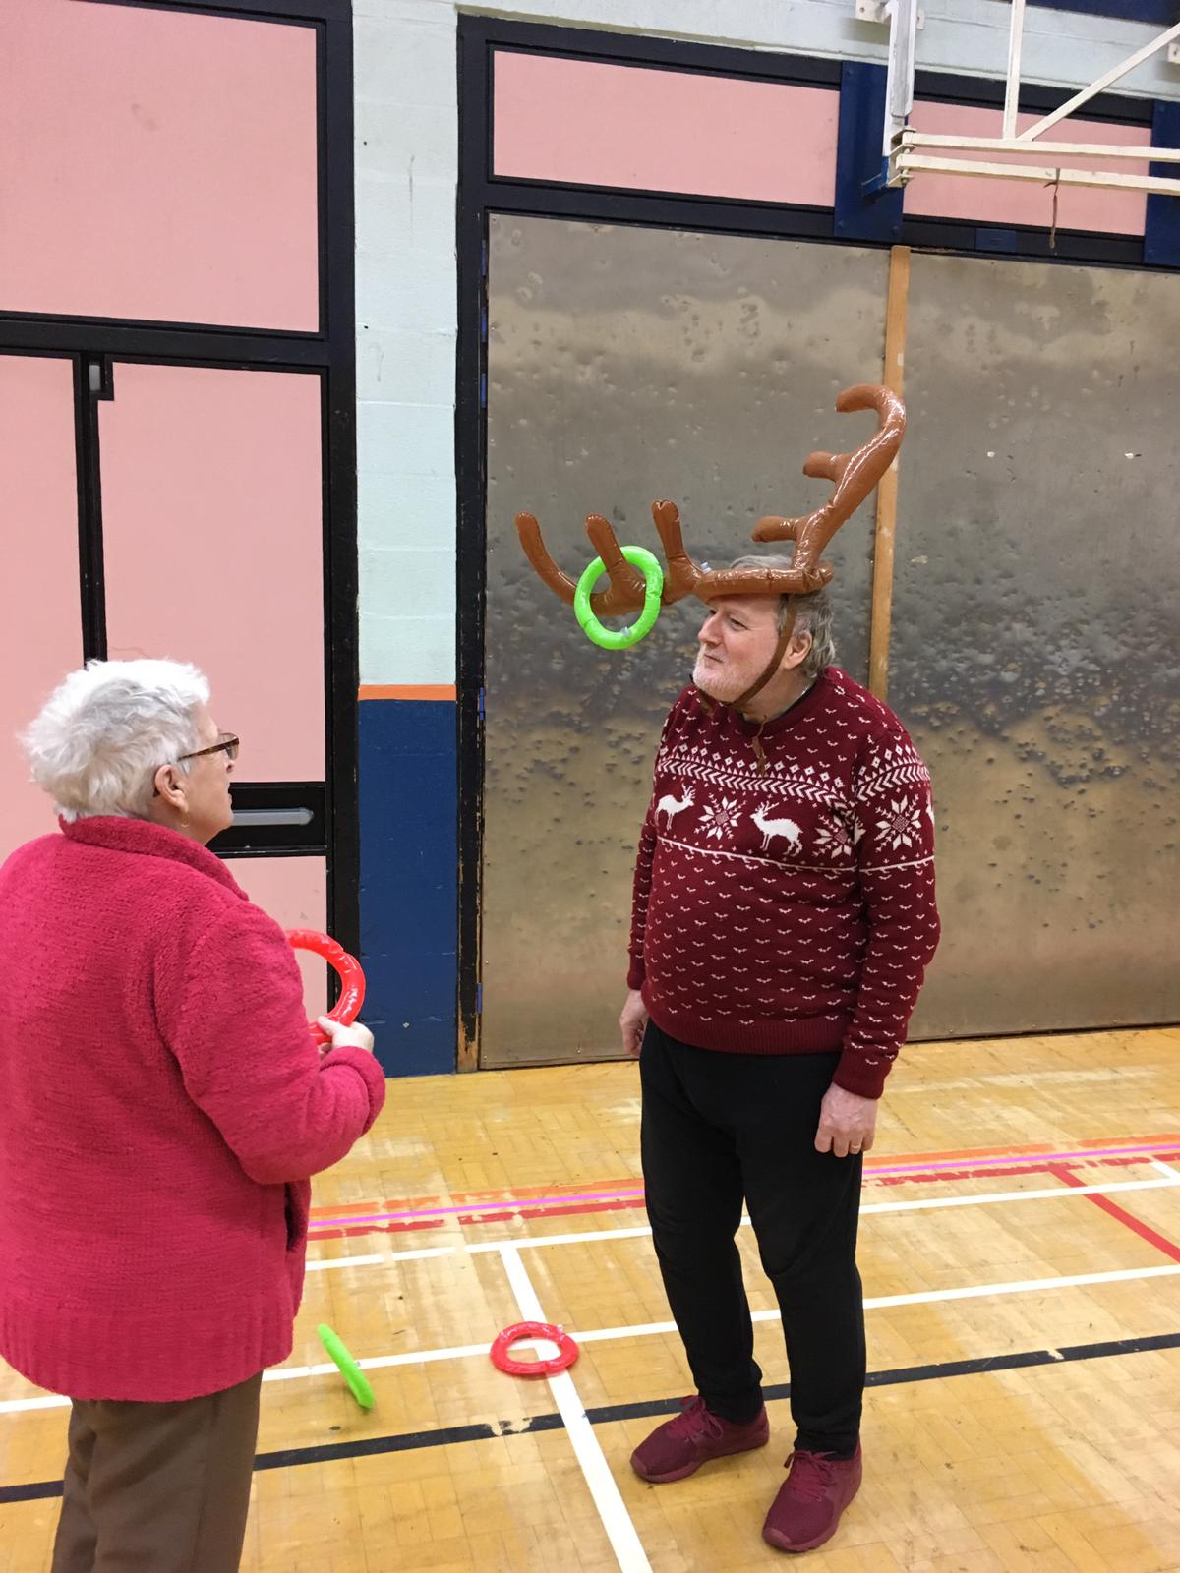
Impacting (2)
65% of all GOGA participants came from the least active (0-20mins per day) group , with 42% admitting to no physical activity prior to GOGA.
Amongst disabled people 71% came from the least active group, and 46% inactive pre-GOGA.
For the least active, 60% are doing more physical activity now than when they started GOGA.
One in five move from being inactive to active (CMO definition) – small steps are key here for this group.

Slide 5
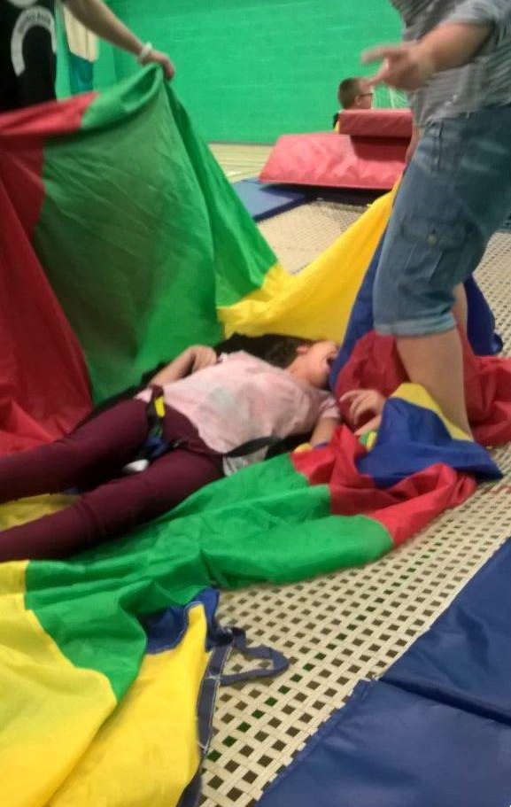


Impacting (3)
Wellbeing improvements for the least active:
  Life satisfaction, life worthwhile, and happiness
  Anxiety
More positive about engagement with their local community and feel more able to engage in activities in that community.
65% say they have a more positive view of disabled people as a result of their GOGA experience.

Slide 6
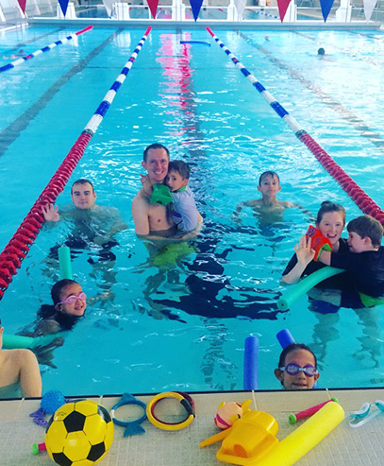
A GOGA Approach?
Components and cornerstones for the ‘right’ participant experience

Slide 7
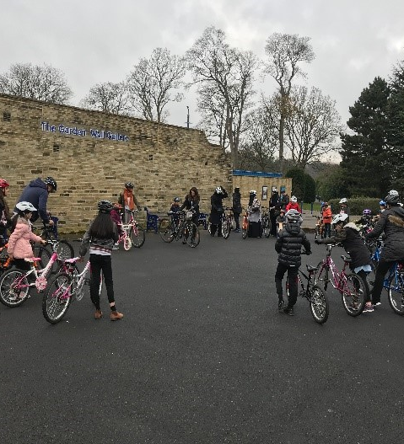
Key Ingredients of a GOGA Approach

Slide 8
Using 'active recreation' to reach the very least active disabled and non-disabled people tailored to local needs through:
Outreach focused on, facilitated by, and tailored to, targeted communities
Active support for disabled and non-disabled people to be 'active together' through genuinely inclusive delivery practice in an inclusive environment and setting
Approaches that engage participants and develop workforce skills and practice through the use of the ten talk to me principles
Explicit focus upon attaining sustainability through:
Building the foundations for participants to remain active post-GOGA
Engagement approaches shaped by participant needs
A consistent and effective marketing approach that's participant relevant
Deliberately developing inclusive local delivery systems and practice
Ensuring the transfer of learning within, and beyond, programme partners
Delivering – GOGA Approach (Components)

Slide 9
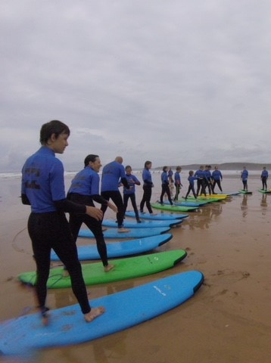
A GOGA Approach
Components and cornerstones for the ‘right’ participant experience

Slide 10
How cornerstones fit together
Commissioner support
Facilitation and development of partnership
Delivery partner approach
Delivery of core GOGA ingredients facilitating an inclusive participant experience

Slide 11
Support from a commissioner who…
Advocates a flexible commissioning approach to encourage testing and piloting of new ideas/approaches
Is driven by engagement and outcomes rather than a sole focus on numbers and head counts
Seeks to enhance existing provision only supporting the delivery of new when clear demand or need
Builds in project set up / close down periods around programme delivery and management

Slide 12
A lead partner / programme consortium aiming to reach the least active that…
Creates, develops, and supports a partner network founded on a core programme focus and a strong brand
Initiates partnership building with a community development focus to foster improved sports development using local and national partner expertise
Engages an evaluation partner at programme start, combining programme management and evaluation through co-production and single team working
Rethinks programme development to focus on understanding needs, motivations, and barriers to physical activity of the least active and work to address each in turn
Has an explicit focus on 'active together' as the key delivery philosophy and approach
Defines sustainability and works to embed it in programme delivery right from the very start

Slide 13
Delivery partner focus
1) Gets out and gets engaging with those most likely to be inactive, using extensive outreach through local community contacts
2) Extend partnerships into communities and specialist community groups using unexplored routes beyond existing physical activity networks
3) Actively consults with the least active to understand activity barriers/hurdles and co-produce an activity offer
4) Embed an 'Active Together' delivery approach
5) Actively includes time for, and facilitation of, participant socialising seeing it as important as physical activity
6) Ensure all delivery consistently offers a friendly, welcoming approach in locations/venues that participants feel are 'safe
7) Are open to testing and piloting and changes tack in response to learning
8) Actively seek help from specialist partners to improve delivery
9) Have a structured approach to the recruitment, management and use of all volunteers (informal and formal) emphasising the value of lived experience
10) Underpin delivery through workforce development with specific focus on inclusivity training for all levels of staff
11) Focus on sustaining participation and referring participants to appropriate and relevant opportunities for further activity

Slide 14
Examples of delivery partner focus
Delivery partner approach components | Selected examples
Getting out and engaging | Local community group encouraged to run disability friendly session in Bradford Engagement with local high school to engage teenage girls leaving school in Fife Specialist carer group engagement in Rochdale.
Extending partnerships | Accessing older people in day centres and sheltered housing in Lincolnshire and Wandsworth. Work with the Royal British Legion in Lincolnshire.
Actively consulting to understand barriers/hurdles | Female fitness session altering start times in Bradford. Couch to 5k sessions in alternative venues in Nottingham. Advertising activities as volunteer led to make more informal and less scary in Thanet.
Embedding ‘Active Together’ delivery | Delivery moving away from disability only session in Rochdale. Engagement of three family generations by activities in Fife. Family orientated approach in family focussed events in Forth Valley, Armagh, Bainbridge and Craigavon, and Derry and Strabane.
Actively encouraging and facilitating socialising | Tea, Talk, Try sessions in Derry and Strabane and Grampian. Emphasising social connection in Thanet, exercise is secondary.

Slide 15
Examples of delivery partner focus
Delivery partner approach components | Selected examples
Ensuring consistent friendly and welcoming delivery | Cycling in Pembrokeshire built around building new friendship groups. All ability boxing in Bradford encouraging social connection then physical activity. Free introductory activity sessions in Wigan.
Actively testing and piloting | Testing of women’s golf in Wrexham where numbers were initially low but rose a word of mouth brought new members Switch from Walking Football to multi-activity sessions in Derry and Strabane.
Seeking help from specialist partners | Support to identify need for engaging Women in Thanet and Wrexham from Women in Sport. BAME and Faith Centre engagement support from Sporting Equals in Bradford.
Structured approach to use of volunteers | Complete revamp in use of volunteers supported by Volunteering Matters in Fife. Online toolkit provided by Volunteering Matters drawn from examples across the GOGA programme. Participants becoming volunteers in Lambeth, Rochdale and Wrexham. Programme ambassadors in RCT.
Workforce development focussed on inclusivity training | Inclusivity training for new instructors and faith centres supported by Sporting Equals in Bradford. Walk leader training in Fife. Peer education work in Wigan. All levels of staff in Leisure Centres provided with inclusivity training in Thanet and Wrexham.
Focus on sustaining participation and progression | Referral to leisure centre programmes and membership card options in Wrexham. Prize giving and certificate issue in Fife and Grampian. Loyalty and reward schemes in Lincolnshire, Wigan and Wrexham.

Slide 16
Participant experience that is…
a) Focused on having FUN and encouraging participants to build on, and create new, social connections with others
Talk to Me Principles in Action: Talk to as many of my values as possible; Reassure me I’m going to fit in; Ensure my first experience is good.
d) Offered some familiar activities, some new, but actively reassures around any participation or ability worries. Scaleable options are always available!
Talk to Me Principles in Action: See me as an individuals, Talk to as many of my values as possible, Continue to fulfill my values in new ways; Reassure me I’m going to fit in.
e) Inclusivity at its centre to enable disabled people and non-disabled to be active together
Talk to Me Principles in Action: Make me feel I can do it; Reassure me I’m going to fit in; Encourage me via existing advocates.
c) Offered a friendly and welcoming approach every time they attend, and actively encourages them to return
Talk to Me Principles in Action: Talk to as many of my values as possible; Ensure my first experience is good, Reassure me I’m going to fit in.
b) Delivered in a 'safe', familiar 'local' setting not always associated with physical activity
Talk to Me Principles in Action: See me as an individual, Stay local to me; Talk to as many of my values as possible; Make it easy for me to tell you my needs.
g) Role models available to support participants to overcome their existing and emerging barriers to participation. Lived experience a desireable feature
Talk to Me Principles in Action: Talk to as many of my values as possible; Make me feel I can do it; Encourage me via existing advocates.
h) Ensured participants feel listened to, have control over activity options, and the speed at which they engage and progress
Talk to Me Principles in Action: Make it easy for me to tell you my needs; Encourage me via existing advocates.
f) Always offered the chance to participate with friends and family if desired
Talk to Me Principles in Action: Make me feel I can do it, Make it easy for me to tell you my needs.

Slide 17
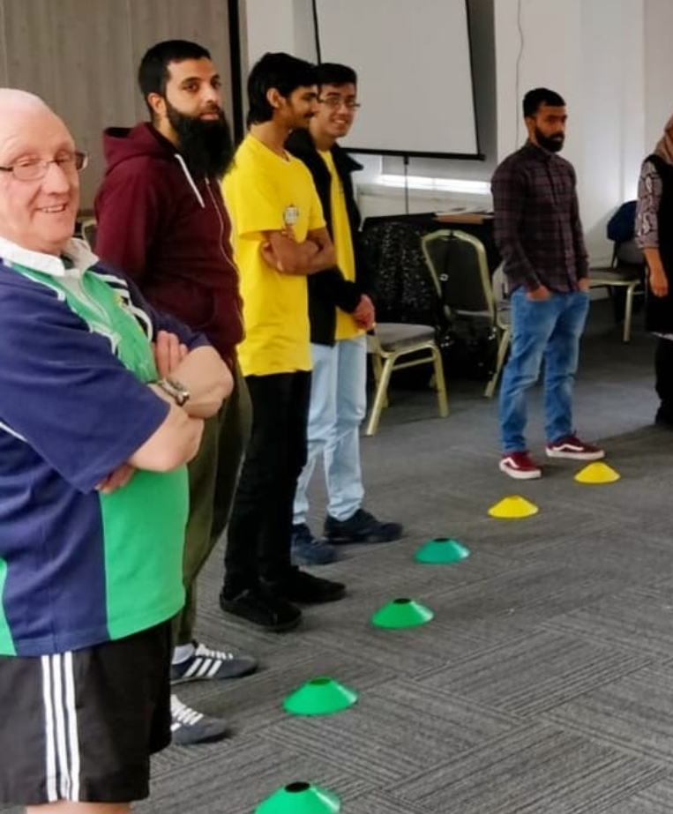
Sustainability

Slide 18





Sustaining (1) – 6 months on
Those who were active prior to GOGA were doing an extra
7 minutes of activity per day
The tracked sample as a whole were doing an extra 15 minutes of activity per day
Those who were very inactive prior to GOGA were doing an extra
18 minutes of activity per day
Those who were inactive prior to GOGA were doing an extra
33 minutes of activity per day

Slide 19
Sustaining (2) – 15 months on
Those who were active prior to GOGA were doing an extra
2 minutes of activity per day
Those who were inactive prior to GOGA were doing an extra
12 minutes of activity per day
The tracked sample as a whole were doing an extra 16 minutes of activity per day
Those who were very inactive prior to GOGA were doing an extra
24 minutes of activity per day

Slide 20
A sustaining participant journey…
Before – ‘Hurdles to participation’
Now – ‘Person-centred, welcoming and friendly’
Future – ‘Active now with new opportunities’
Physical activity is intimidating and inaccessible
Fun, social, Active Together, inviting others along too
I'm considering new activity options, I’m Active!
Same old coaching/ activity options
Staff really understand what I want and how I want to take part
New challenges within and beyond GOGA
Do I fit in? Will I be able to do what others are doing?
I'm comfortable to take part and there's support if I need it.
Volunteering is something I'm doing, or considering
I won't know, or get along with, anyone there.

Slide 21
A sustaining workforce journey…
Before – 'I know best'
Now – 'Tell me more to help shape a new offer'
Future – 'Influencing others and engaging participants'
Lacking consultation or co-production
A consultative community challenge to gather insight
Widening community delivery to include wider local focus on need
Same old options provided limited scaling
Inclusivity and Active Together key to delivery
Using volunteers to sustain delivery and change
If 'we provide it they will come' attitude
I'm a skilled coach I can work with mixed ability groups
There are others who know more about these communities
Participants know what they want and how to progress
Telling others about the importance of inclusivity

Slide 22
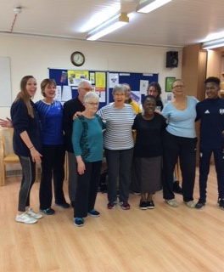
Learning for Phase 2 delivery

Slide 23
Phase 2 planning – delivery partners
For your targeted inactive groups identify the best local contacts and community groups your outreach work will need to start with. Develop an outreach strategy
Think about ways to extend partnerships into communities and specialist community groups including unexplored routes beyond existing physical activity networks
Think how you will consult with the least active groups you strive to work with and how you will collate the intelligence on the barriers/hurdles they face
Identify ways you will embed an 'Active Together' in your delivery approach and how you will co-produce this with participants
Identify ways in which your delivery will enable participant socialising and how the social element can be actively facilitated
Be clear how you will ensure all delivery consistently offers a friendly, welcoming approach in locations/venues that participants feel are 'safe
Identify how you will test and pilot delivery approaches and how you might change tack in response to learning
Identify local and national specialist partners who may be able to help you consult with the inactive and support improving delivery
Develop a structured approach to the recruitment, management and use of all volunteers (informal and formal), peer mentors, coaches and leads that emphasise the value of lived experience and empathy
Develop a GOGA workforce development strategy to enable delivery of inclusivity training for all levels of staff
Identify clear approaches to sustain participation and referral and progression routes to appropriate and relevant local activity opportunities
Above all, try not to rush into delivery. Consult, engage, and consult again to 'fine-tune' a co-produced activity offer

Slide 24
Phase 2 planning – ‘experience’ delivery
Identify how delivery will ensure fun, socialising, and group connectivity Talk to Me Principles in Action: My values; Reassure me; Welcome me.
Identify ways to develop and co-produce an activity programme that always includes scaleable options and seeks ways of refreshing provision.
Talk to Me Principles in Action: My values and Listen to Me.
Be clear how inclusivity will be central to all delivery so that disabled people and non-disabled can be active together.
Talk to Me Principles in Action: Include me, and Reassure me.
How will delivery ensure a friendly and welcoming approach every time they attend, and actively encourage them to return?
Talk to Me Principles in Action: Include me, and Welcome me.
Identify with participants 'safe', familiar 'local' settings where delivery might be hosted. Identify how participants will access the setting.
Talk to Me Principles in Action: My locality, and Listen to me.
Develop the activity programme to ensure it always offers the chance to participate with friends and family if desired.
Talk to Me Principles in Action: My values and Reassure me.
Identify how role models will be available to support participants to overcome their existing and emerging barriers to participation, particularly looking for those with lived experience.
Talk to Me Principles in Action: Show me, and Reassure me.
Develop ongoing consultation mechansims so participants feel listened to, and have control over activity options, and the speed at which they engage and progress.
Talk to Me Principles in Action: Listen to me, and My values.
How will delivery celebrate participant success, particularly for those that move from inactivity to active lives?
Talk to Me Principles in Action: Show me,and Me, not my impairment.

Slide 25

For further information please contact:
The GOGA team: goga@activityalliance.org.uk
01509 227751
Wavehill team:
wavehill@wavehill.com
01545 571711

