Slide 1
Work, Worklessness and Health: Local Infographic Tool
Harrow
Produced on 13 June 2018

Slide 2
Setting the context
Work, worklessness and health is an important public health issue at both local and national level and is highlighted in many health and wellbeing strategies, devolution plans and in the Five Year Forward View and sustainability and transformation partnerships for the NHS. With combined costs from worklessness and sickness absence amounting to over £100bn annually, greater than the annual budget of the NHS, there is a strong economic case as well as a moral and ethical case for greater action. Employment is a primary determinant of health, impacting both directly and indirectly on the individual, their families and communities. Unemployment is associated with an increased risk of mortality and morbidity, including limiting illness, cardiovascular disease, poor mental health, suicide and health-damaging behaviours. This set of infographics has been developed from the initial work and health infographics, released in 2016.(1) It includes indicators at regional and local level and is based on feedback on the need for locally relevant data to support local stakeholders to make the case and inform planning on embedding health, work and worklessness across these issues. A series of health and work evidence briefings are being prepared by Public Health England (PHE) Knowledge and Library Services to inform the production of e-learning training modules. These will be available from April 2018.
(1)
https://www.gov.uk/government/publications/health-and-work-infographics

Slide 3
Work, Worklessness and Health: Local Infographic Tool
This infographic tool has been generated from data in the Wider Determinants profile on the PHE Fingertips platform: The aim is to present data in a format that can be used to raise awareness of work, worklessness and health issues with a variety of audiences. This tool presents data for the local area, the statistical region it resides in, and the national value. We would value your views on the usefulness of this resource. Please click on this link to provide your feedback:
https://fingertips.phe.org.uk/
.
https://surveys.phe.org.uk/TakeSurvey.aspx?PageNumber=1&SurveyID=l252n655&Preview=true#
For all other information:
LKISEast@phe.gov.uk

Slide 4
Finding further information
2
Wherever you see this image = you can click on it for further information and references

Slide 5
Employment, economic inactivity and unemployment
Employment rate
England
London
Harrow
16-64 yrs (2016/17)
74.4%
73.8%
73.5%
Economic inactivity rate
21.8%
21.6%
21.4%
16-64 yrs (2016/17)
2
Unemployment rate
4.8%
5.7%
4.8%
16+ yrs (2016)

Slide 6
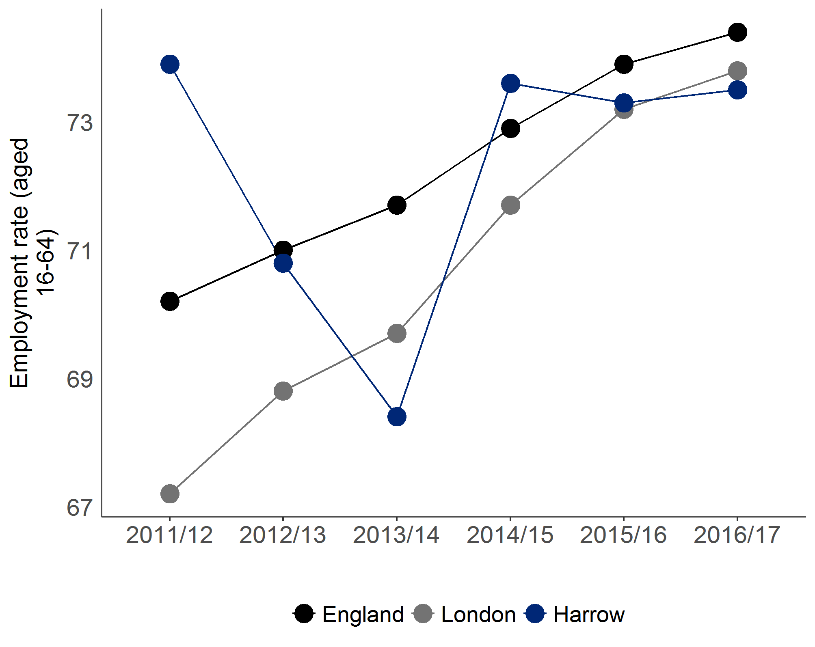
Employment rate trend
The graphs show the changes in employment rates over time. This can help us understand the trends in the employment market and the context of work/employment as one of the wider determinants of health.

Slide 7
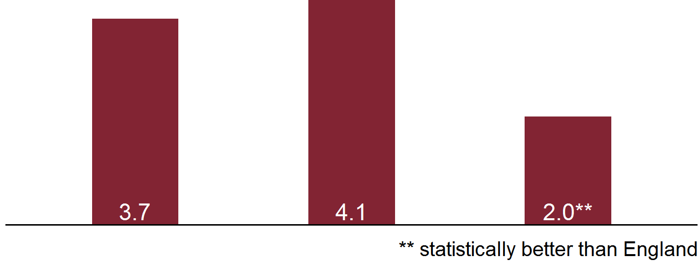
Long-term Jobseeker's Allowance claimants
Long-term Jobseeker's Allowance (JSA) claimants describes the rate per 1,000 population aged 16-64 years of people claiming JSA for more than 12 months. JSA is being phased into Universal Credit and reflects benefit to support active job seekers. Long-term unemployment is associated with poorer health and a higher risk of suicide. The long-term JSA claimants data provides an opportunity to focus on the pathways of support for people actively job seeking and whether health issues are creating additional barriers. It also creates an opportunity to reflect on the population level health and wealth perspective.
England
London
Harrow
Population (per 1,000) on long-term JSA (2016)
Number of people on long-term JSA (2016)

Slide 8
Long-term Jobseeker's Allowance claimants
Discussion and reflection points to explore the local context and response to the issue
Is there local information on how health affects those claiming JSA? What is the local offer to JSA claimants to protect and improve their own health and wellbeing while unemployed? How are local health employers creating job opportunities, especially for people with health issues?
National resources to support local action
The has been used in some areas in Jobcentre Plus with all new JSA claimants. . provides supporting information on the connection between population health and local economic wealth.
OneYou How Are You quiz
The PHE and Local Government Association (LGA) joint Health and work and health related worklessness guide

Slide 9
Learning disabilities employment gap
The gap between the employment rate for those with learning disabilities and the overall employment rate is a reflection on how well the local system is supporting some of those with the most significant employment challenges to achieve their employment potential. It may be helpful to contrast the gap with that for people with long-term conditions. There is a broad spectrum of learning disabilities and neuro-divergent identities.
England
London
Harrow
% point gap in the employment rate between those with a learning disability and the overall employment rate (2016/17)
** statistically better than England
Gap in employment rate
Gap in employment rate (eg, 65%)

Slide 10
Learning disabilities employment gap
Discussion and reflection points to explore the local context and response to the issue
How well do local learning disabilities (LD) strategic plans reflect employment issues and opportunities for action? How well established is the employment support offer for people with LD from school through adulthood transition? How are local employers being supported to offer employment opportunities for people with learning disabilities? How are local public sector employers creating job opportunities, especially for people with learning disabilities?
National resources to support local action
There is support via and for employers. Project Search, Remploy and Ambition for Autism all provide specific support for employers around placements and job opportunities for people with learning disabilities, and there may be local third sector organisations providing specific support in the area as well.
Access2Work
Disability Confident

Slide 11
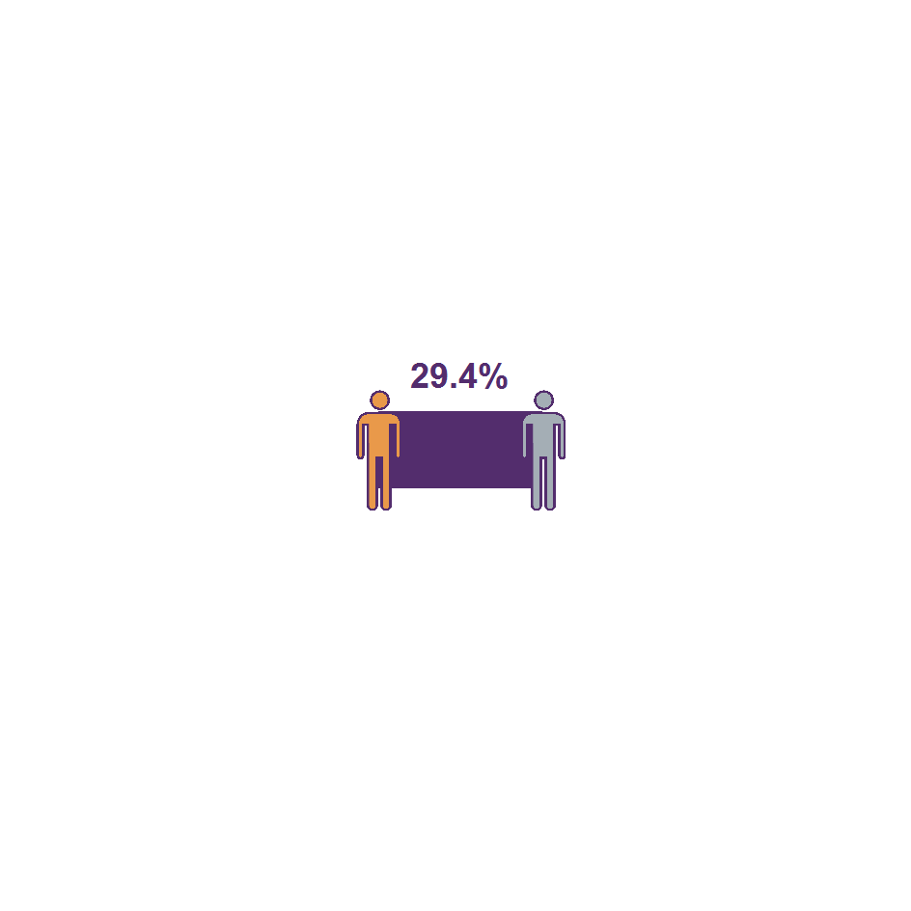
Long-term conditions employment gap
The gap between the employment rate for those with a long-term condition and the overall employment rate is a good reflection on how well the local system is enabling people with long-term conditions to achieve their employment potential. Enabling people with long-term conditions to access work that supports their needs is fundamental to supporting people to have independence and autonomy in their lives. Focusing on the employment gap for people with long-term conditions provides an opportunity to reflect on how well the health system is working with local partners, including employers, to support employment.
England
London
Harrow
Percentage point gap in the employment rate between those with a long-term health condition and the overall employment rate (2016/17)
** statistically better than England
2x
60%
2
2
A national survey of adult health in Great Britain found that unemployed people were more than twice as likely as employed people to report having a limiting long-term condition (2013)
Nationally, having a long-term condition is associated with unemployment and worklessness. People with a long-term condition have an employment rate of only 60% (2014)

Slide 12
Long-term conditions employment gap
Discussion and reflection points to explore the local context and response to the issue
How does the health and wellbeing board, joint strategic needs assessment and local strategy reflect the health related employment gap? How do local healthcare professionals talk about work in the context of holistic patient care? How are local employers being supported to offer employment opportunities for people with long-term conditions? How are local health employers creating job opportunities, especially for people with health issues?
National resources to support local action
PHE is working in partnership to develop a national programme for clinical staff to better support work as part of holistic patient care. This includes free e-learning on health and face to face peer education through the Royal College of Occupational Therapists Clinical Champion programme. There is support via and schemes for employers.
Access2Work
Disability Confident

Slide 13
Mental health conditions employment gap
The gap between the employment rate for people supported by secondary mental health services and the overall employment rate is a good reflection on how well the local mental health system is enabling people with mental health conditions to achieve their employment potential. There is a wide spectrum of mental health conditions including anxiety, depression and bipolar disorder.
England
London
Harrow
Gap in employment rate for those in contact with secondary mental health services and the overall employment rate (18-69 yrs, 2016/17)
* not statistically different from England
Percentage of total Employment Support Allowance claimants with primary condition of mental and behavioural disorders (2017)
A national survey in England found that almost 1 in 6 people of a working age have a diagnosable mental health condition
2

Slide 14
Mental health conditions employment gap
Discussion and reflection points to explore the local context and response to the issue
How well do local mental health strategic plans reflect employment issues and opportunities for action? How well established is the evidence based individual placement support (IPS) programme locally? How are local employers being supported to offer employment opportunities for people with mental health conditions? How are local health employers creating job opportunities, especially for people with mental health issues?
National resources to support local action
There is support via and for employers and PHE produced a for employers on mental health issues with Business in the Community (BITC). The has information about how to support implementation of individual placement support (IPS).
Access2Work
Disability Confident
specific toolkit
Centre for Mental Health

Slide 15
Musculoskeletal (MSK) conditions
Musculoskeletal conditions remain one of the most significant barriers to employment and highest causes of sickness absence. Although there is a broad spectrum of musculoskeletal issues that affect work, back pain remains one of the most common causes of sickness absence. Focusing on the burden on the welfare system created by MSK provides an opportunity to reflect on how well the health and welfare system are working with employers to prevent MSK conditions and intervene early to provide support.
England
London
Harrow
Total number of Employment Support Allowance claimants where MSK conditions are primary health cause identified (2017)
Percentage of Employment Support Allowance claimants where MSK conditions are primary health cause identified (2017)
Nationally, in Great Britain
507,000
workers suffering from work-related musculoskeletal disorders (new or long-standing) in 2016/17
8.9 million
working days lost due to work-related musculoskeletal disorders in 2016/17
A study of adults in Great Britain found that 1 in 10 of the working age population reported having an MSK condition
2
2

Slide 16
Musculoskeletal (MSK) conditions
Discussion and reflection points to explore the local context and response to the issue
How well do local MSK pathways and strategic plans reflect employment issues and opportunities for supporting patients to remain economically active through vocational rehab? How well established is the narrative around early identification, self-care and management of MSK, especially back pain? How are local employers being supported to offer employment opportunities for people with MSK conditions? How are local health employers demonstrating how to reduce the burden of MSK in the workplace?
National resources to support local action
There is support via and schemes for employers and PHE produced a for employers on MSK issues with BITC. The has extensive resources and materials to support action on back pain in the workplace.
Access2Work
Disability Confident
specific toolkit
Health and Safety Executive

Slide 17
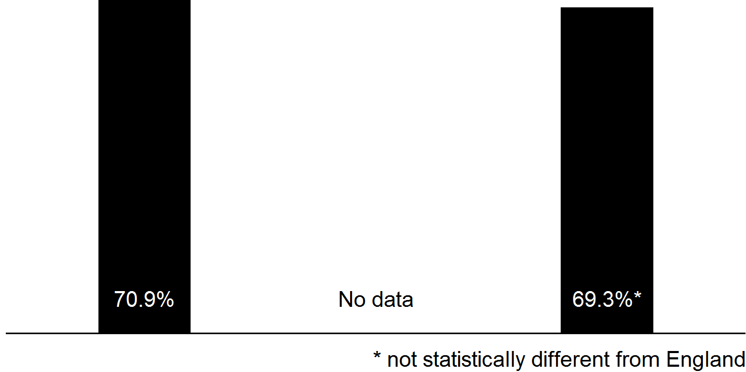
Employment issues and over 50 year olds
Focusing on employment in the population aged over 50 years can be an important opportunity to consider preparation for retirement and opportunities to maximise individuals potential to have a healthy old age. As life expectancy in England has increased, so has the proportion of life spent with chronic disease and disability and much of this develops in later middle age, where this can create significant challenges to employment potential. Focusing on the employment issues for older adults can be a useful opportunity to consider how to support the ageing population to remain independent for longer.
England
London
Harrow
Employment rate in 50-64yr olds (2016/17)
In England, 3.1% of people 50yrs and over are unemployed (2016)
9.0%
2
Employment Support Allowance in England among 50-64yr olds
2

Slide 18
Employment issues and over 50 year olds
Discussion and reflection points to explore the local context and response to the issue
How are local partners working together to address ageing populations issues? How are local chronic disease pathways supporting individuals to remain in work? How are local employers being supported to offer employment opportunities for people with long-term conditions? How are local public sector employers supporting older workers to remain in the workplace and prepare for retirement?
National resources to support local action
There is support via and schemes for employers to support people with long-term conditions. The Health & Safety Executive have produced for older workers. by Government Office for Science may also be a useful report to consider the local infrastructure.
Access2Work
Disability Confidence
specific health and safety guidance
The Future of ageing: workplace infrastructure report

Slide 19
Local spotlight on young people
Local authorities have specific responsibilities in relation to young people who are not in employment, education or training (NEET). Similarly the NHS has a duty of care to young people with health conditions and disabilities. Considering the specific needs of young people entering the workforce for the first time can help explore how young people with health conditions are being supported to achieve their employment potential. The young people focused data provides an opportunity to understand how the local system including employers and education are working together to support young people and especially how young people with health conditions are supported to enter and remain in work.
England
London
Harrow
NEET rate in 16-17yr olds (2016)
NEET rate in 19-24yr olds (2017)
NEET definition
Not in education, employment or training

Slide 20
Local spotlight on young people
Discussion and reflection points to explore the local context and response to the issue
How are NEET young people with health issues being supported to enter the workplace locally? How do local apprenticeship opportunities support young people with health conditions to enter work? How are young people entering the welfare system being identified and supported to move into work? How has the local troubled families approach addressed young people's access to work issues? How is the public sector locally working to become an exemplar employers of young people with health issues?
National resources to support local action
PHE's report on provides useful context and opportunities for action at local level to close the gap. There are a range of national programmes to support employment opportunities for young people, these include , and the
health inequalities affecting NEET
Apprenticeships
Supported Internships
Youth Obligation in Full Service Universal Credit areas
and the Voluntary Community
Service and programmes
Get Into
vInspired

Slide 21
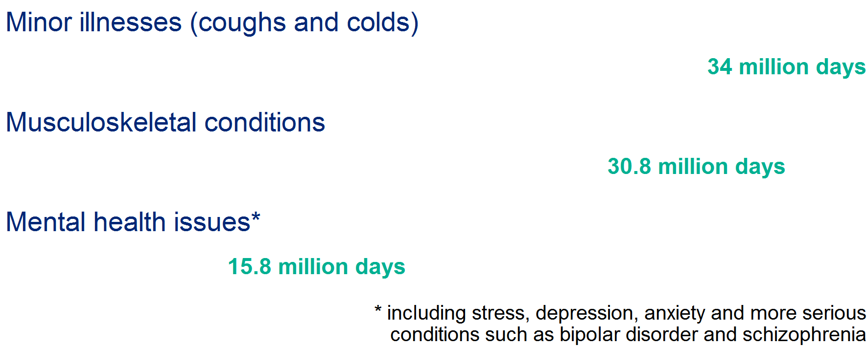
Local spotlight on sickness absence
Sickness absence provides a high level indicator of the way local businesses are supporting staff health and wellbeing. It reflects both employers efforts to support staff to remain well in work when affected by chronic health issues, as well as supporting their general health and wellbeing and how quickly staff are supported to return to work after a period of ill health. The sickness absence data provides an opportunity to focus on how employers are supporting health and wellbeing issues in the workplace and how the local public health system is supporting action across every size and sector of industry and business in the local area.
England
London
Harrow
% employees with at least 1 day off in previous week (2014-16)
% working days lost to sickness absence (2014-16)
Main causes of lost working days in England 2016
2

Slide 22
Local spotlight on sickness absence
Discussion and reflection points to explore the local context and response to the issue
How does the health and wellbeing board and public health team engage with local employers on adult health issues? How easy is it for local employers to understand the local public health offer? How are local employers engaged with public health campaigns? How is the public sector locally working to become an exemplar?
National resources to support local action
National standards on local workplace accreditation schemes. PHE and Business in the Community employer toolkits on mental health, musculoskeletal disease and suicide prevention and postvention. Health and Safety Executive workplace stress management standards.

Slide 23
About Public Health England
Public Health England exists to protect and improve the nation's health and wellbeing, and reduce health inequalities. We do this through world-leading science, knowledge and intelligence, advocacy, partnerships and the delivery of specialist public health services. We are an executive agency of the Department of Health and Social Care, and a distinct delivery organisation with operational autonomy. We provide government, local government, the NHS, Parliament, industry and the public with evidence-based professional, scientific and delivery expertise and support.
Public Health England Wellington House 133-155 Waterloo Road London SE1 8UG Tel: 020 7654 8000
www.gov.uk/phe
Twitter:
@PHE_uk
Facebook:
www.facebook.com/PublicHealthEngland
© Crown copyright 2018 You may re-use this information (excluding logos) free of charge in any format or medium, under the terms of the Open Government Licence v3.0. To view this licence, visit https://www.nationalarchives.gov.uk/doc/open-government-licence/version/3/ or email psi@nationalarchives.gsi.gov.uk. Where we have identified any third party copyright information you will need to obtain permission from the copyright holders concerned.
Published 13 June 2018 PHE publications gateway number: 2018081

